Slide 1
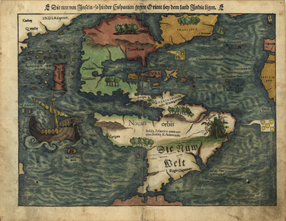
Colonial Rule in the Americas

Slide 2
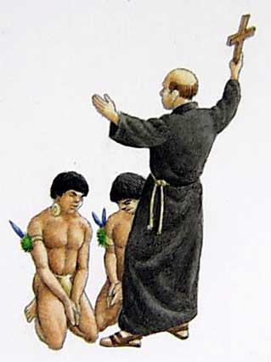
Catholicism in America
For Spain & Portugal ___________________________
____________________________________ was just as important as acquiring wealth and land.
The ________________________________________ ________________ and as the country’s power grew in the Americas, so did the Church’s.
__________________________________ _______________who helped the rulers govern the settlers and natives.
___________________ were built all over the Americas and _________________ ____________________________; but many of those were forced.

Slide 3
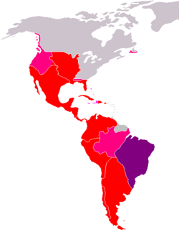
European Colonial System
In the ______________________ in the Americas, the nations of ____________________________ most of their new lands.
The local/_________ ____________ they put in place ________________ ___________________
Example ~ Spanish king creates ____________________ to pass laws to for the colonies. And appoints a
__________– a ______________ who ruled in his name. One viceroy presided over each of the five provinces.

Slide 4
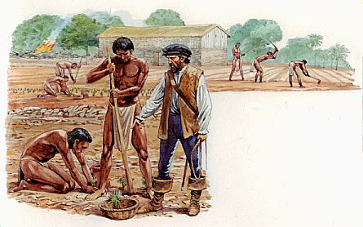
Laborers of Spanish America
Early Spanish colonists were first granted ____________ ____________to organize ________________________.
This ________________system began a massive wave of __________________________________.
The colonists also set up _____________; Spanish owned plantations that used native slave labor.
The encomiendas and haciendas combined to deliver _____ ______________________________________________ to those who refused to work, and b/c of that the
_____________________ population _______________.

Slide 5
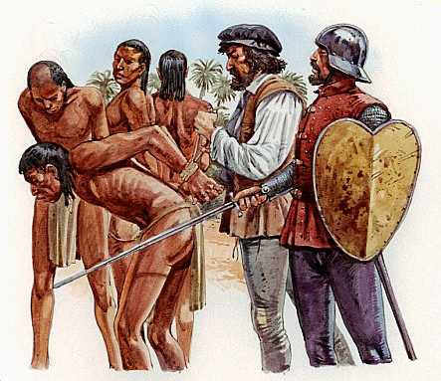
Las Casas
____________________, a mission priest, stood up for the natives and pleaded to the king of Spain to _______________.
The king did pass the ________________ _______________________________ ___________________, but was too far away to enforce them. Millions of Native Americans died.*
In the 1530’s in order to fill the labor shortages due to the decline of native population the Spanish and Portuguese colonies began ____________________ __________________________
______________________________
_______________________were shipped to America.

Slide 6
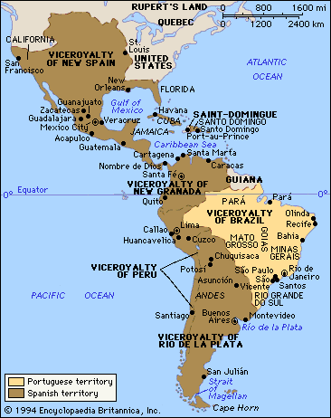
Big Idea:
______________ ______________ ______________ ______________ _________________________ _________________________.

Slide 7
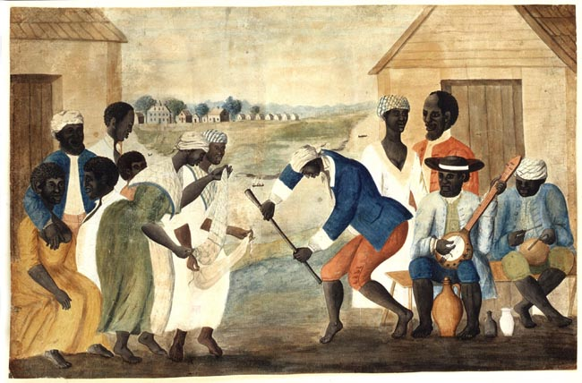
Cultural Contributions
__________________– Indian artistic styles, building styles, canoes, and cuisine (foods).
________________________– Brought Christianity, animals (mainly cows and horses), and technological advances (military, goods production, etc.)
____________– Farming methods, cooking styles, and crops (okra, palm oil, etc.)
African song and dance blended to enhance Christian ceremonies. Africans developed new religions that mixed African and Christian beliefs (Cuba, Haiti, etc.)

Slide 8
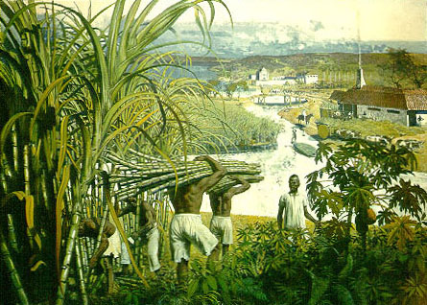
Economy in the New World
European nations at this time adopt the economic idea of ______________. (an economic practice based on the theory that ___________________________________ ________________
Spain created laws so that their ____________________ ____________________________________(not other countries or even other colonies).
The main element of the colonial economies were _____ ________________; aka - ____________(mines in the Andes Mtns. of Peru) and _________(Central Mexico)
_____________became a huge resource in the West Indies. Sugar cane was made into _______________________.

Slide 9
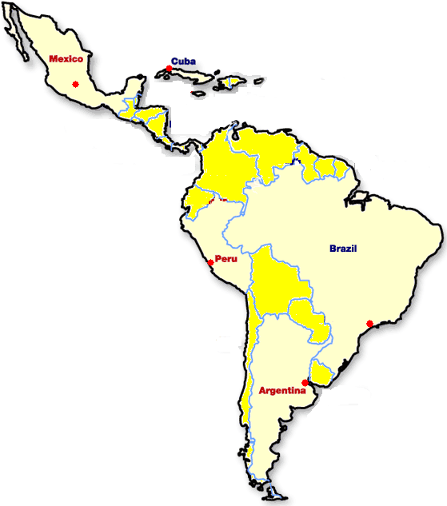
Colonial Trade Cities
Spain and Portugal established major outposts for colonial importing and exporting (mercantilism) in the following cities:
___________(Cuba)
________________
________(Peru)
____________(Brazil)
________________ (Argentina)

