Slide 1
SOL Daily Quiz
#1. Da Gama was the first European to sail where?
#2. Martin Luther believed salvation could be reached through ___ alone.
#3. What Florentine banking family was a big patron of the arts during the Renaissance?
#4. The word Renaissance means “___.”
#5. What Reformation leader introduced the idea of predestination?
Bonus Q – What is humanism?

Slide 2
Colonial Rule in the Americas
WH II #11

Slide 3
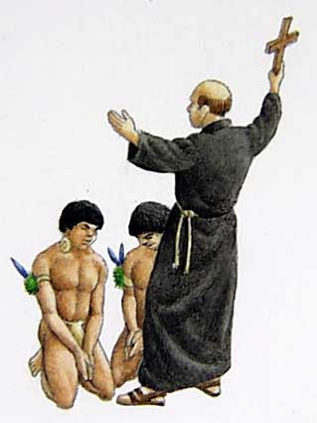
Catholicism in America
For Spain & Portugal spreading Christianity
(Catholicism) throughout Latin America was just as important as acquiring wealth and land.
The Catholic Church had a huge influence in American colonies and as the country’s power grew in the Americas, so did the Church’s.
Church leaders were often the royal officials who helped the rulers govern the settlers and natives.
Mission Churches were built all over the Americas and Catholic priests converted thousands of natives; but many of those were forced.

Slide 4
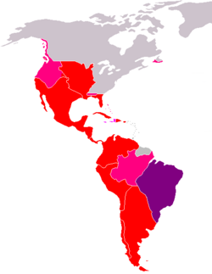
European Colonial System
In the post-conquest period in the Americas, the nations of Portugal and Spain colonized most of their new lands.
The local/colonial governments they put in place mimicked their home governments.
Example ~ Spanish king creates Council of the Indies to pass laws to for the colonies. And appoints a
Viceroy – a colonial officer who ruled in his name. One viceroy presided over each of the five provinces.

Slide 5
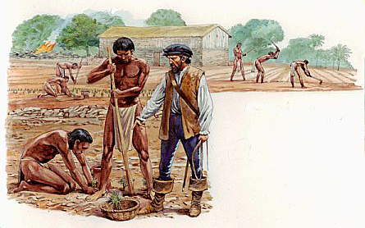
Laborers of Spanish America
Early Spanish colonists were first granted royal permission to organize forced and unpaid labor.
This Encomienda system began a massive wave of slavery and brutality in Spanish America.
The colonists also set up Haciendas; Spanish owned plantations that used native slave labor.
The encomiendas and haciendas combined to deliver brutal working conditions, starvation, disease, and execution to those who refused to work, and b/c of that the
Native American population was decimated.

Slide 6
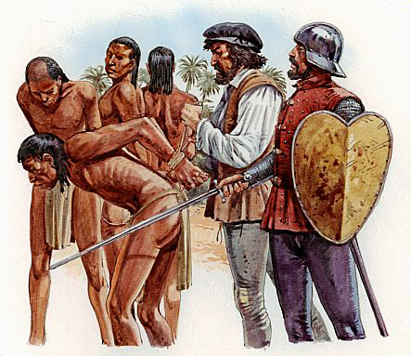
Las Casas
Bartolome de las Casas, a mission priest, stood up for the natives and pleaded to the king of Spain to stop encomiendas.
The king did pass the ‘New Laws of the Indies’ to stop the enslavement of Native Americans, but was too far away to enforce them. Millions of Native Americans died.*
In the 1530’s in order to fill the labor shortages due to the decline of native population the Spanish and Portuguese colonies began importing slave laborers to the Americas from…
Africa’s “Gold Coast” (West Africa).
Millions of African slaves were shipped to America.

Slide 7
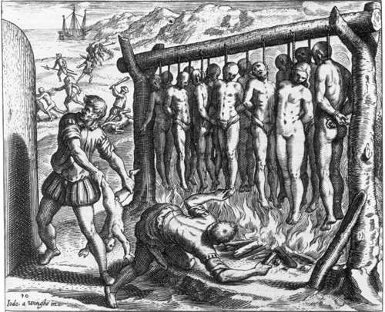
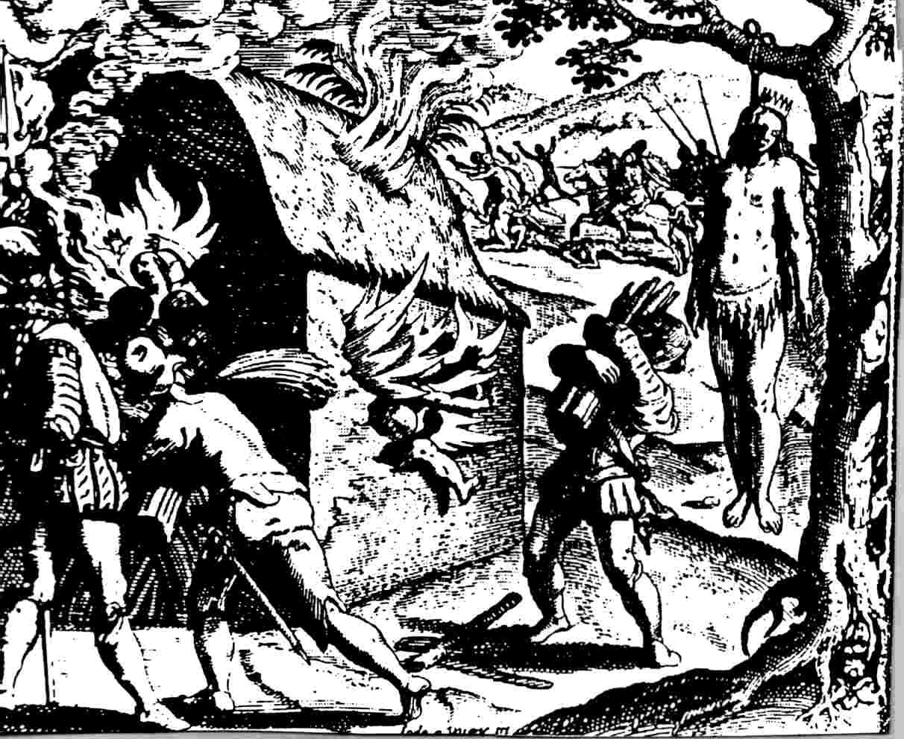
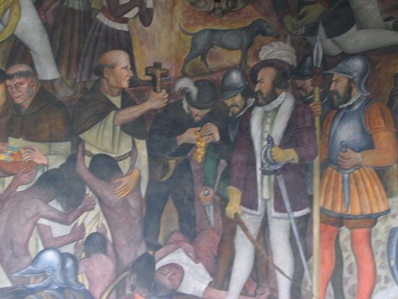
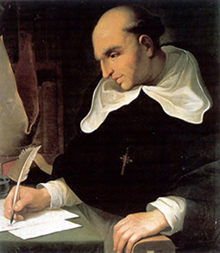
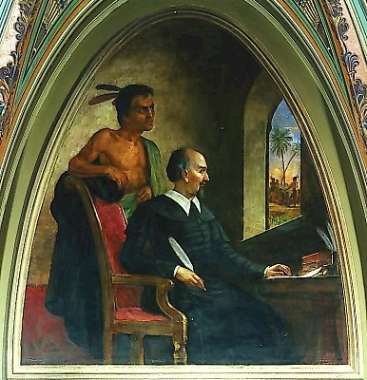
B. De Las Casas
*

Slide 8
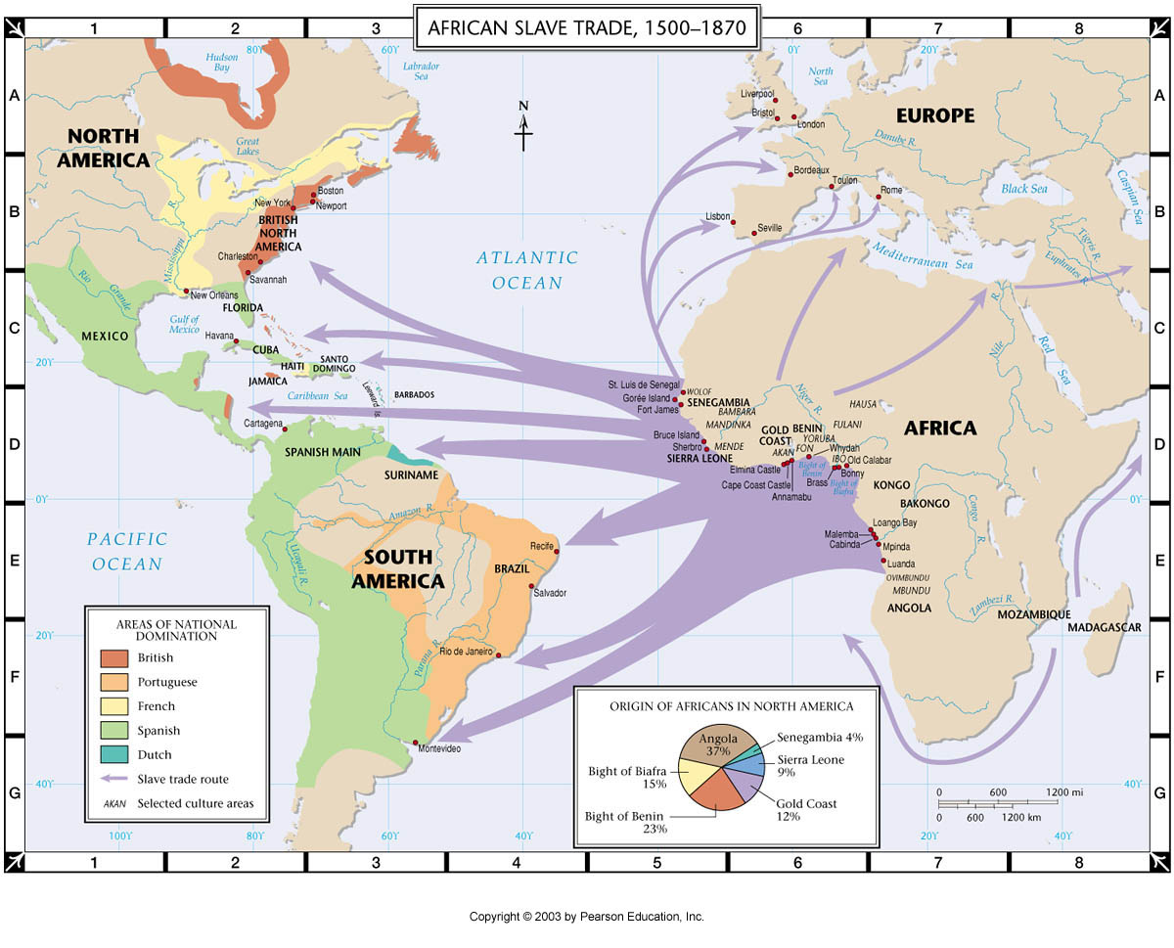

Slide 9
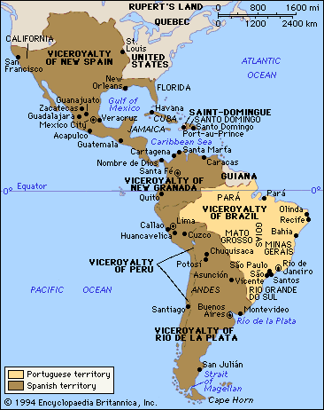
Big Idea:
The blending of European, African, and Native American people and traditions resulted in a new, unique American culture.

Slide 10
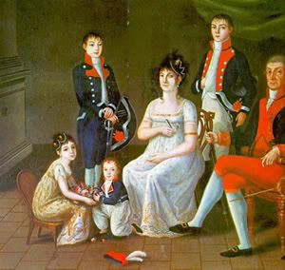
Colonial Status
Several different levels of social order existed in New Spain and the other four Spanish provinces:
1st ~ Peninsulares – anyone born in Spain.
(name comes from Iberian Peninsula)
They held the high ranking positions in the Church and in the colonial governments.
2nd ~ Creole (Criollo) – a descendant of a Spanish settlers, born in the Americas.
Owners of the mines and plantations.

Slide 11
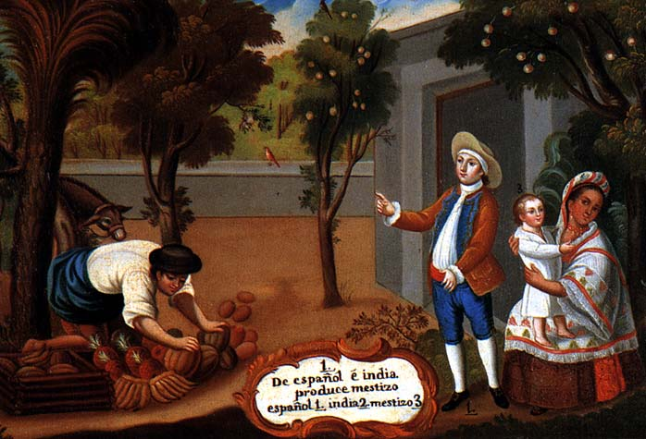
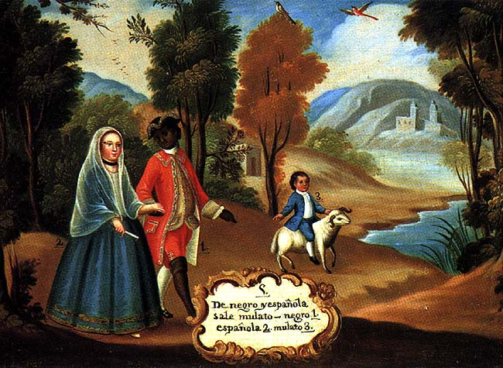
Spanish Colonial Status
3rd ~ Mestizo – someone of Native American and European descent.
4th ~ Mulatto – someone of African and European descent.
These groups were the “blue- collar” merchants, and craftsman.
5th ~ Native Americans and imported Africans.
These two groups were the lowest social class and almost entirely made up the force of slaves, servants, and manual laborers.

Slide 12
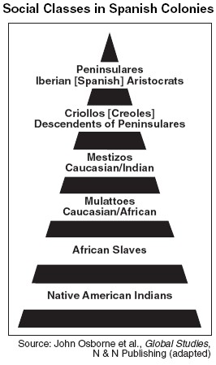

Slide 13
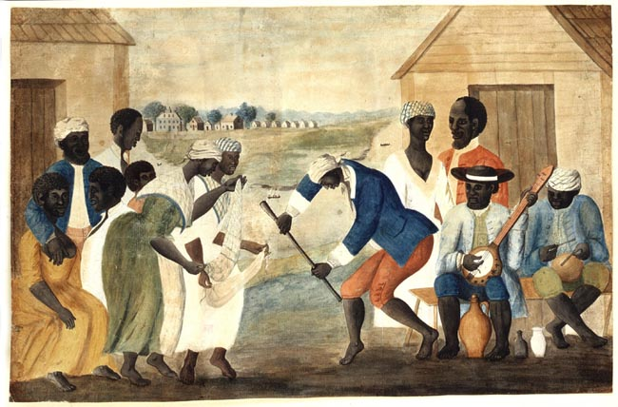
Cultural Contributions
Native American – Indian artistic styles, building styles, canoes, and cuisine (foods).
Colonizers (Europeans) – Brought Christianity, animals (mainly cows and horses), and technological advances (military, goods production, etc.)
Africans – Farming methods, cooking styles, and crops (okra, palm oil, etc.)
African song and dance blended to enhance Christian ceremonies. Africans developed new religions that mixed African and Christian beliefs (Cuba, Haiti, etc.)

Slide 14
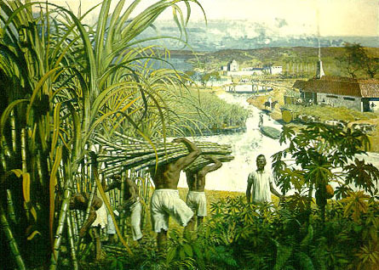
Economy in the New World
European nations at this time adopt the economic idea of Mercantilism. (an economic practice based on the theory that colonies existed for the benefit of the mother country).
Spain created laws so that their colonies could only import and export goods with Spain (not other countries or even other colonies).
The main element of the colonial economies were export of precious metals; aka - SILVER (mines in the Andes Mtns. of Peru) and GOLD (Central Mexico)
Sugar cane became a huge resource in the West Indies. Sugar cane was made into sugar, molasses, and rum.

Slide 15
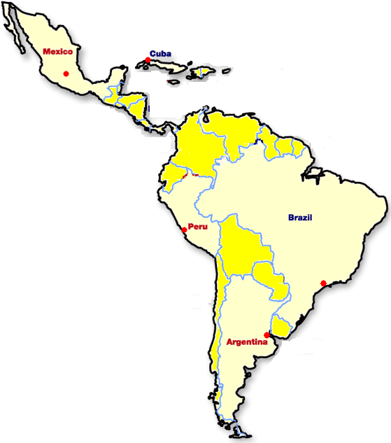
Colonial Trade Cities
Spain and Portugal established major outposts for colonial importing and exporting (mercantilism) in the following cities:
Havana (Cuba)
Mexico City
Lima (Peru)
Sao Paulo (Brazil)
Buenos Aires (Argentina)

