Slide 1
The Mughals, Qing Dynasty, and Tokugawa Japan

Slide 2
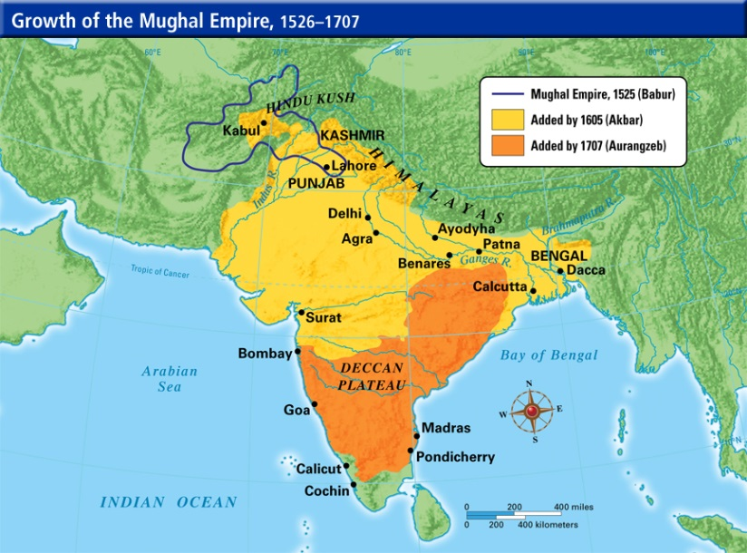
Mughal Empire
The Mughal Empire originated in northern India, eventually spreading to cover most of present day India
The Mughals spread Islam throughout India
Made contact with European explorers and traded with them
Indian textiles (cloth) were
greatly desired by the British
Southern India traded in silk,
spices, and gems

Slide 3
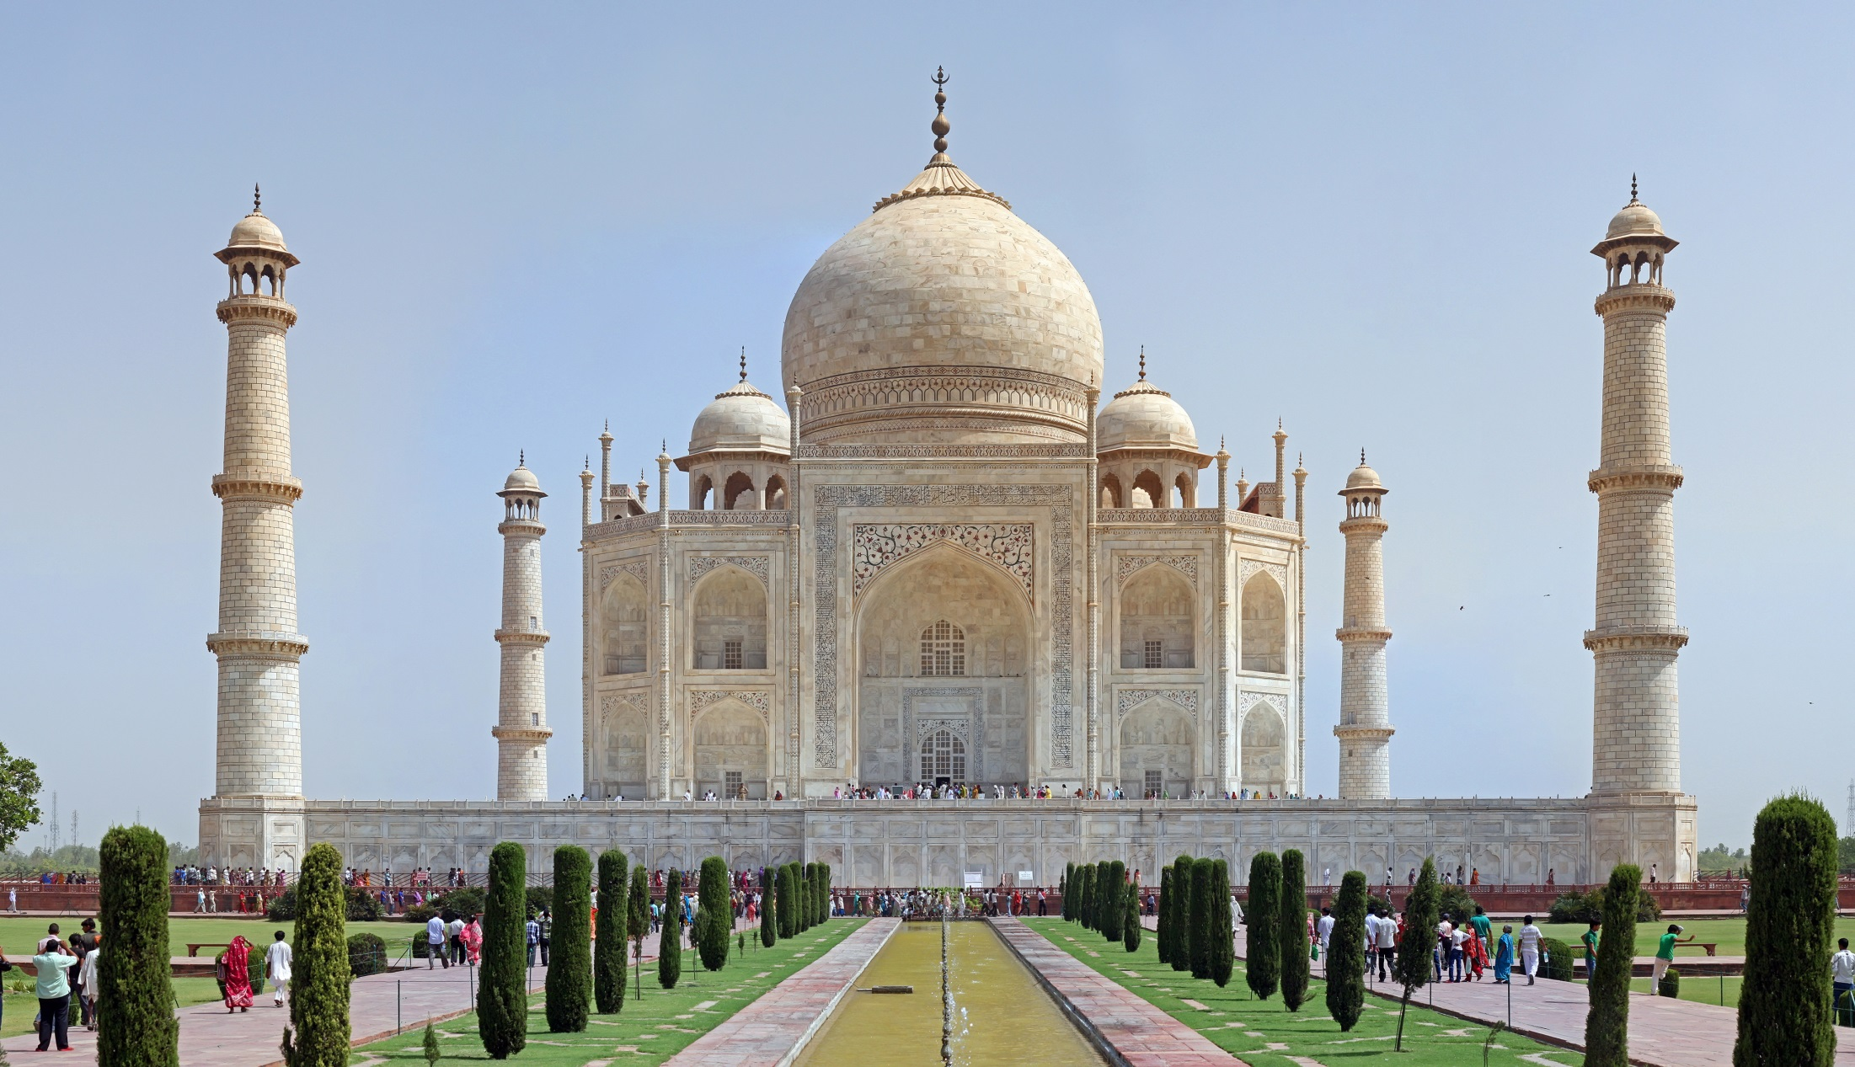
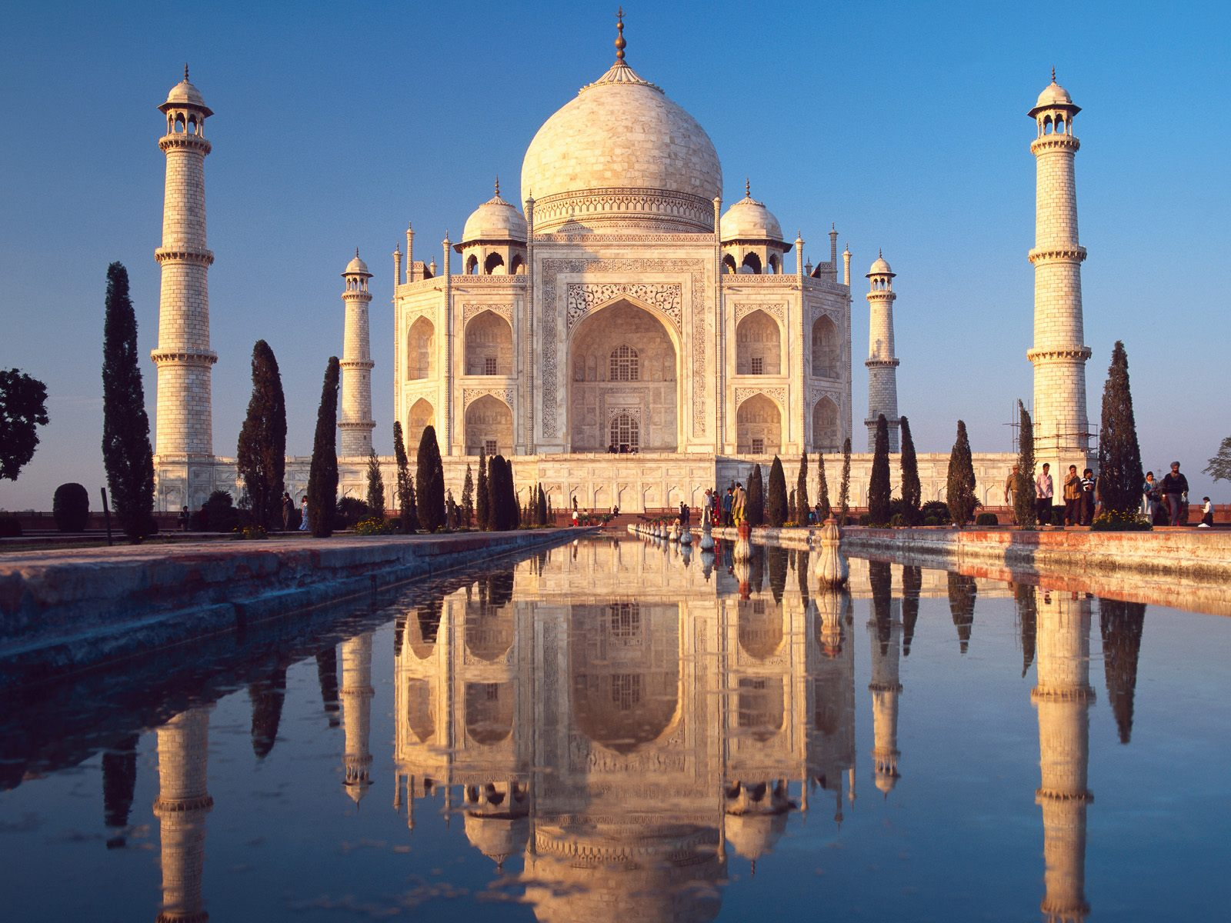
Mughal Empire
Mughals were fascinated with architecture and built the Taj Mahal – a tomb built by a Mughal shah for his wife

Slide 4
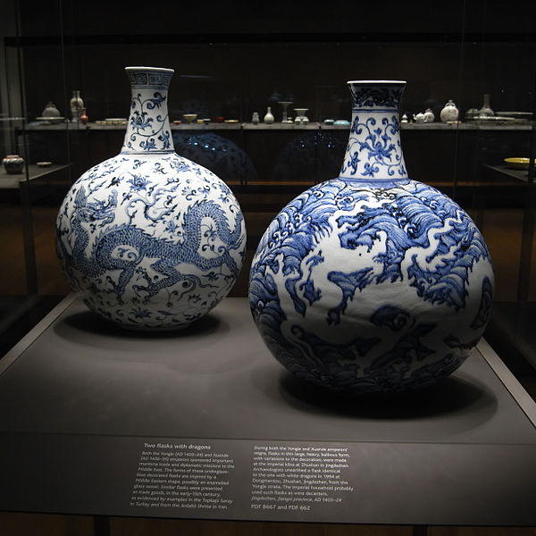
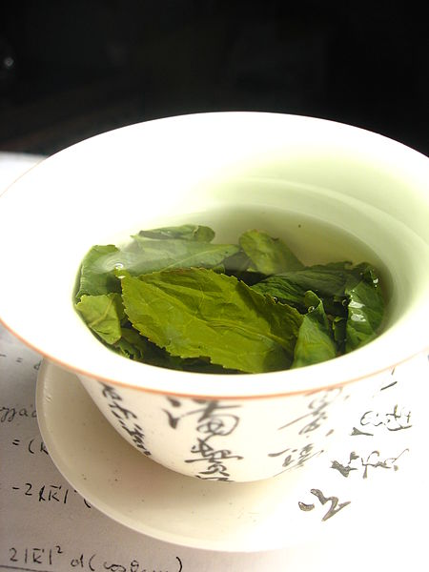
China
During the 1700s, China (Qing Dynasty) began opening up to trade with Europeans
China wanted to control the trade, though, so they established foreign enclaves (an area of a country surrounded by another country) to keep an eye on Europeans
Chinese tea and porcelain became very popular in Europe

Slide 5
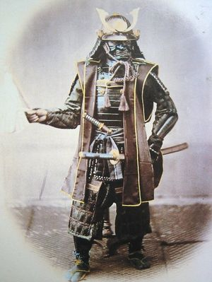
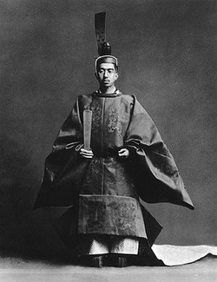
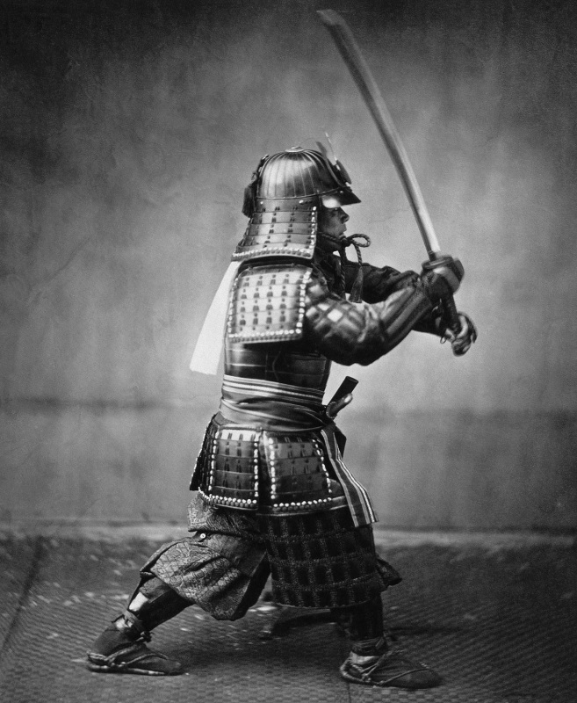
Japan
The Japanese empire was characterized by a powerless emperor and was controlled by a military leader called a shogun
Japan adopted the policy of isolationism in order to keep Europeans out

Slide 6
Europe
Many European nations were in constant competition over colonies, resources, and trade with foreign empires
This led to the Commercial Revolution – new economic systems
New money and banking systems were created
Mercantilism – the economic policy in which an accumulation of wealth and trade is the primary focus (lead to many wars)

