Slide 1
Daily QUiz
What Islamic empire conquered India and built the Taj Mahal?
Name one item that the Ottomans traded.
Which city did the Ottomans conquer in 1453?
Which two Asian countries practiced isolationism to keep Europeans out?
Why did the Ottoman Empire fall?
Bonus: What military leaders controlled Japan?

Slide 2
Suleiman “The Magnificent” The Greatest Ottoman Emperor
WHII #16

Slide 3
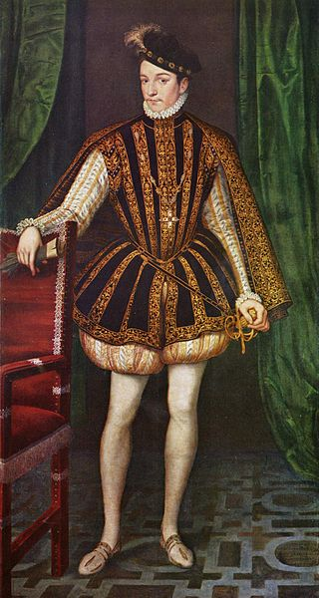
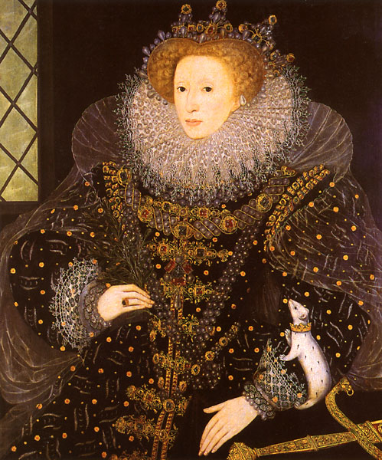
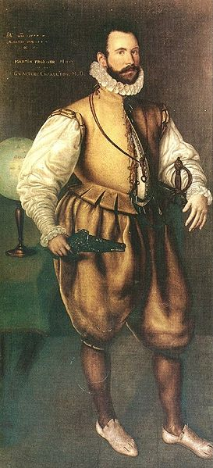
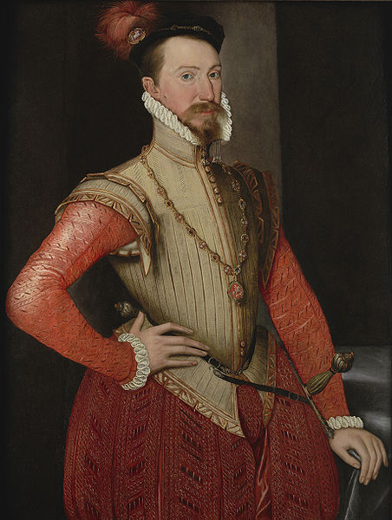
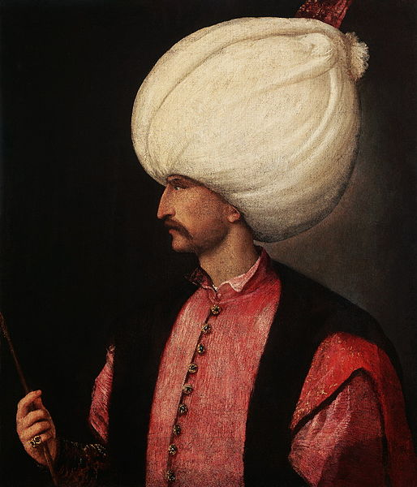
Suleiman I
Suleiman I (1494-1566) was the greatest and longest reigning sultan (emperor) of the Ottoman Empire, ruling for 46 years
Known in the West as Suleiman the Magnificent, he was known in the Middle East as “The Lawgiver”, due to the law
codes that he introduced
His rule is known as the Golden
Age of the Ottoman Empire

Slide 4
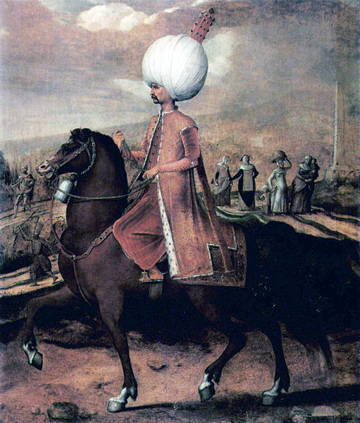
The Soldier
Under Suleiman’s rule, the Ottomans greatly expanded the territory of their empire.
He conquered areas in Eastern Europe, North Africa, and the Middle East
Under his rule, the size of the Ottoman navy was larger than all the navies of
the Mediterranean put together
He continually defeated
European armies until he was
stopped at Venice

Slide 5
Quote from the Ottoman Ambassador
"On [the Turks'] side are the resources of a mighty empire, strength unimpaired, habituation to victory, endurance of toil, unity, discipline, frugality and watchfulness... Can we doubt what the result will be?...When the Turks have settled with Persia, they will fly at our throats supported by the might of the whole East; how unprepared we are I dare not say."

Slide 6
Suleiman’s Expansion

Slide 7
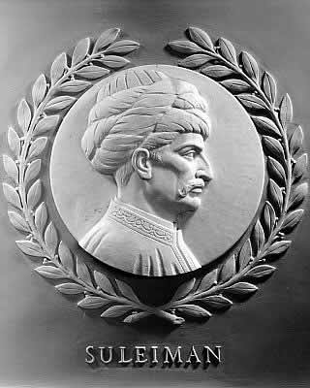
The Lawgiver
Suleiman was known as “The Lawgiver” in the East because of the brand new law codes he brought to the Ottoman Empire
Laws in Muslim empires had typically been based off of traditional Islamic law (the Koran), so those laws could not be broken
However, he issued modern legal codes that did not violate Muslim law, such as criminal and taxation laws
These new law codes brought the Ottoman Empire into a modern legal world

Slide 8
The Patron
Suleiman also had many breakthroughs in the world of art and literature – especially poetry
His law codes provided for an education system that was vastly greater than that of the Europeans
Architecture also flourished under his rule – he sought make Constantinople the center of Islamic civilization by funding the creation of new palaces and mosques

Slide 9
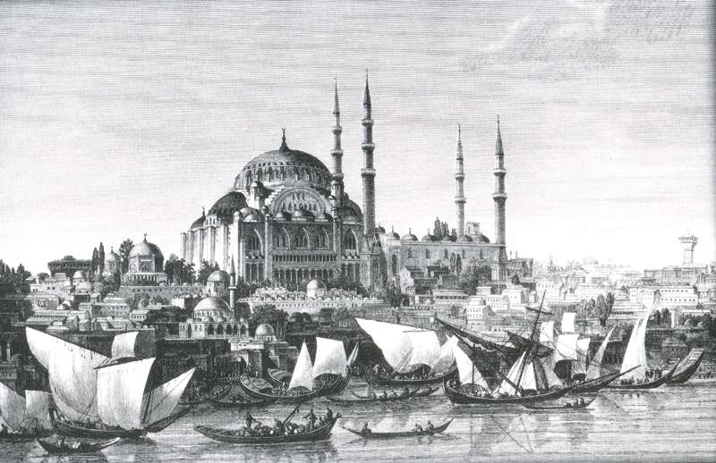
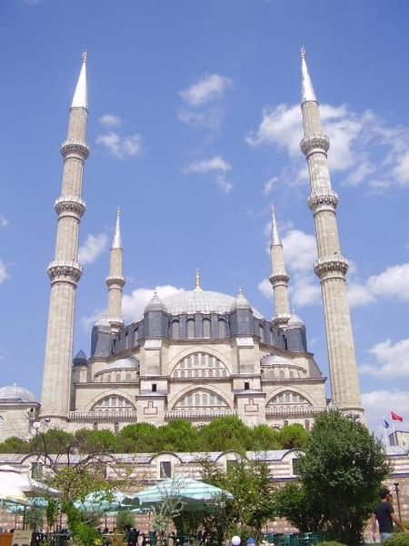
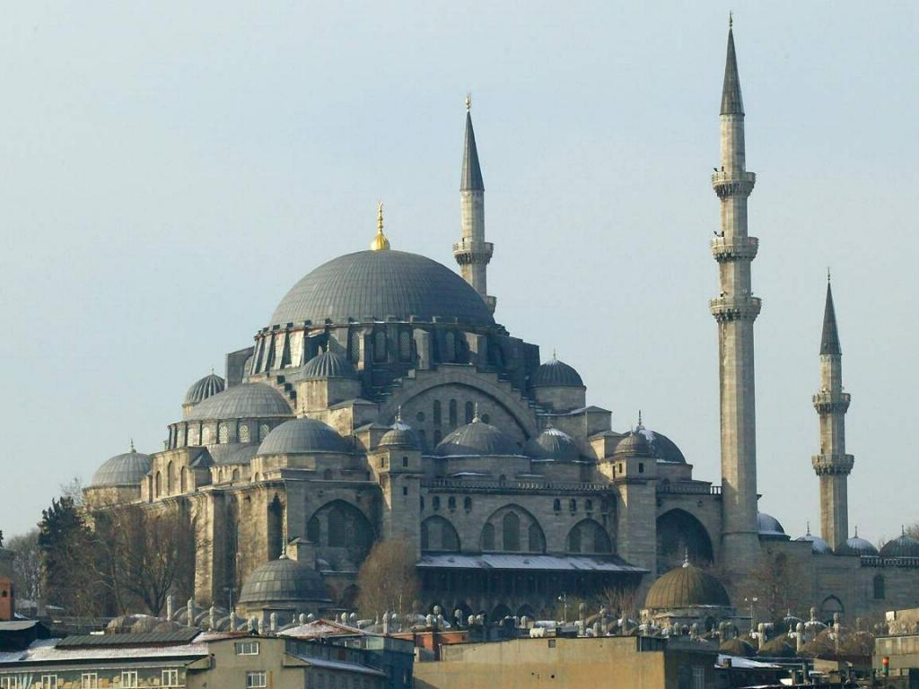
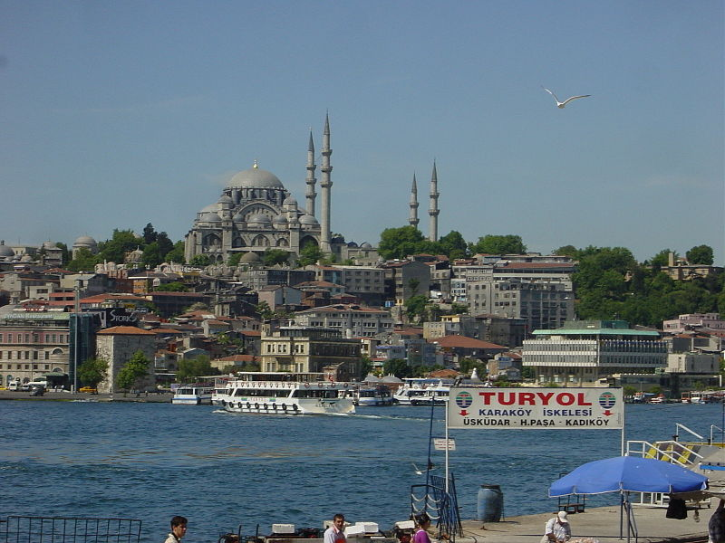
Architecture

Slide 10
Legacy
At Suleiman’s death, the Ottoman Empire was one of the strongest powers in the world
Suleiman had brought all of the major Muslim cities under his control, including Mecca, Medina, Jerusalem, Damascus, and Baghdad
His military and cultural advancements brought about the height of the Ottoman Empire and would lead to 150 years of Ottoman domination

