Slide 1
The Commonwealth & the Glorious Revolution

Slide 2
Oliver Cromwell

Slide 3
Oliver Cromwell as Lord Protector
Cromwell (a Puritan) ruled England for 5 years as a dictator (not a monarch because he was not of royal blood).
The monarchy had been abolished; England was known as a Commonwealth.
Cromwell was given the title “Lord Protector.”
Cromwell ruled through the army. He enforced his laws with military action. Conquered Scotland & Ireland.
Wanted educated Protestants; boys and girls started school.

Slide 4
Cromwell as Lord Protector cont…
Cromwell and the Puritan Parliament enacted many strict religious based laws:
Sunday was strictly for religious observance only.
Cromwell closed all theaters, outlawed profanity, and frowned on dancing, gambling, and taverns.
Pushed for marriages of love, not just business.
Has religious tolerance for all, especially Jews, except for Catholics – he crushes a rebellion among Catholics in Ireland
Kills 40% of all ethnic Irish

Slide 5
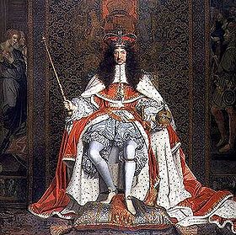
Restoration Period
After Cromwell died, Parliament and most Englishmen, tired of military rule and Puritan laws, decided to bring back the monarchy
(Restoration of the monarchy).
1660 - Charles II, son of executed Charles I, returned to England and claimed the throne. This ended the Commonwealth and Puritan rule.
Charles II learned from his father’s mistakes and did not try to rule with absolute power.

Slide 6
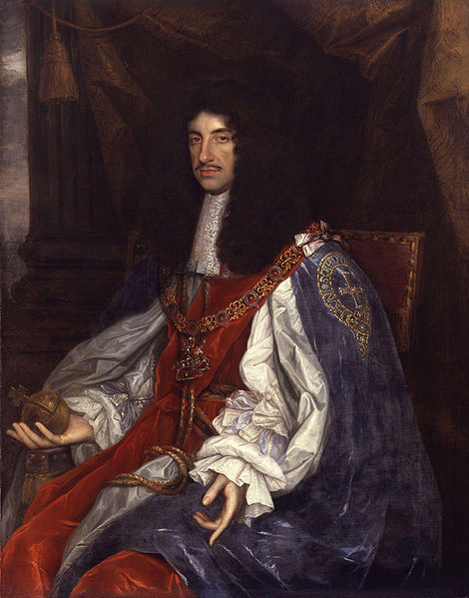
Charles II
The great lesson from the English Civil War was that Parliament could no more exist without the Crown than the Crown without Parliament
Charles II realized that Parliament needed to have authority
He secretly has ties to the
Catholic Church, but he
reestablishes the Church of
England as the country’s religion

Slide 7
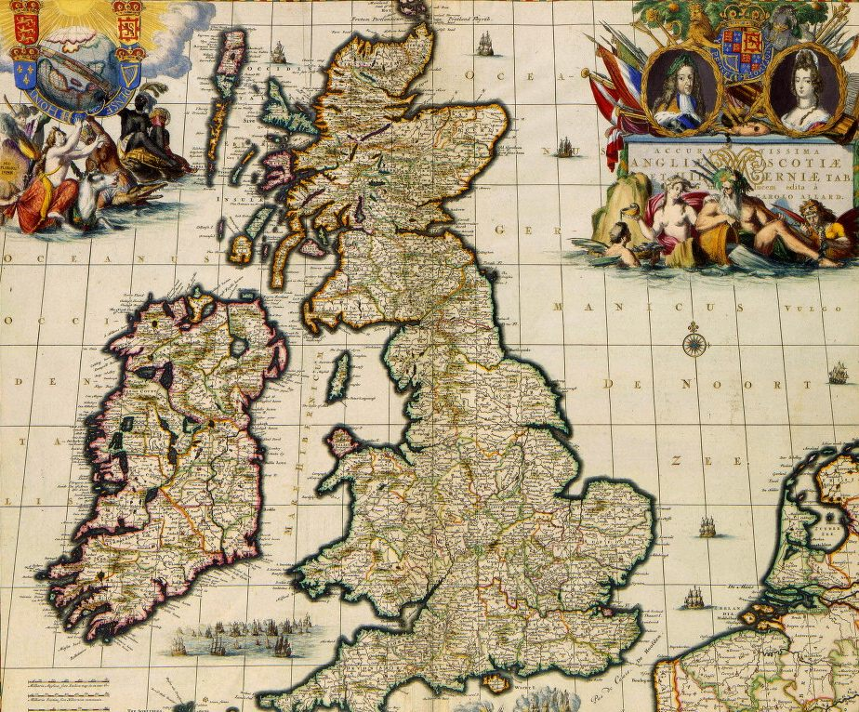
Start of the Glorious Revolution
After Charles II’s death, his Catholic brother took the throne, James II.
Making many Catholic moves (appointing Catholics to high positions, having a Catholic son, etc.) scared the English. They feared James would bring back the Roman Catholic Church.
1688 – Parliament invited James’ Protestant daughter and her husband to invade England and take the throne.

Slide 8
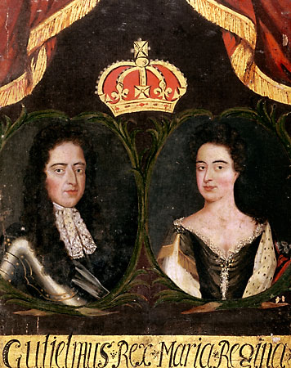
William and Mary
James’ Protestant daughter, Mary and her husband William landed with their army in England and
James fled to France without a fight (1688).
This ‘bloodless’ takeover is known as the Glorious Revolution.
Before being crowned William and Mary had to accept and sign several acts of Parliament’s;
now known as the English Bill of Rights.

Slide 9
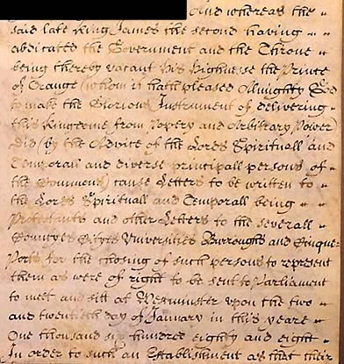
(1689) English Bill of Rights
What did the English Bill of Rights do?
Ensured Parliament’s (the people) power over the monarchy.
The monarch cannot suspend laws made by Parliament.
Barred a Roman Catholic from ruling in England.
It upheld trial by jury, and abolished cruel and unjust punishment.
Established habeas corpus (no person could be held in prison without first being charged with a specific crime).

Slide 10
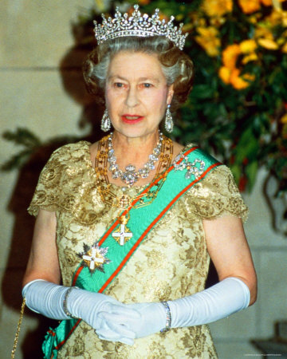
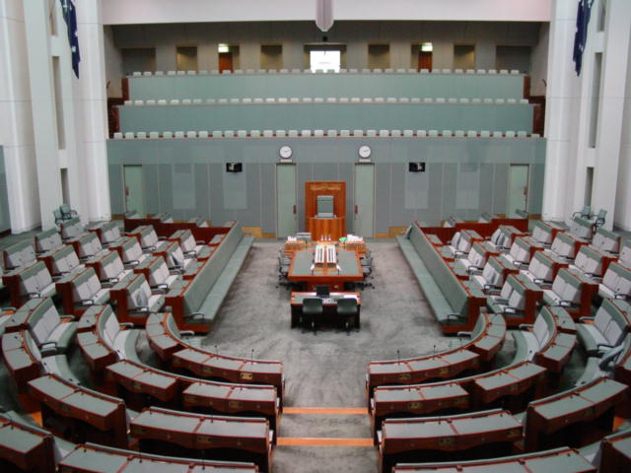
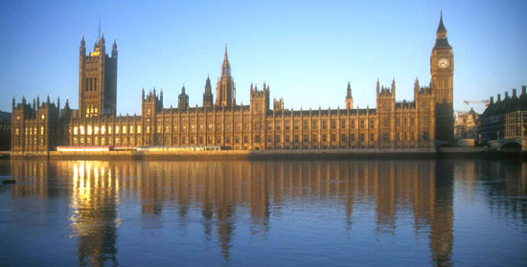
Limited Monarchy
Glorious Revolution and the English Bill of Rights did not exactly make England a democracy, but it created a CONSTITUTIONAL MONARCHY (aka ~ limited monarchy)… part democracy, part monarchy
A system where a constitution or legislative body (Parliament) regulates the ruler’s power.
Monarch shared power with Parliament and obeyed English law. Not an absolute monarch.

Slide 11
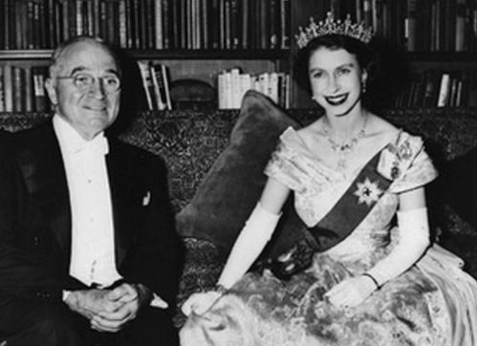
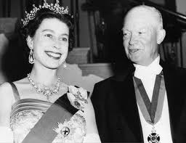
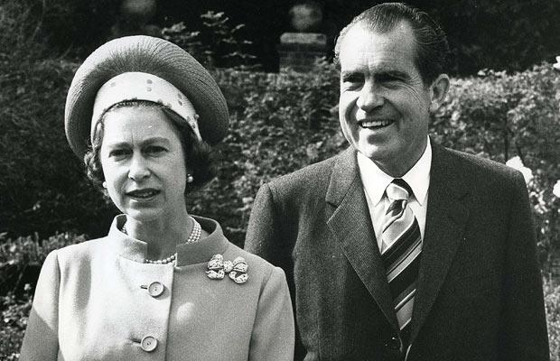
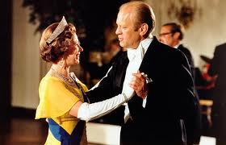
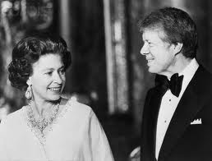
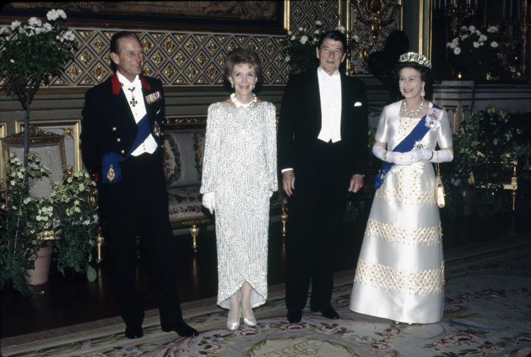
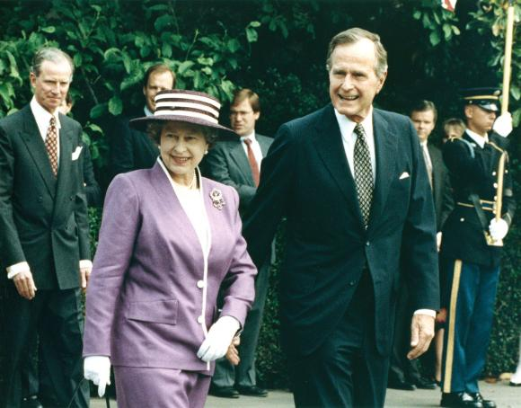
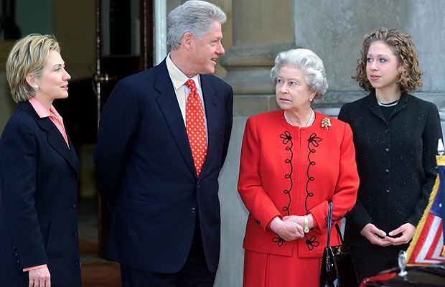
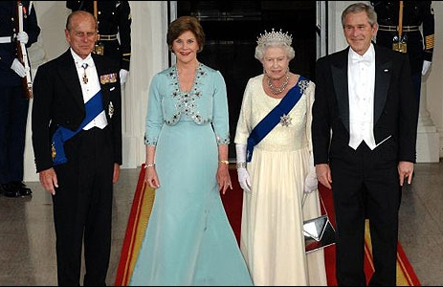
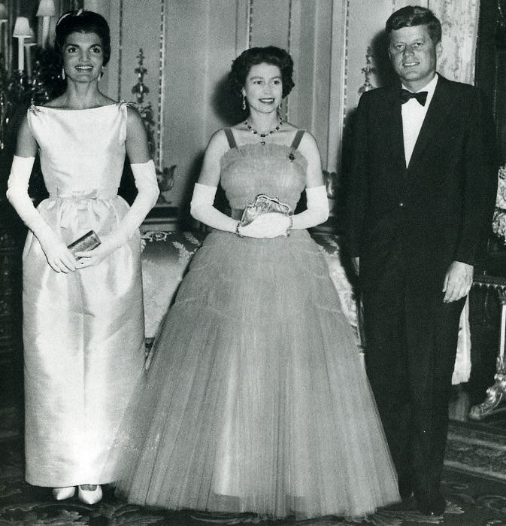
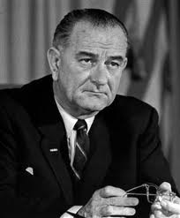
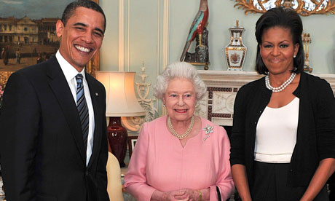
Queen Elizabeth II

