Slide 1
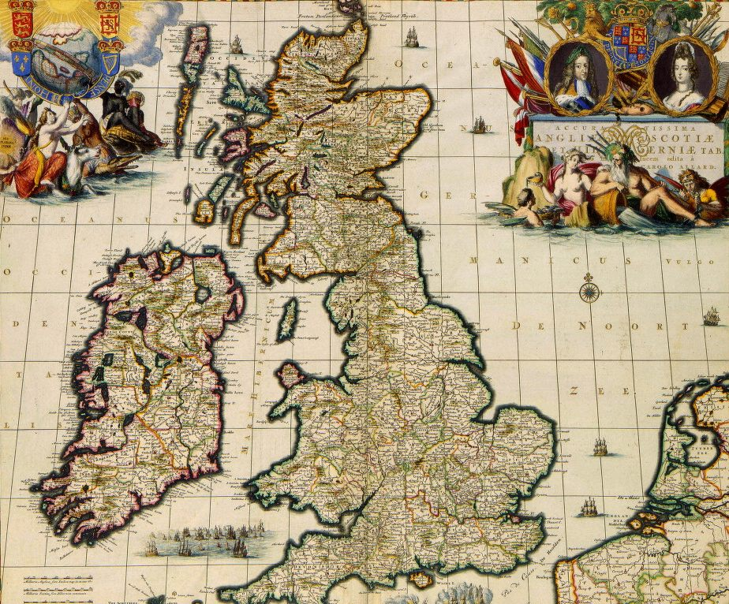
The Commonwealth, The Restoration, and the Glorious Revolution

Slide 2
Oliver Cromwell as Lord Protector
_________________________________________ as a dictator (not a monarch because he was not of royal blood).
The monarchy had been abolished; England was known as a ____________________.
Cromwell was given the title “________________.”
Cromwell _____________________. He enforced his laws with ______________. Conquered Scotland & Ireland.
_____________________________; boys and girls started school.

Slide 3
Cromwell as Lord Protector cont…
Cromwell and the Puritan Parliament enacted many strict _____________________
___________________________________________.
Cromwell closed all theaters, outlawed profanity, and frowned on dancing, gambling, and taverns.
Pushed for ____________________, not just business.
Has __________________________, especially Jews, _________________– he crushes a rebellion among Catholics in Ireland
_____________________________

Slide 4
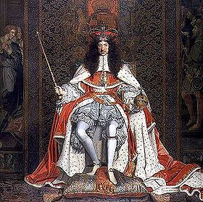
Restoration Period
After Cromwell died, Parliament and most Englishmen, _____________________________ ________, decided to bring back the monarchy
(____________________________).
1660 - ____________, son of executed Charles I, returned to England and claimed the throne. ___ ____________________________ _________________
Charles II learned from his father’s mistakes and _________________ __________________.

Slide 5
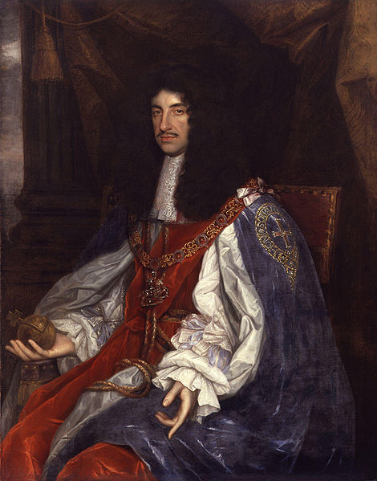
Charles II
The great lesson from the English Civil War was that ______________________________ _____________________________________ ________________
Charles II realized that Parliament needed to have _________________
He secretly has ties to the
Catholic Church, but he
__________________________
________as the country’s religion

Slide 6
Start of the Glorious Revolution
After Charles II’s death, his _________brother took the throne, ___________.
Making many Catholic moves (appointing Catholics to high positions, having a Catholic son, etc.) scared the English. They ______ ___________________________ ________________________
1688 – _______________________ ___________________________ _________to invade England and take the throne.

Slide 7
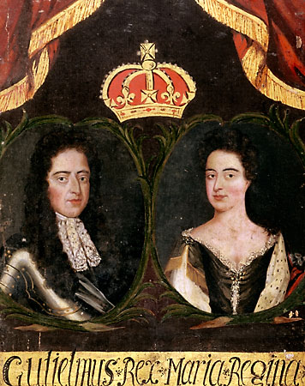
William and Mary
James’ Protestant daughter, ______and her husband __________landed with their army in England and
James fled to France without a fight (1688).
This ___________ takeover is known as the ______________________
Before being crowned William and Mary had to accept and sign several acts of __________________;
now known as the ______________________.

Slide 8
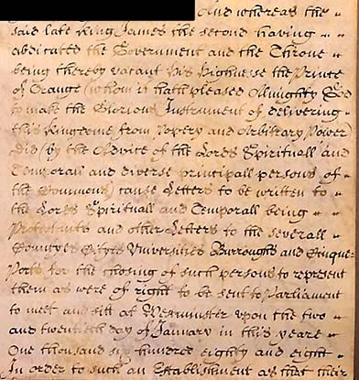
(1689) English Bill of Rights
What did the English Bill of Rights do?
Ensured _______________ (the people) _________________________
The ____________________________ made by Parliament.
_____________________________________in England.
It upheld _________________ and abolished cruel and unjust punishment.
Established ________________ (no person could be held in prison without first being charged with a specific crime).

Slide 9
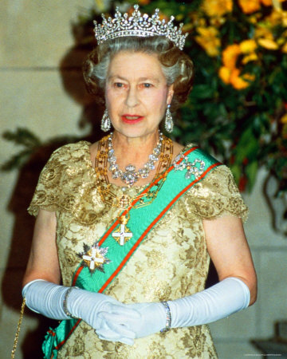
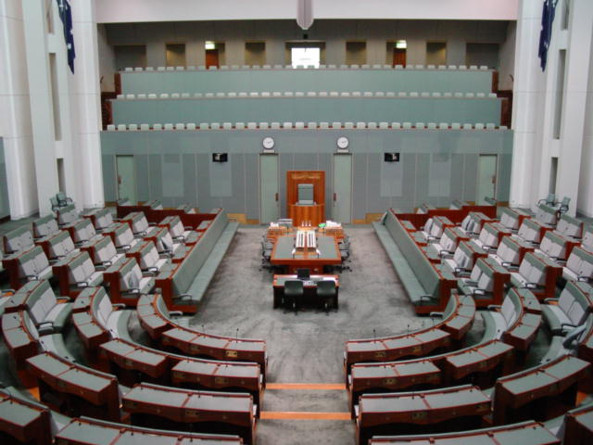
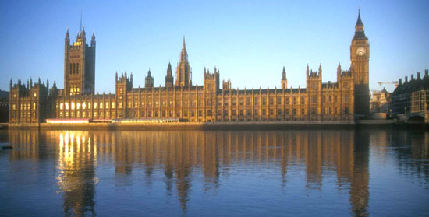
Limited Monarchy
Glorious Revolution and the English Bill of Rights did not exactly make England a democracy, but it created a ___________________________________________ (aka ~ limited monarchy)… part democracy, part monarchy
A system where a constitution or legislative body (Parliament) ___________________________.
_____________________________________________ _______________ ________________________

