Slide 1
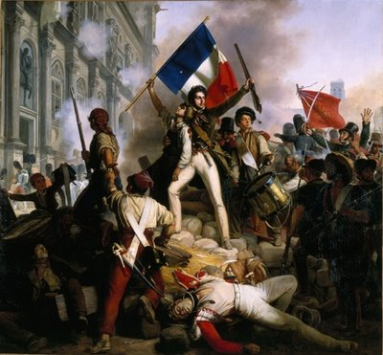
Révolution Française The French Revolution 1789-1799
WHII #21

Slide 2
Background
Two primary reasons behind the
outbreak of revolution:
_________________________
Voltaire, Montesquieu, and
Rousseau greatly contributed
to a ________________________________
2. ____________________________________– French inspired by American victory over the dominant British
Many Enlightenment thinkers were from France – _____________________________ and ___________________________

Slide 3
Louis XVI
__________________ruled France from 1774-1792
He recognized that __________________________ ____________________due to Enlightenment ideas and tried to grant more rights to the peasant class, but is unsuccessful
Helped American colonists during the ___________ ______________– however, France’s involvement will lead to a financial crisis after the war
To sum up Louis XVI – he’s not a bad monarch, but _________________________

Slide 4
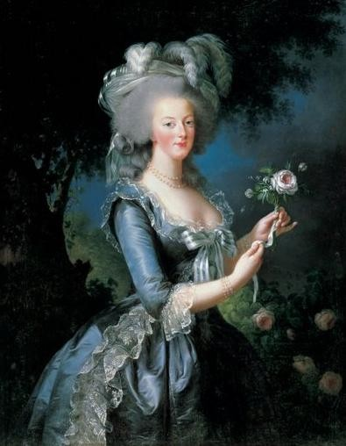
King Louis XVI
Rules during a time when ______ __________________the French countryside
Louis XVI and his wife, ________ _________, have done very little to help the starving peasant class
_____________________
Marie is known for her ________ __________________________
When an uprising begins, Louis does everything he can to try and maintain control

Slide 5
_______________________
Three ___________(social groups) in France
First Estate: ___________– owned _________ _____________
Second Estate: _________________– wealthy nobles who made up ____________________ but owned ____________________
____________: made up of __________ (well educated merchant class), ________________ ________, and ___________ (made up 80% of the pop. and paid most of the taxes)

Slide 6
Estates General
French __________________
that is made up of
______________of the three
estates
Meets in ___________to discuss the country’s state of turmoil and fix the _______________
The third estate wants more __________________, so they form the _________________to accomplish those goals
Make the __________________– vowed to ______ __________________________________________

Slide 7
Storming the Bastille
____________was a famous
Paris prison that often
housed ________________
and was known as a symbol of royal power
On July 14, 1789, _______________stormed the Bastille in search of guns and weapons – only contained a few prisoners, but the ___________ ________________________
__________________________________
Became the defining symbol of the ___________ _____________________

Slide 8
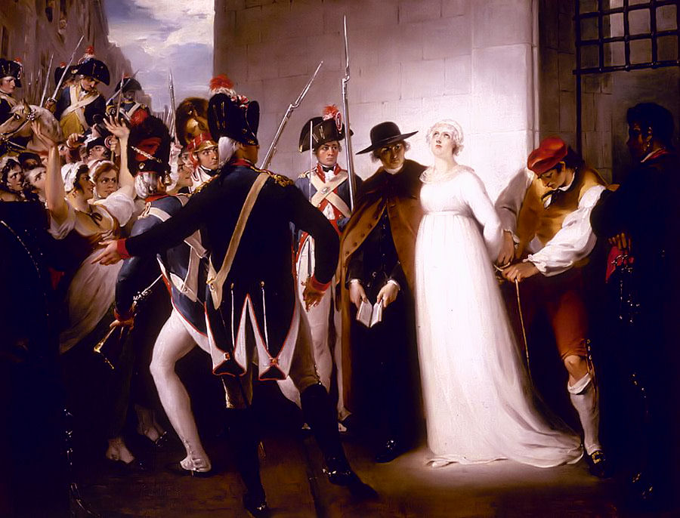
King Louis XVI’s Demise
After the success of the revolution, _____________ ______________________ ______________________ France
Convicted of treason and ______________________ _____________________
______________________ _______10 months later in October, 1793

Slide 9
Now we are free…sort of
The death of Louis XVI meant that
____________________________
and could begin establishing a new
form of government
____________________(1758-1794)
emerged as the leader of new France – his goal was to rid France of __________________________and enemies of the state
Put numerous citizens in prison and later executed them, quickly becomes ____________________
This time period is known as the _______________

Slide 10
Reign of Terror
During this time period, it’s
estimated that around _______
_________________________
Anyone who was seen as a
threat to France was ______________________
Robespierre’s radicalism is seen as too tyrannical, and he’s ________________________________ _____________on July 28, 1794

Slide 11
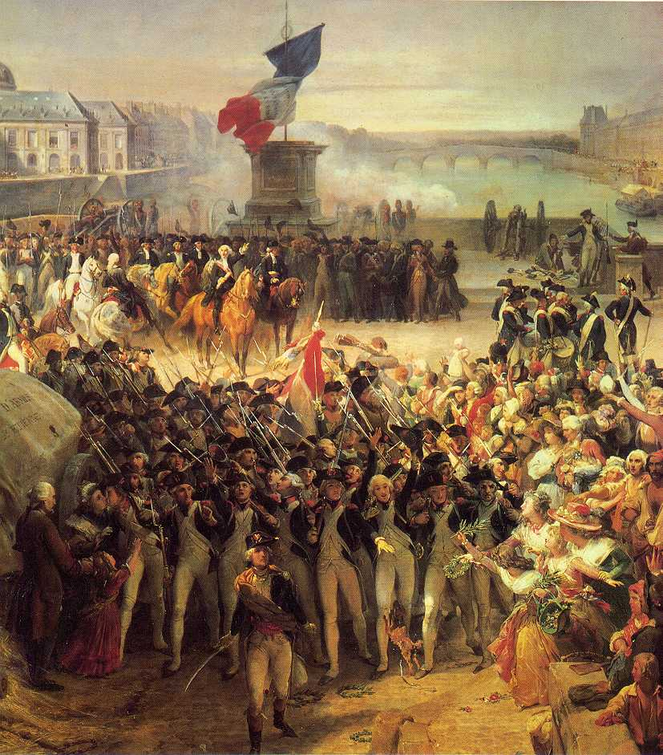
Results
The time immediately following
the reign of terror is full of
______________, but all of that
is settled with the establishment
of the _____________________
_____________ with a 5-man ruling executive body – France will now be a _____________________
A hero of the revolution is appointed the commander of all French armies
His name…. _________________________

Slide 12
Lasting Effects
3 Important lasting effects of the French Revolution:
__________– The people have a greater say in the government
_________________– the movement toward _________________________________________ ___________________________. Religion has less of an impact on the government – _____________ ____________________
___________– Putting the interest of your country above the interest of all others

Slide 13
French Revolution Terminology
Jacobin – a pro-revolutionary political organization during the French Revolution. The Jacobin Club.
Liberte, egalite, fraternite – Liberty, equality, and fraternity – the motto of the French Revolution
Taille – French tax imposed on peasants and other non-noble or clergy members – this is one of the main gripes of the Third Estate
Jean-Paul Marat – a pro-revolutionary journalist who spoke out against anyone who did not support the revolution. He was murdered for his views.

