Slide 1
SOL DQ
Martin Luther is credited with starting the Protestant Reformation. Those who followed Luther’s teachings were called what?
Francis Drake was an English privateer and was the second person to do what?
The Mughals constructed what large building in India?
What were the two groups who fought in the English Civil War?
Who painted the Sistine Chapel?
Bonus: Who founded the Anglican Church?

Slide 2
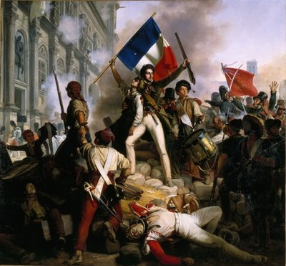
Révolution Française The French Revolution 1789-1799

Slide 3
Background
Two primary reasons behind the
outbreak of revolution:
Enlightenment Ideas –
Voltaire, Montesquieu, and
Rousseau greatly contributed
to a change in the French way of thinking
2. Influence of the American Revolution – French inspired by American victory over the dominant British
Many Enlightenment thinkers were from France – promoted separation of powers and limited central authority

Slide 4
Louis XVI
Louis XVI (1754-1793) ruled France from 1774-1792
He recognized that absolutism was becoming unpopular in France due to Enlightenment ideas and tried to grant more rights to the peasant class, but is unsuccessful
Helped American colonists during the American Revolution – however, France’s involvement will lead to a financial crisis after the war
To sum up Louis XVI – he’s not a bad monarch, but he’s a weak monarch

Slide 5
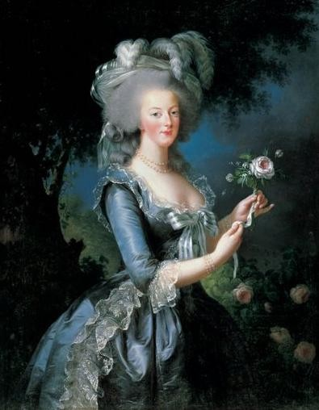
King Louis XVI
Rules during a time when severe famine has swept the French countryside
Louis XVI and his wife, Marie Antoinette, have done very little to help the starving peasant class
“Let them eat cake.”
Marie is known for her lavish spending and is unpopular
When an uprising begins, Louis does everything he can to try and maintain control

Slide 6
The Three Estates
Three estates (social groups) in France
First Estate: the Clergy – owned 10% of the land
Second Estate: the Aristocracy – wealthy nobles who made up 2% of the population but owned 30% of the land
Third Estate: made up of bourgeoisie (well educated merchant class), skilled city workers, and the peasants (made up 80% of the pop. and paid most of the taxes)

Slide 7
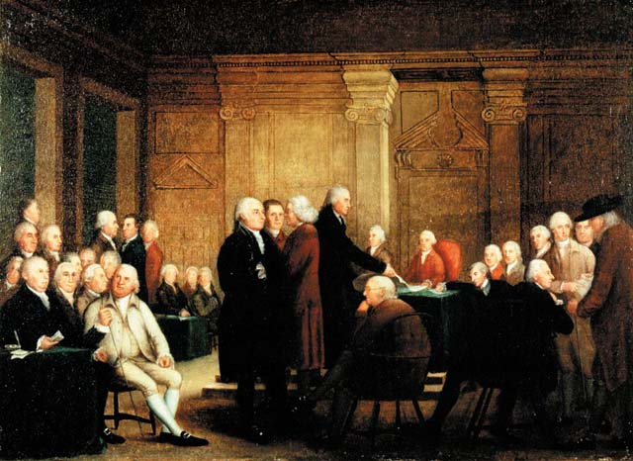
Estates General
French legislative assembly
that is made up of
representatives of the three
estates
Meets in June of 1789 to discuss the country’s state of turmoil and fix the financial crisis
The third estate wants more rights and freedoms, so they form the National Assembly to accomplish those goals
Make the Tennis Court Oath – vowed to write a constitution and end the absolute monarchy

Slide 8
Questions
How are the events leading up to the French Revolution similar to the American Revolution?
We discussed TWO reasons why the revolution broke out. Give me ONE of them and explain why that reason is important.

Slide 9
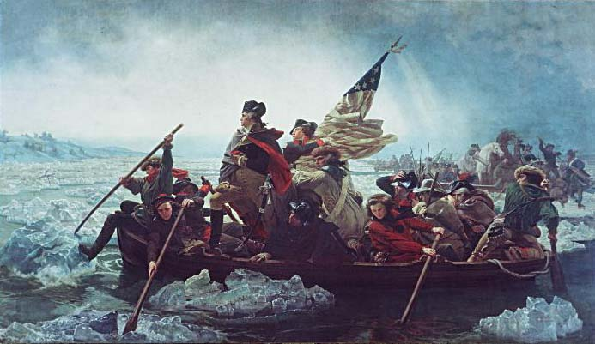
Storming the Bastille
The Bastille was a famous
Paris prison that often
housed political prisoners
and was known as a symbol of royal power
On July 14, 1789, 800 Parisians stormed the Bastille in search of guns and weapons – only contained a few prisoners, but the symbolism of the event was significant
Open revolution was now official
Became the defining symbol of the French Revolution

Slide 10
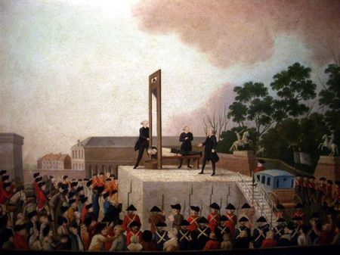
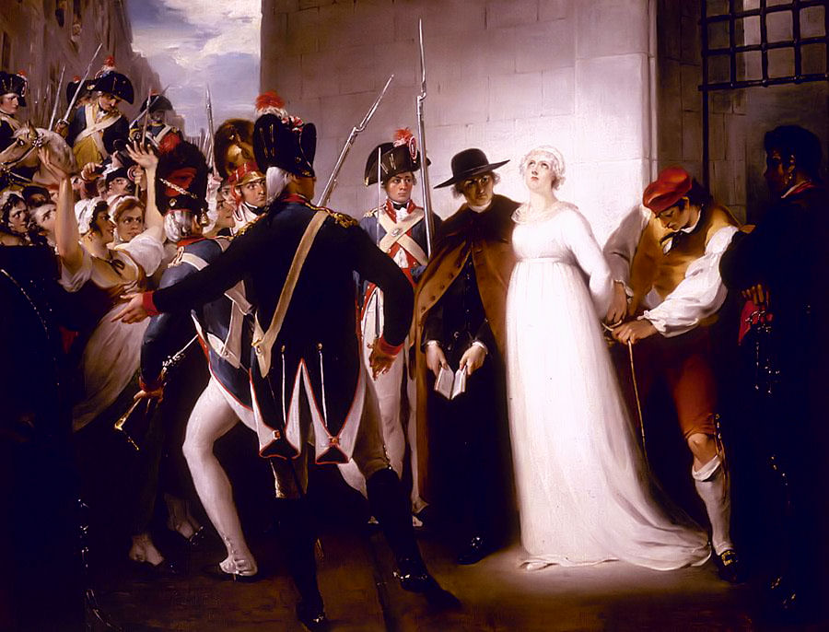
King Louis XVI’s Demise
After the success of the revolution, Louis XVI is held as a prisoner and put on trial for betraying France
Convicted of treason and executed by the guillotine in January of 1793
Marie Antoinette is executed 10 months later in October, 1793

Slide 11
Now we are free…sort of
The death of Louis XVI meant that
France was free of a monarch
and could begin establishing a new
form of government
Maxmilien Robespierre (1758-1794)
emerged as the leader of new France – his goal was to rid France of all potential foreign invaders and enemies of the state
Put numerous citizens in prison and later executed them, quickly becomes known as a tyrant
This time period is known as the REIGN OF TERROR

Slide 12
Reign of Terror
During this time period, it’s
estimated that around 17,000
French citizens were executed
Anyone who was seen as a
threat to France was executed or imprisoned
Robespierre’s radicalism is seen as too tyrannical, and he’s captured and executed by the guillotine on July 28, 1794

Slide 13
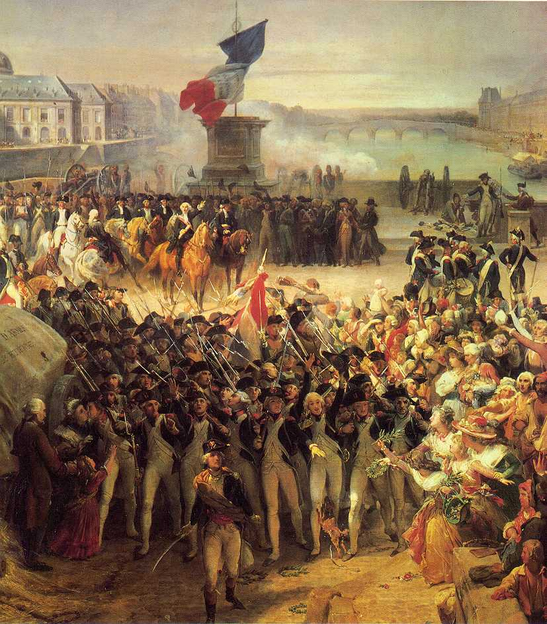
Results
The time immediately following
the reign of terror is full of
political turmoil, but all of that
is settled with the establishment
of the Directory – a two house
legislative body with a 5-man ruling executive body – France will now be a constitutional republic
A hero of the revolution is appointed the commander of all French armies
His name…. NAPOLEON BONAPARTE

Slide 14
Lasting Effects
3 Important lasting effects of the French Revolution:
Democracy – The people have a greater say in the government
Secularism – the movement toward modernization in government and away from traditional religious philosophies. Religion has less of an impact on the government – separation of church and state
Nationalism – Putting the interest of your country above the interest of all others

Slide 15
French Revolution Terminology
Jacobin – a pro-revolutionary political organization during the French Revolution. The Jacobin Club.
Liberte, egalite, fraternite – Liberty, equality, and fraternity – the motto of the French Revolution
Taille – French tax imposed on peasants and other non-noble or clergy members – this is one of the main gripes of the Third Estate
Jean-Paul Marat – a pro-revolutionary journalist who spoke out against anyone who did not support the revolution. He was murdered for his views.

Slide 16
Questions

