Slide 1
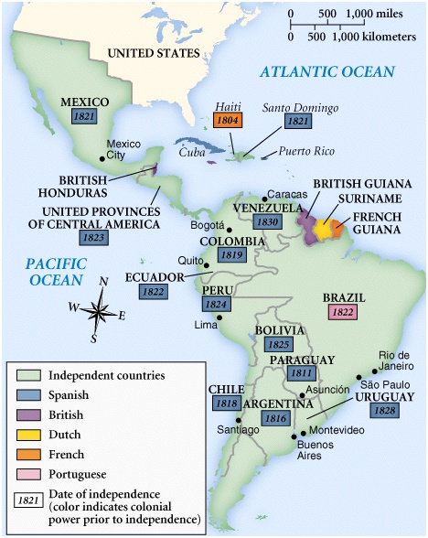
Causes & Effects

Slide 2
Latin American Revolutions

Slide 3
Brief description of the event:
Who?
What?
When?
Where?

Slide 4
Brief description of the event:
Who? – Lower class people (mostly creoles) VS. their colonial rulers (Spain, France, Portugal)
What? – a series of uprisings against oppressive European colonial rulers that resulted in gaining independence.
When? – starting in 1791, ending in 1820s
Where? – Latin America (Mexico, the Caribbean, & South America)

Slide 5
CAUSES:
Enlightenment ideas (questioning society & gov’t)
American Revolution & French Revolution (source of inspiration)
Strong desire for independence (nationalism) – want to control their own land & economy
Mercantilism exploiting Latin America’s resources & economy

Slide 6
CAUSES:
Napoleonic Wars (his brother became King of Spain)
Inequalities in the rigid Latin American social structure
Creole resentment (they had little power compared to the peninsulares)
Treatment of lower class people

Slide 7
EFFECTS:
Many independent nations created & end of European colonization in Latin America
Struggles for power & civil wars break out
Military dictators end up taking control of the new independent nations – caudillos
Many failed democracies

Slide 8
EFFECTS:
Not much change in social status of the people
Peonage system develops & families are tied to the land
Unequal distribution of land
Increase in poverty
Latin America remained unindustrialized & became reliant on others to trade

