Slide 1
Latin American Revolutions

Slide 2
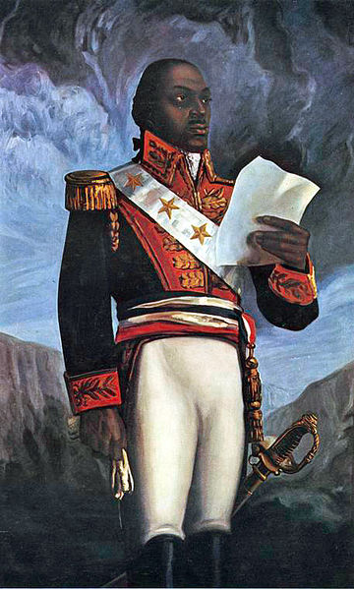
Haiti
Being a French colony, ___________________ _____________________________________
_____________________________led a slave rebellion and was then appointed leader of Haiti during its revolution against France
Despite being captured by French forces and
dying of pneumonia, Toussaint's
forces were victorious – ________________ ________________________________

Slide 3
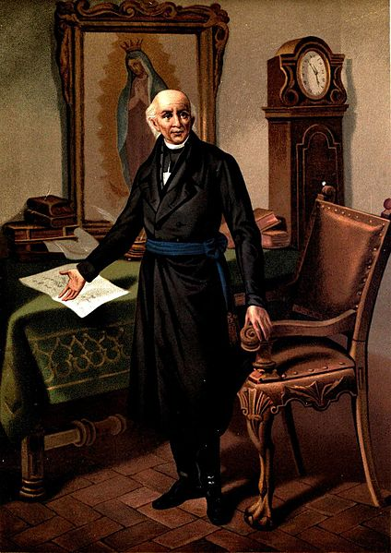
Mexico
Mexican revolutionaries were led by an unlikely hero – __________________________________
Due to heavy poverty among the Mexican peasants, Hidalgo decided to lead the revolt against Spain
After gathering an army of 90,000 peasants and farmers, he was eventually _________________ ______________________________
Hidalgo was executed by the Spanish,
but his legacy carried on ___________ __________________________________

Slide 4
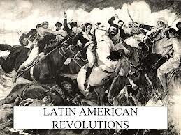
Pushing Forward
After the success of the revolutions in Haiti and Mexico, revolutions will begin popping up _______ _________________________________________
A total of around 10 nations will achieve independence from _________________________ _________________________________________

Slide 5
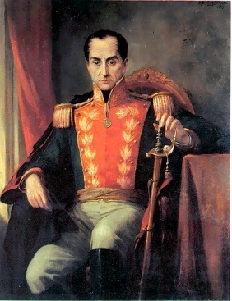
Simón Bolívar
___________________(1783-1830) was a Creole revolutionary leader from __________________
He was arguably the _____________________ _____________________________________, and is known as one of the most important politicians in the ______________________
He personally aided in the _______________ ______________________
Every city or large town in Venezuela
has a ___________________________ ____________________________

Slide 6
Bolívar’s War
He issued _____________________, also known as the ________________________, which permitted the murder of anyone who was born in Spain (peninsulares)
After achieving victory in Venezuela, Bolívar then took his army and to fight in the revolutions of ________________________________________– he also served as president of all those nations
Bolívar became the single most important figure in all Latin American revolutions, _________________ ___________________________________
Bolívar died of _______________at the age of 47

Slide 7
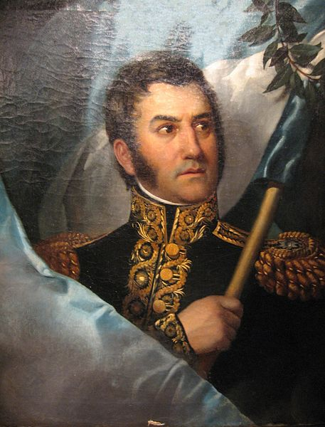
_________________________________
San Martín became famous for liberating __________________________________________________________________________________
While born in Argentina (____________________ _______) he actually served in the Spanish military and fought in campaigns across ________________ ________________________________
When he returned to Argentina, he
immediately began aiding the locals in
________________________________

Slide 8
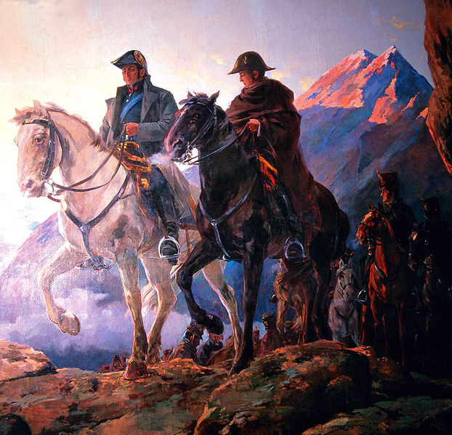
San Martín cont…
After leading the revolution against the Spanish in Argentina, Martín then _______________________ _________________________________________
He would also aid Bolívar in liberating the nation of _____________________________of that country
After serving only one year
as president, San Martín
_________________ to live out
the rest of his life

Slide 9
