Slide 1
Unifications of Europe Italy and Germany
WHII #25

Slide 2
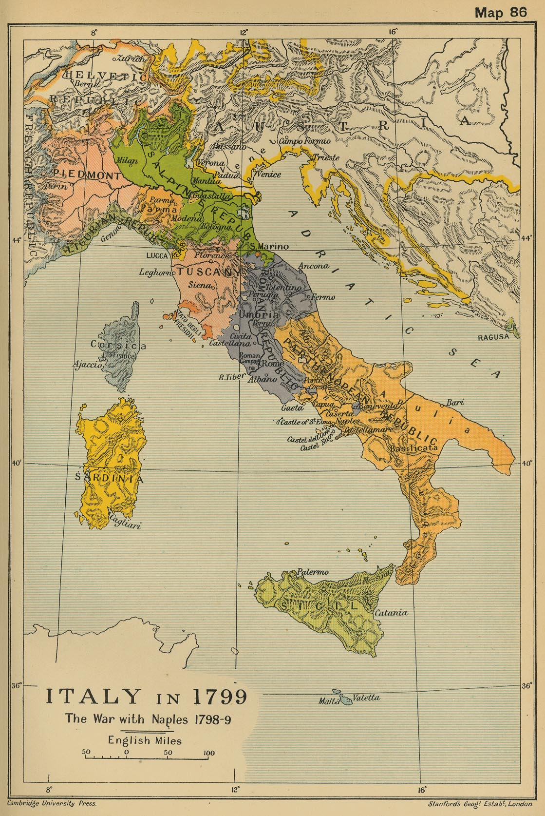
Unification of Italy (1870)
By the mid 1800s, Italy was still broken up into several different city-states or principalities
Each city-state was ruled by a monarch or prince
There was not one unified government, nor was their one unified leader
Beginning around 1830, there was a push among many Italians to make Italy one single state
This push was mainly due to NATIONALISM

Slide 3
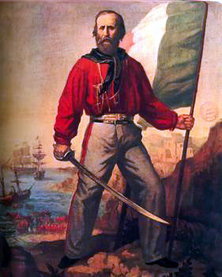
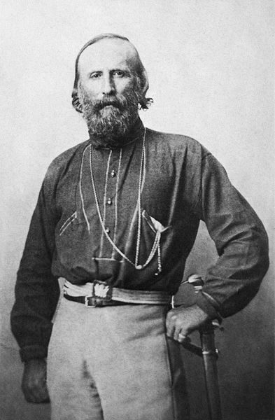
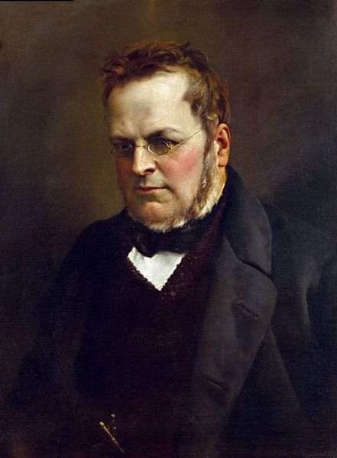
Two Revolutions
Beginning in 1848, Italy started fighting its first of three wars for independence against the princes to unite the country
In the north the revolutionaries were led by a politician named Count Cavour – Prime Minister of the Kingdom of Piedmont-Sardinia
In the South, the revolutionaries were
led by a fearless Italian general named
Giuseppe Garibaldi
Those who fought with Garibaldi were
known as the Red Shirts

Slide 4
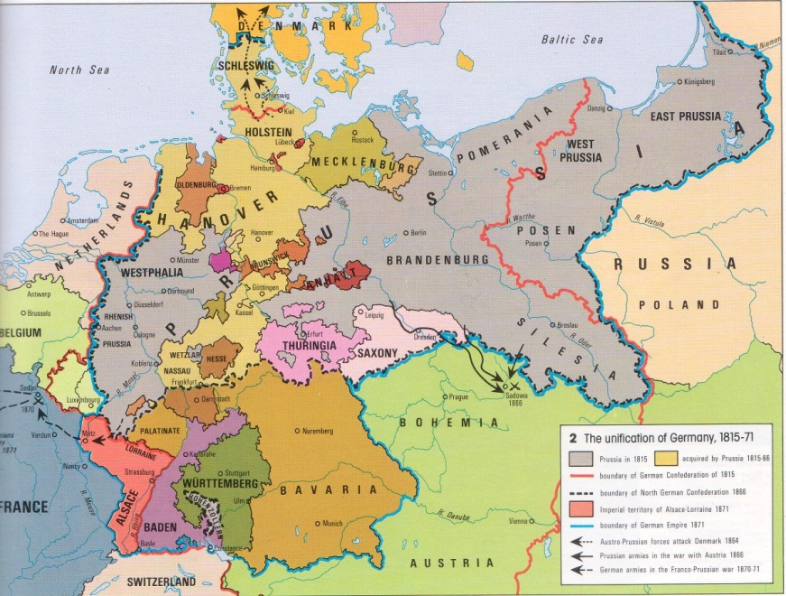
German Unification
Germany was broken up into two main regions:
The Kingdom of Prussia
The German Principalities – several small kingdoms ruled by a prince
Like Italy, these different areas were not united under one ruler (with the exception of Prussia)
It would take a great event to unite both Prussia and the principalities
- That event was the Franco-Prussian War

Slide 5
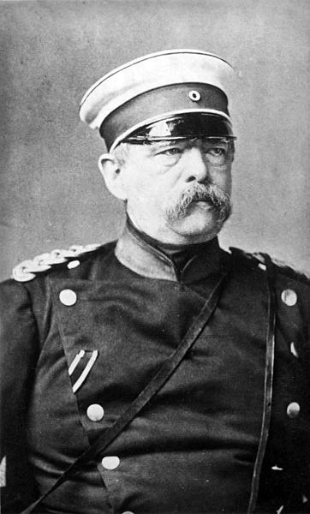
Franco-Prussian War
The Franco-Prussian War was fought between France and Prussia over territory
The Prussian minister, Otto von Bismarck, concocted a plan that would assuredly help Prussia win the war – he would unite the Prussian empire with the German principalities
Bismarck stressed nationalism and knew
that a united German state would be one
of the strongest powers in all of Europe
When Germany unified together, France
was powerless and Germany quickly won
the war

Slide 6
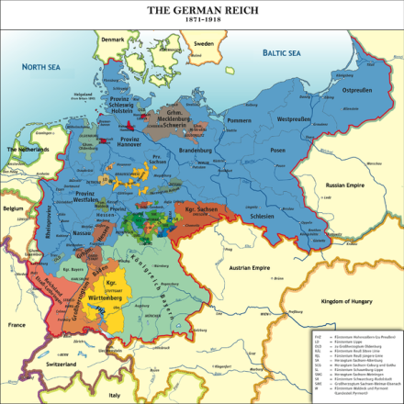
German Unification
Bismarck was named the first Chancellor of the newly formed German Empire, while Wilhelm I was named the Emperor of Germany
Germany took territory from France, which would be one of the leading causes of World War I
Out of all of this unification, an important political philosophy came from Bismarck known as Realpolitik
This political idea promoted the notion that a country should use any means necessary to pursue its goals

