Slide 1
Industrial Revolution 1750-1850

Slide 2
The Beginning
What is the ___________________________?
The period during the 18th and 19th century where man began to ___________________________ – increase in INDUSTRY
____________________of lifestyle occurs
____: Most people living on farms, grow their own food and work the land, made their clothes
________: Many people now buy clothes in stores, used machines for farming, live in city (urban)
Movement from ___________________________ ___________________to factories

Slide 3
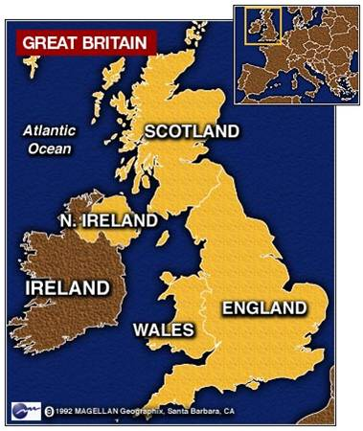
It All Begins in Britain
Several reasons why everything
began in Britain:
____________________ – had
overseas ____________all over the
world and could control them due to a strong navy, able to get lots of ___________________
2) ___________– island nation, allowed for strong trade. Also has a strong, stable government

Slide 4
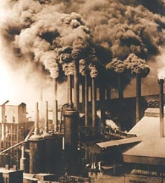
It All Begins in Britain
_____________________– laws that allowed land owners to fence in their lands in order to increase wool output
Owners could _________________________as opposed to wasting time traveling from plot to plot
Since the work was more efficient, less people were needed in the rural areas

Slide 5
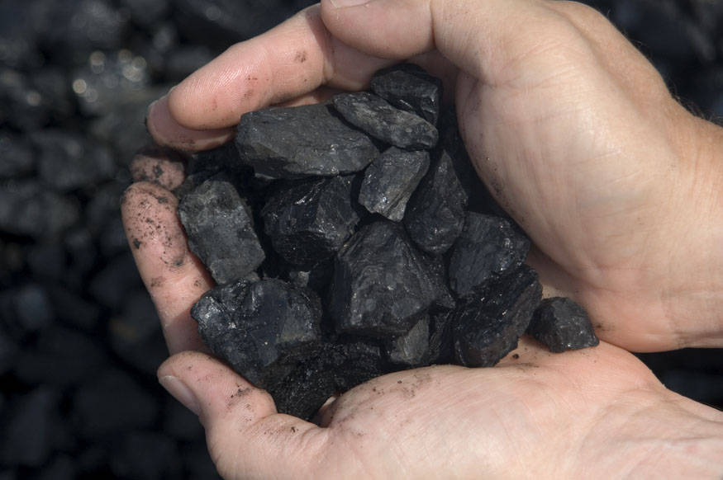
It All Begins in Britain
_________________– coal,
iron ore, and running water
are all used as a source of
energy
____________is used to build machinery
_______is used to power the new steam engines
Since less people are needed to work on farms, there is more ________________to mine natural resources and run machines

Slide 6
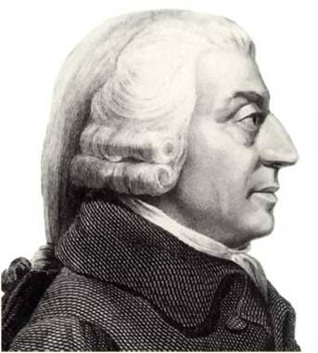
It All Begins in Britain
__________– a ____________ system in which private parties control business, is driven by competition
______________ economics – untouched by the government
____________ writes the Wealth _________, inspiring capitalism to spring up throughout England
Government no longer regulates the ___________________

Slide 7
The Spread
Since ideas tend to spread quickly, _________________quickly spread to western Europe and the United States
Since ________________________on farms, they move to towns or cities in search of work – known as _______________
Cities develop _____________– produce large quantities of goods

Slide 8
The Spark That Started it All
_________________contributors to
the start of the Industrial Revolution:
__________– advancement in tools
and the application of resources
__________– need for goods grows
and the British Empire expands
3) __________– wealth and free market economies want to invest in new technologies and businesses, like __________________________

