Slide 1
Industrial Revolution 1750-1850

Slide 2
The Beginning
The period during the 18th and 19th century where man began to use machines to produce goods – increase in INDUSTRY
Drastic change of lifestyle occurs
1750: Most people living on farms, grow their own food and work the land, made their clothes
1850: Many people now buy clothes in stores, used machines for farming, live in city (urban) apartments
Movement from cottage industry (producing goods in your home) to factories

Slide 3
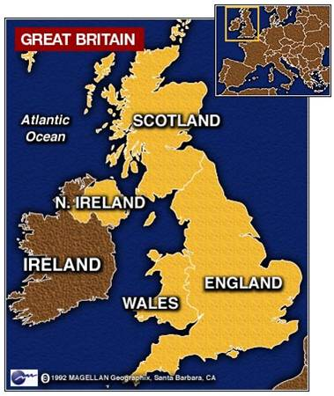
It All Begins in Britain
Several reasons why everything
began in Britain:
Worldwide Empire – had
overseas colonies all over the
world and could control them due to a strong navy, able to get lots of natural resources
2) Geography – island nation, allowed for strong trade. Also has a strong, stable government

Slide 4
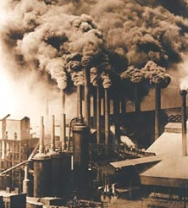
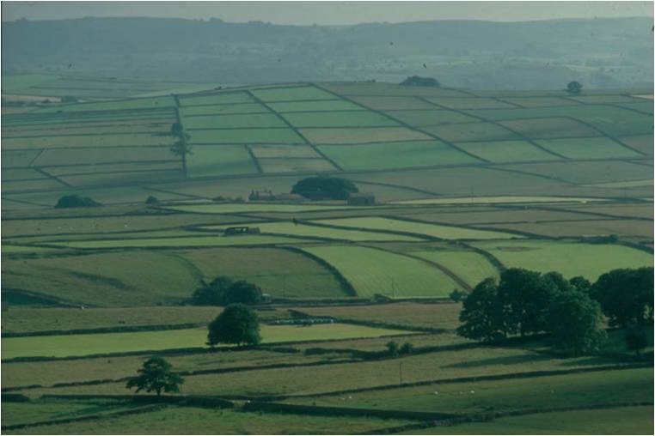
It All Begins in Britain
Enclosure Movement – laws that allowed land owners to fence in their lands in order to increase wool output
Owners could invest money in machinery as opposed to wasting time traveling from plot to plot
Since the work was more efficient, less people were needed in the rural areas

Slide 5
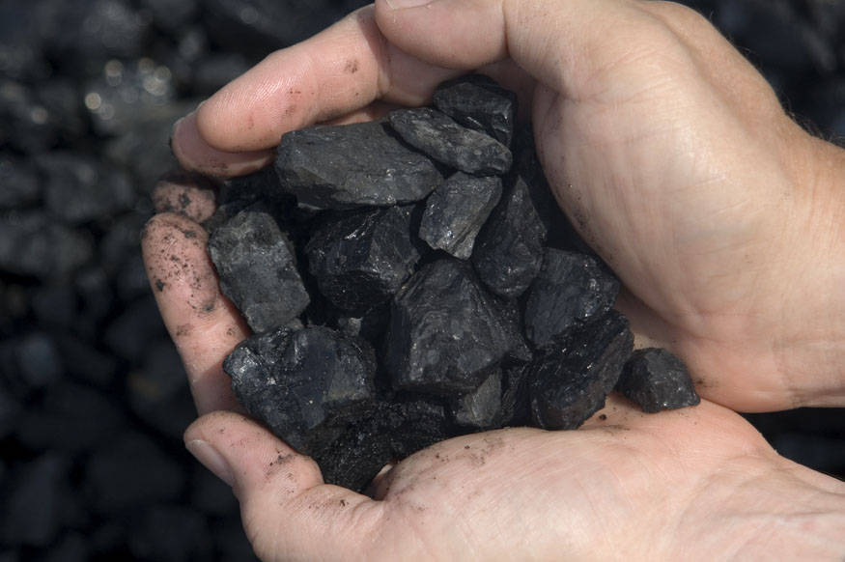
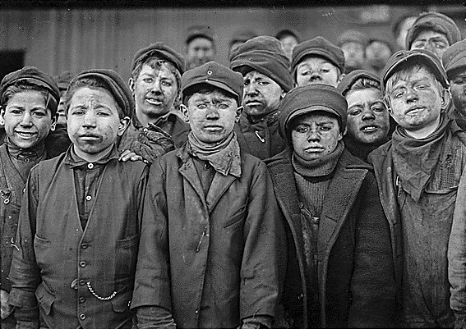
It All Begins in Britain
Natural Resources – coal,
iron ore, and running water are
all used as a source of energy
Iron ore is used to build machinery
Coal is used to power the new steam engines
Since less people are needed to work on farms, there is more available labor to mine natural resources and run machines

Slide 6
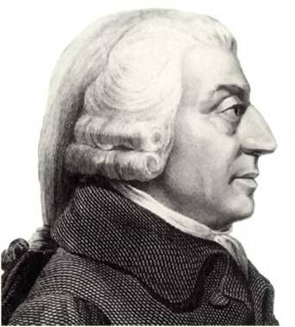
It All Begins in Britain
Capitalism – a free economic system in which private parties control business, is driven by competition
Laissez-faire economics – untouched by the government
Adam Smith writes the Wealth of Nations, inspiring capitalism to spring up throughout England
Government no longer regulates the national economy

Slide 7
The Spread
Since ideas tend to spread quickly, industrialization quickly spread to western Europe and the United States
Since fewer workers are needed on farms, they move to towns or cities in search of work – known as urbanization
Cities develop factories – produce large quantities of goods

Slide 8
The Spark That Started it All
Three important contributors to
the start of the Industrial Revolution:
Technology – advancement in tools
and the application of resources
Demand – need for goods grows
and the British Empire expands
3) Capital – wealth and free market economies want to invest in new technologies and businesses, like mines, factories, and railroads

