Slide 1
Industrial Revolution Part #2

Slide 2
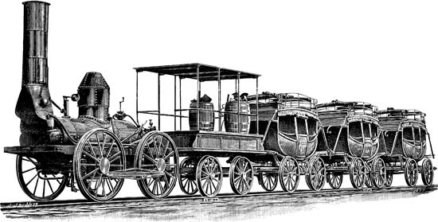
Invention of the Railroad
Invention of the Railroad was almost simultaneous in Europe and the United States.
Meant that _____________________in almost any location; ______________________of workers and supplies.

Slide 3
Positive Outcomes of the I.R.
Improvement in the ____________________
Rise of the _______________________
Increased ____________________
______________, cheaper goods
Increased _________________
Improvements in __________________
Neutral Outcomes of the I.R.
Population increase
Growth of cities (_________________)

Slide 4
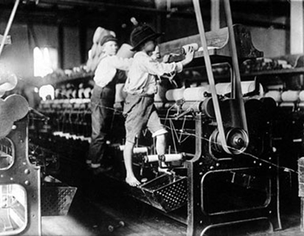
Negative Outcomes of the I.R.
______________________(unsanitary, long hours)
Rise of ___________________(tenement housing)
Breakdown of the ____________unit
Environmental __________________
_______________

Slide 5
In Response to Worker Abuses in a Capitalistic Society:
_________________________of worker abuses in capitalism.
# 1 ~ ______________________________–
A system of government in which _____________ ___________________ the economy and a single, often authoritarian party, holds power.
Communism – wealth and goods
are ___________________among
the people.

Slide 6
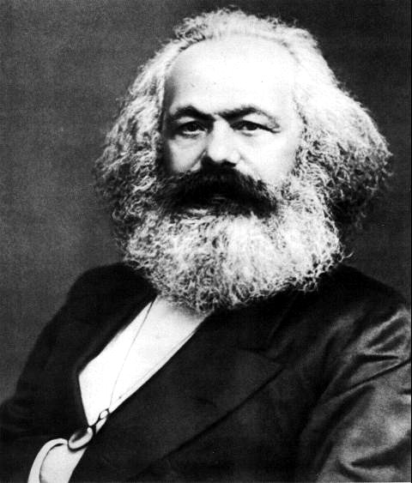
Marxism
_______________& Fredrich Engels wrote ______________________and Das Capital.
About the middle class overthrowing the upper class so that ___________________ _______________and end private property.

Slide 7
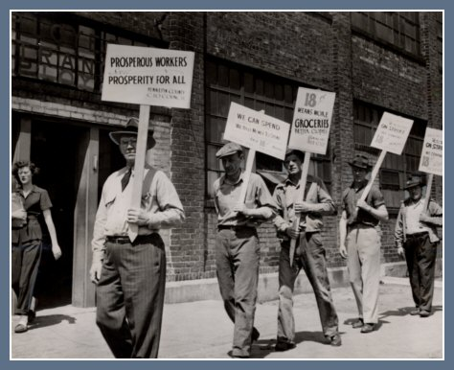
Effects of Worker Abuses
#2 ~ ______________________________–
People with the same job organize into a ________ ____________________; better pay, benefits, and working conditions.
To achieve their goals unions usually use ______________________or a ______________.
#3 ~ ____________________–
Brought about _______________.
Work place improvement rules.
Pollution regulation.

