Slide 1
Industrial Revolution Part #2
WH II #21

Slide 2
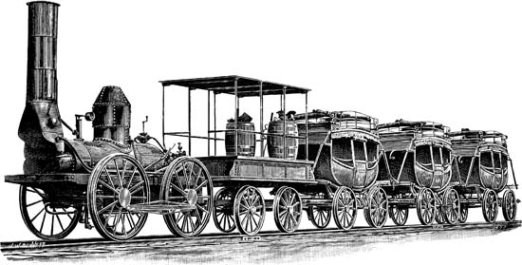
Invention of the Railroad
Invention of the Railroad was almost simultaneous in Europe and the United States.
Meant that industry could grow in almost any location; increased transportation of workers and supplies.

Slide 3
Positive Outcomes of the I.R.
Improvement in the standards of living
Rise of the middle class
Increased number of jobs
More goods, cheaper goods
Increased education
Improvements in medicine
Neutral Outcomes of the I.R.
Population increase
Growth of cities (urbanization)

Slide 4
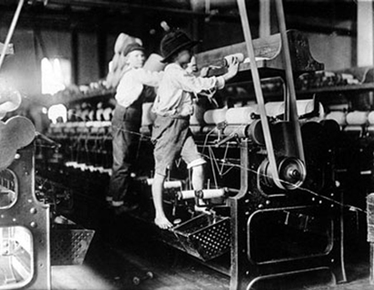
Negative Outcomes of the I.R.
Poor working conditions (unsanitary, long hours)
Rise of inner-city slums (tenement housing)
Breakdown of the family unit
Environmental pollution
Child labor

Slide 5
In Response to Worker Abuses in a Capitalistic Society:
3 MAJOR EFFCTS of worker abuses in capitalism.
# 1 ~ Rise of Communism (Socialism) –
A system of government in which the state plans and controls the economy and a single, often authoritarian party, holds power.
Communism claims to make progress toward a classless society in which all goods and wealth are equally distributed among the people.

Slide 6
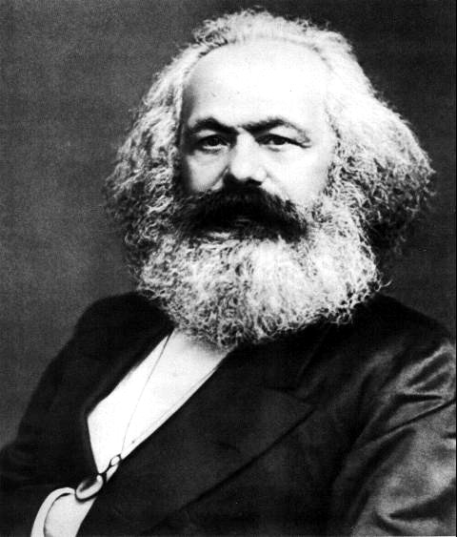
Marxism
Karl Marx & Friedrich Engels wrote Communist Manifesto and Das Capital.
About the middle class overthrowing the upper class so that society would be class-less and end private property.

Slide 7
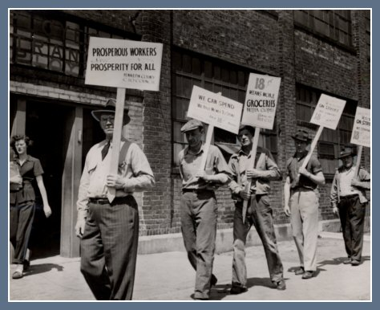
Effects of Worker Abuses
#2 ~ Development of Labor Unions –
People with the same job organize into a group to demand worker rights; better pay, benefits, and working conditions.
To achieve their goals unions usually use collective bargaining or a strike.
#3 ~ Democracy –
Brought about child labor laws.
Work place improvement rules.
Pollution regulation.

