Slide 1
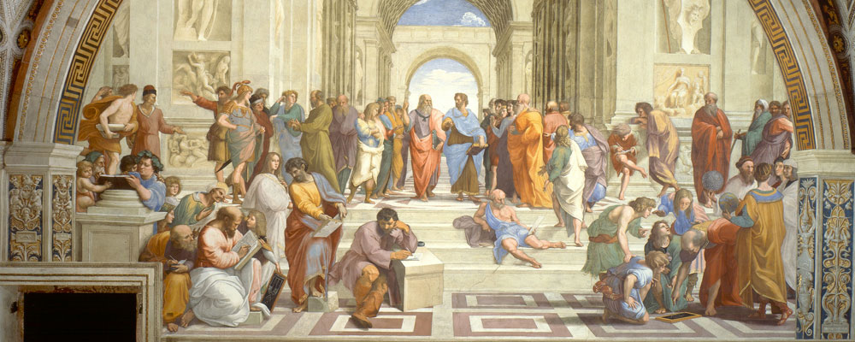
The Italian Renaissance

Slide 2
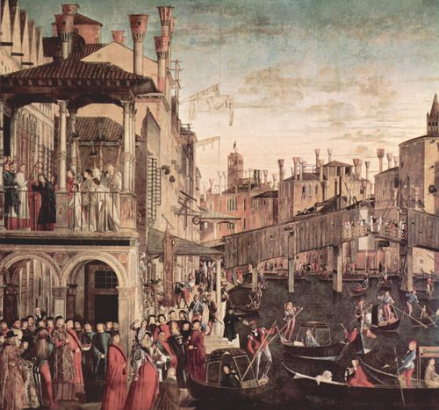
Meaning
What is the Renaissance?
_________________________________
Push to bring back ideas from ____________ ____________________________
New ideas in ___________________________ ___________________
Began in the early 1400s
__________________________________________________________________________________________________________________________________________________

Slide 3
Origins
The Renaissance began in the ____________ _____________________________________________________________– WHY???
1. _____________– spread ideas and cultures
Florence – ___________________________ ____________
Milan – _____________________________ _______________________________________________________
Venice – _____________________________ _____________________________________

Slide 4
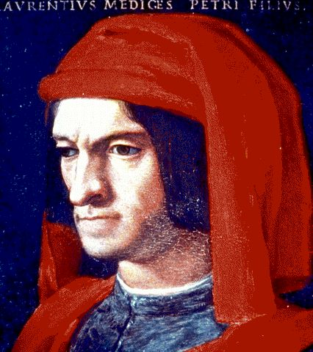
Origins cont…
2. ______________________in the three city-states funded new ideas in art and culture – these rich merchants were called ___________
__________________________________________________________________________________

Slide 5
Accomplishments in Art
One of the largest examples of ___________ ____________ was in art
While art in the Middle Ages tended to focus strictly on ________________________ ______________________________________________________________
A big reason for this was because the ____________________________________________________________________________

Slide 6
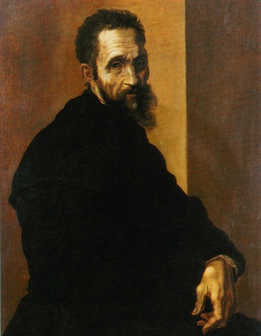
Michelangelo
_____________(1475-1564) was an Italian artist best remembered for his ___________________ _______________________
Much of his work was of __________________ ___________________________
His two most famous sculptures, ___________ ____________________________
completed before he turned 30
While using many Christian
symbols in his art, he focused
on many ____________________

Slide 7
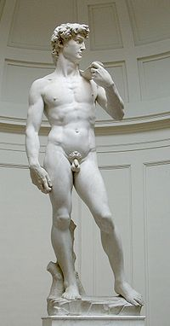
Michelangelo’s David
The statue of David was based on the ___________ __________________
David was a popular subject in Florence art, and it came to be a symbol of the __________ _______________________
The statue is the ________ ______________________________________________

Slide 8
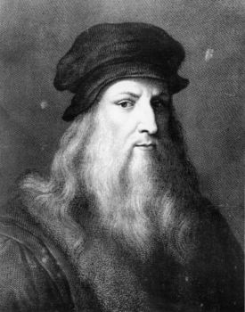
Leonardo da Vinci
__________________________________________________________________________________
Despite being ____________________________, da Vinci did not consider himself a great artist
Many of his greatest accomplishments came from his inventions
Da Vinci ________________________________ _______________________________________________________________________________________________________________

