Slide 1
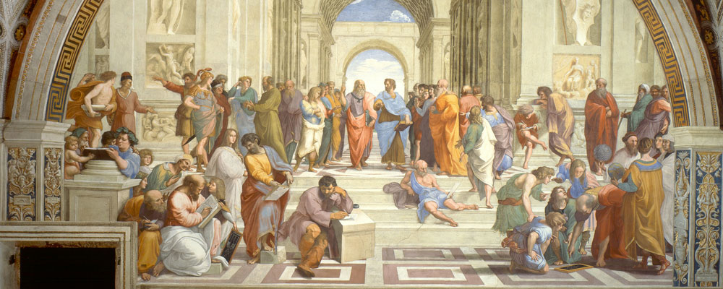
The Italian Renaissance

Slide 2
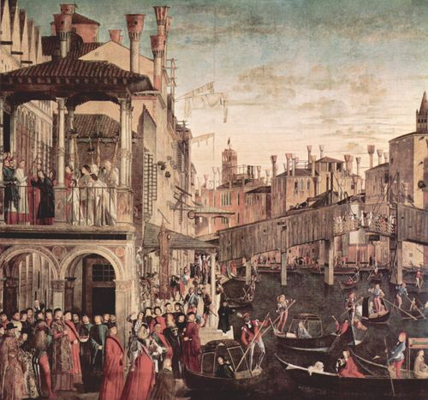
Meaning
What is the Renaissance?
“Rebirth” of classical knowledge
Push to bring back ideas from Ancient Greece and Ancient Rome
New ideas in art, music, literature, philosophy
Began in the early 1400s
A cultural and political
change that greatly
influenced Europe

Slide 3
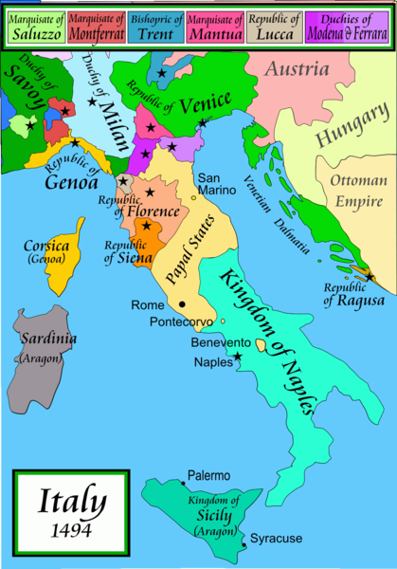
Origins
The Renaissance began in the Italian city-state of Florence and spread throughout Milan and Venice – WHY???
1. Trade – spread ideas and cultures
Florence – major trade city of northern Italy
Milan – located at a major trading
route between the Alps and the
coast
Venice – Link between Asia and
Western Europe

Slide 4
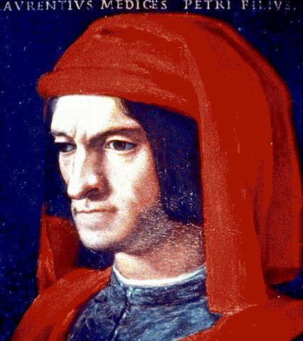
Origins cont…
2. Wealth – rich merchants in the three city-states funded new ideas in art and culture – these rich merchants were called patrons
In Florence, the city was controlled by the Medici family, who were wealthy bankers

Slide 5
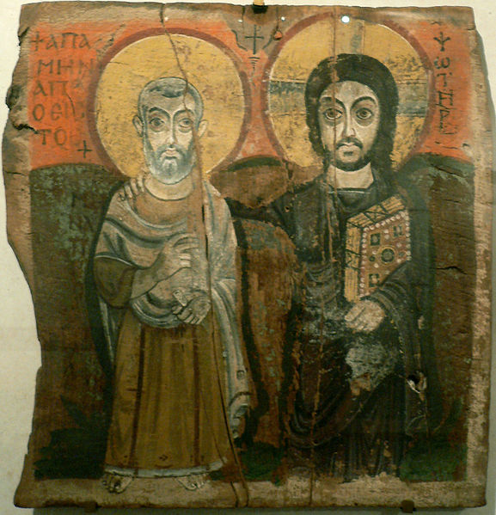
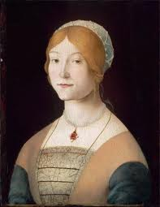
Accomplishments in Art
One of the largest examples of Renaissance influence was in art
While art in the Middle Ages tended to focus strictly on Christian symbols, Renaissance art began to focus more on everyday life
A big reason for this was because the Catholic Church had lost much of its authority and influence

Slide 6
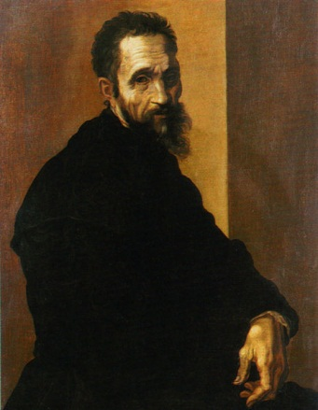
Michelangelo
Michelangelo (1475-1564) was an Italian artist best remembered for his paintings and sculptures
Much of his work was of Christian figures or themes
His two most famous sculptures, Statue of David and The Pieta were
completed before he turned 30
While using many Christian
symbols in his art, he focused
on many realistic themes

Slide 7
Michelangelo’s David
The statue of David was based on the hero from the Bible
David was a popular subject in Florence art, and it came to be a symbol of the Florentine Republic
The statue is the defining icon of Renaissance sculpting

Slide 8
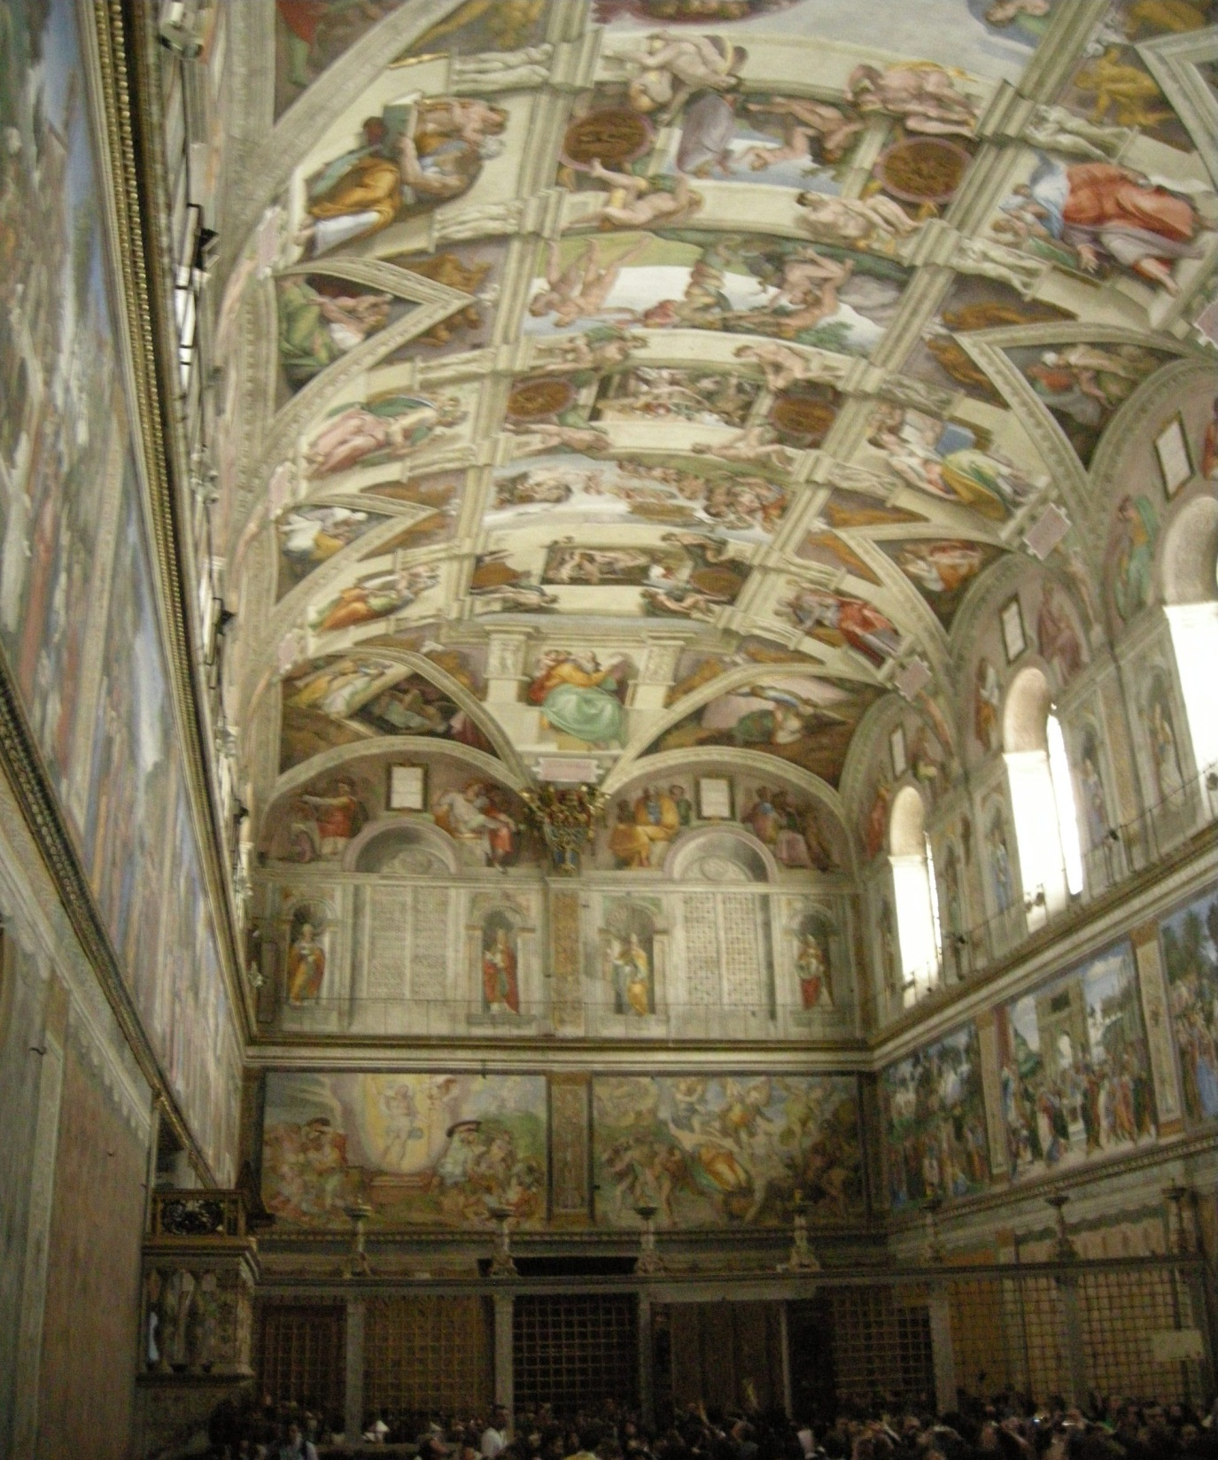
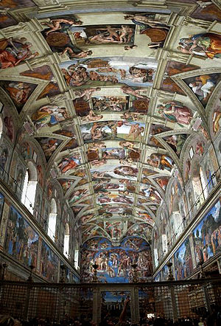
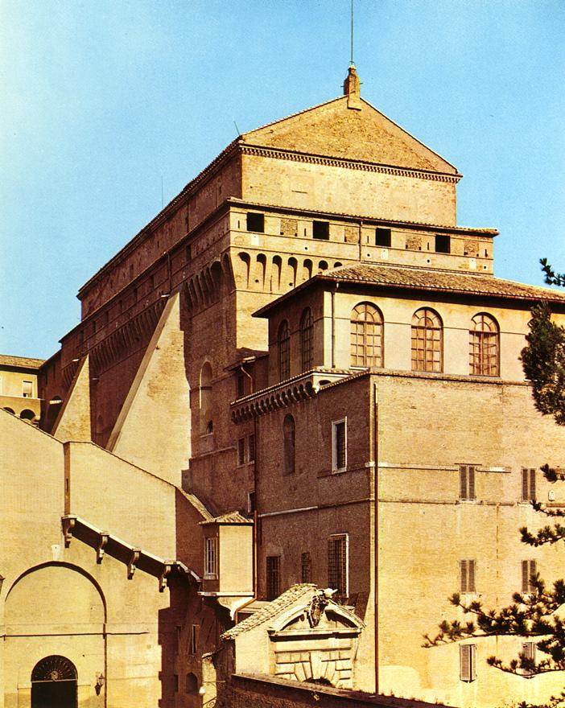
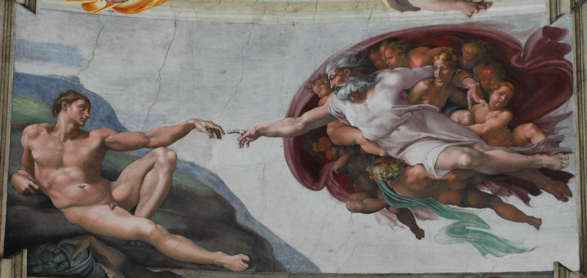
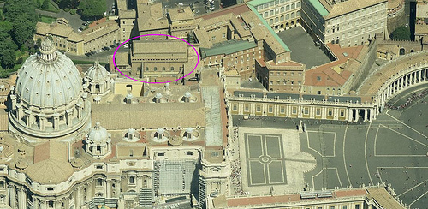
Sistine Chapel

Slide 9
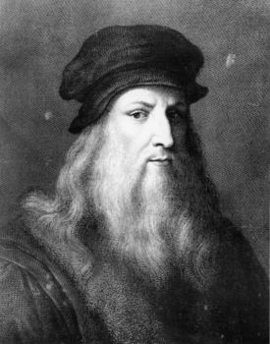
Leonardo da Vinci
Leonardo da Vinci (1452-1519) was an Italian artist, inventor, scientist, and mathematician
Despite being well known for his paintings, da Vinci did not consider himself a great artist
Many of his greatest accomplishments came from his inventions
Da Vinci designed many objects
that would not be built for
hundreds of years

Slide 10
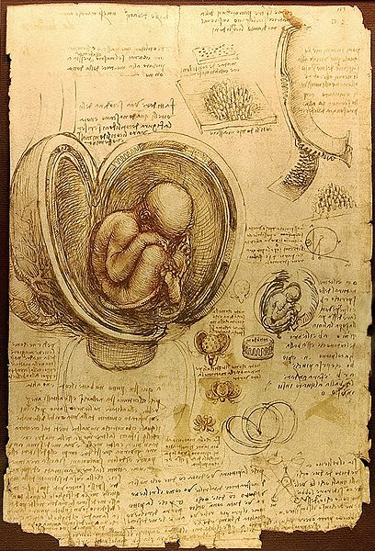
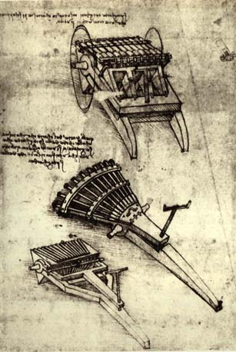
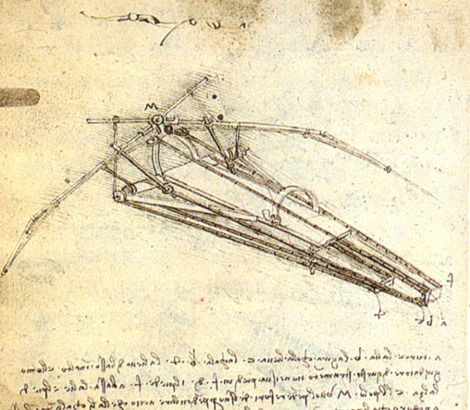
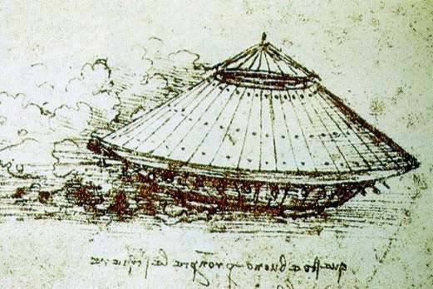
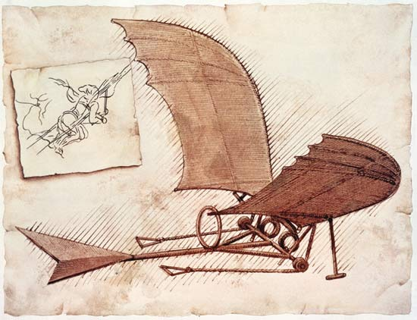
Da Vinci Inventions

