Slide 1
The Rise of Joseph Stalin The Soviet Union Dictator
WHII #35

Slide 2
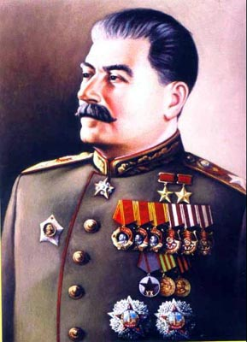
New Communist Soviet Leader
January 1924 V. Lenin dies at age 53.
Amidst the struggle for power emerges the new Soviet leader Joseph Stalin (“man of steel”).
He strengthened his grip on
power throughout the USSR
and made it a totalitarian
state.
Totalitarianism is when one dictator controls all aspects of life and government in their country.

Slide 3
Stalin’s Economics
Stalin goal is to return the Soviet Union to “true” communism by bringing all economic activity under the control of the government (him).
Stalin very quickly puts in place his Five-Year Plan:
He sets very high production goals and under his rule transportation, large industry, and overall production did improve.
However, the workers had little to show for their hard work as nearly all money and goods went to the state.

Slide 4
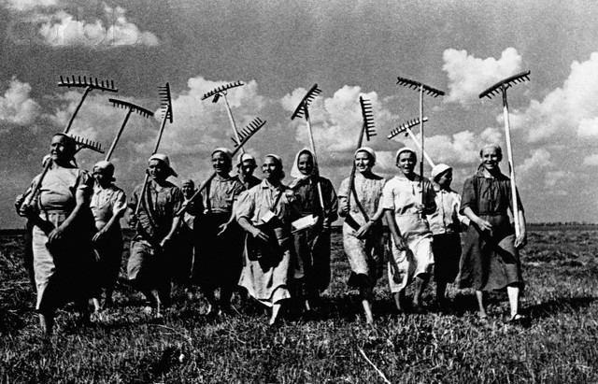
Collectivization
Agriculture also came under the control of the government by Stalin’s orders.
Under Lenin and the NEP small farmers could keep their land, but now under Stalin they had to work for and turn over all land, animals, and tools to collective farms.
A collective farm is a large farm that combined many smaller plots of land into one big state-owned farm.
Workers resisted collectivization with revolts and intentionally low production. Stalin and government responded by starving them to death; 12+ million died.

Slide 5
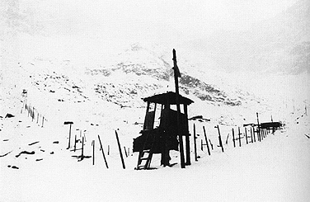
Soviet Citizens Suffer under Stalin
He created a division of Secret Police, later known as the KGB
They were loyal only to Stalin himself and he used them to instill fear in the population.
The secret police enforced all of Stalin’s worst ambitions; they directed censorship and encouraged citizens to spy on one another.
Any person thought to be disloyal was sent to forced labor camps in Siberia called gulags or were
simply executed.

Slide 6
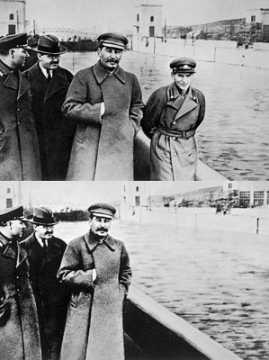
Soviet Citizens Suffer under Stalin
The Great Purges –
Stalin was always fearful of a overthrow so he and his secret police rooted out all “conspirators.” He had many artists, intellectuals, military leaders, etc. rounded up and sent to the gulags or killed.
There are a recorded 4 million people purged under Stalin, but it is believed that the number is much higher.

