Slide 1
Protestant Reformation
WH II #3

Slide 2
The Protestant Reformation
Let’s first examine what Protestant Reformation means… what’s your guess?
________ant = protest, to publically declare.
Protestant = new religious direction, contemporary denominations include _________________, Presbyterian, Quaker, Lutheran, etc.
_________ation = process of change, improvement.
__________________________=
Attempt to alter or improve religious beliefs by going against the old way.

Slide 3
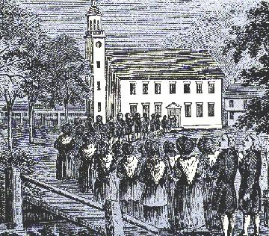
The Protestant Reformation
Who ruled the world of religion at this point?
The ____________________________________:
Nobles on the periphery of the Roman Catholic Church began to ____________________________________ ___________
English and German nobles grew tired of _________ ________________________
> “Instead of saving the souls of the dead and sending them to Heaven, they gorge themselves at banquets after funerals.”

Slide 4
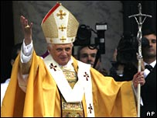
Church Abuses
________were very interested in politics and having political power; this led to ___________________ ________. They used their high ranking positions for self gain instead of helping others.
Popes lived lavish lifestyles; to pay for this they increased fees for services and started promoting the ______________________
_______________________________ _______________________________
Many _____________urged for a return to the simple ways of the early Church.

Slide 5
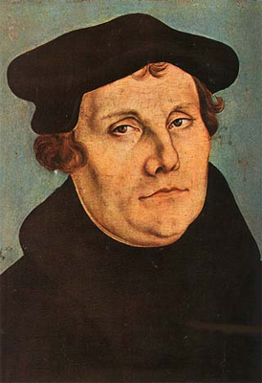
_________________
___________priest and professor of theology led the _____________ ___________________________.
Luther’s fundamental beliefs:
______________________________
__________________________________
not the Pope’s interpretation of faith.
___________________________________ (Individualism).

Slide 6
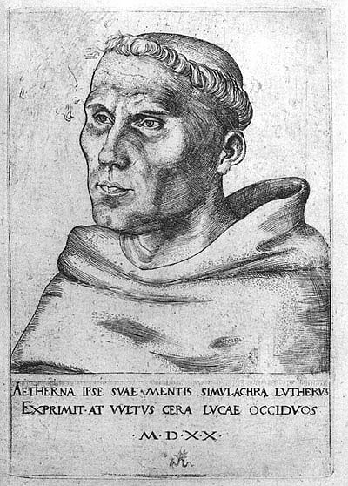
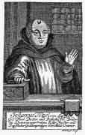
Turning Points for Luther
Early in life, Martin Luther was studying to be a lawyer. As he rode from home to university one evening during a thunderstorm a _______ ____________________________________.
He yelled out in fear, ____________________ ________And he honored that vow for the rest of his life.
1517 – a priest in Luther’s home town, _________________ ____________to help pay for the rebuilding of St. Peter’s Cathedral in Rome.
______________________________________ _______________________________

Slide 7
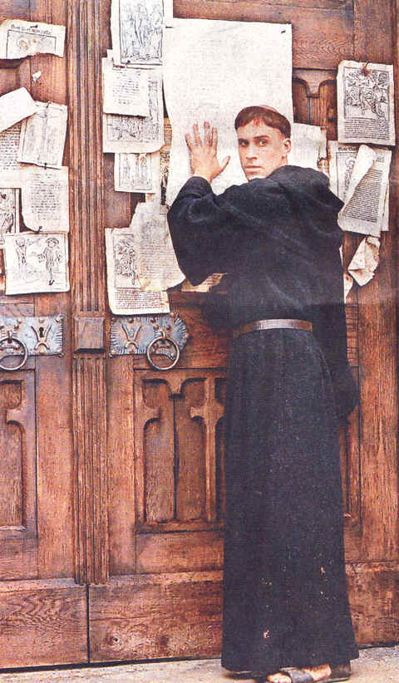
More on Luther…
Wrote the _______________~
(1517) Paper including 95 issues with the Church.
He nailed them to the Church’s doors.
Thought that all children should learn to read the Bible. ________________________ ______________Vernacular.
Emphasized the sermon not Mass.

Slide 8
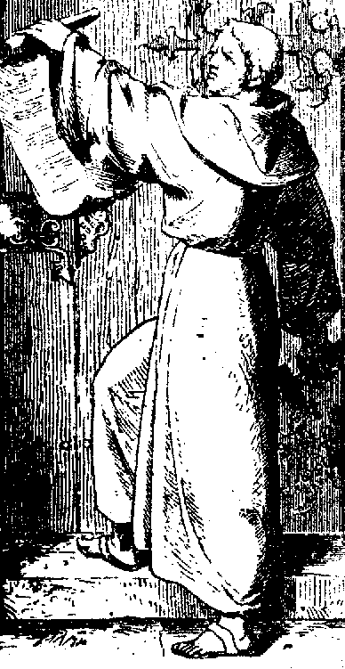
More on Luther…
Due to his radical ideas and his refusal to ________ the _______
______________________ and declared him an outlaw.
By 1530 his following had spread from Northern Germany.
They called themselves ___________ and started the “Protestant Reformation” – those who _________________ _________________________.

Slide 9
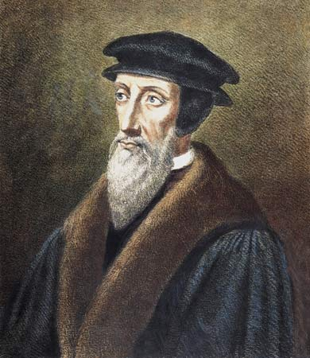
John Calvin
____________priest and lawyer.
Like Luther, believed you could _________________ __________________________________________ ___________
Published the “Institutes of Christian Religion”- offered advice on how to run a Protestant Church.
Led a community in Geneva, Switzerland.
___________________________, thrift, honesty, and morality.
Banned fighting, swearing, laughing in church, and dancing.
Model community; utopia.

Slide 10
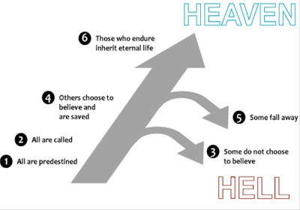
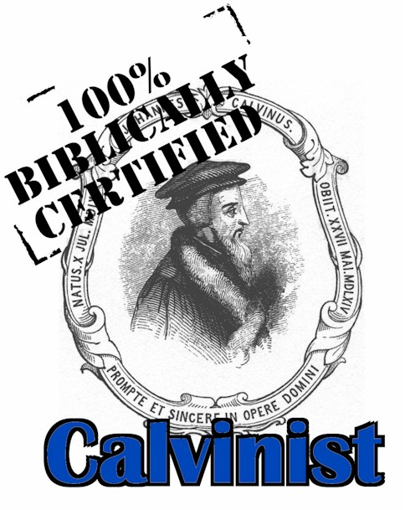
Calvinism…
___________________ ~
________________________________.
Believed that we all ________________.
Your faith could only be revealed by living a _____________________ _________.
Calvinism helped _______ ______________________ throughout Europe.

Slide 11
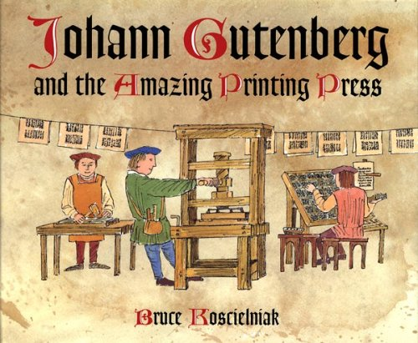
The Spread on Info & Education
_________________________________________
It allowed Bibles to be printed _______________ ____________ and made them faster, easier, and cheaper which ___________________________ ____________.
The Church could not burn them all.
Helped ____________ _________________ ____________.

