Slide 1
The Holocaust
WHII #41

Slide 2
Background Information
The Holocaust – the mass, execution of over 6 million European Jews, and an additional 6 million Romani (gypsies), disabled, homosexual, and other people by the Nazis
This is an example of genocide – the systematic and purposeful destruction of a racial, political, religious, or cultural group
Though Jews had been persecuted by the Nazis since Hitler’s rise to power, the executions did not begin until 1941

Slide 3
History of Anti-Semitism
Jews had been persecuted throughout history
They were originally kicked out of their homeland (Israel) by the Romans nearly 2,000 years ago and were forced to migrate into Europe
Jews tended to find jobs working in banks or in the economy, which led to the stereotypical view of them always controlling money

Slide 4
Anti-Semitism Under Hitler
When Hitler rose to power in Germany, he immediately began blaming Jews for the economic depression and the defeat in WWI
Jews were blamed for destroying the economy, which led to the defeat in WWI and the depression in Germany afterwards
Hitler promoted his idea of the “master race”, anyone of Aryan decent
Jews did not fit his description of the master race, and were thus persecuted even further

Slide 5
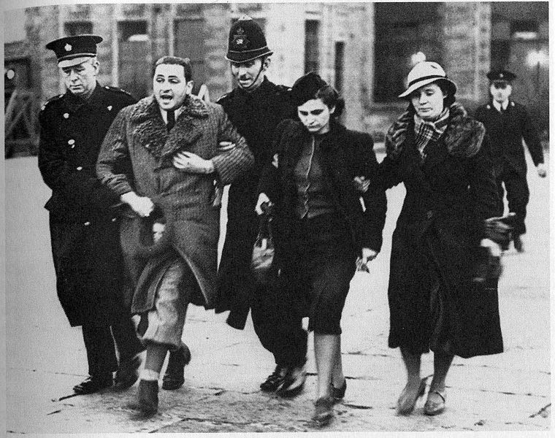
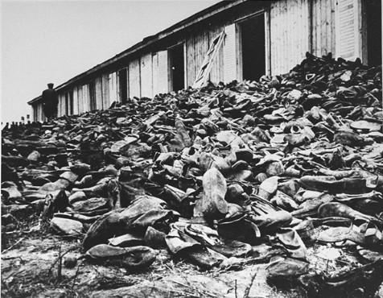
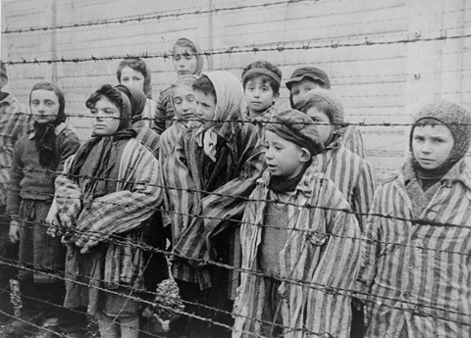
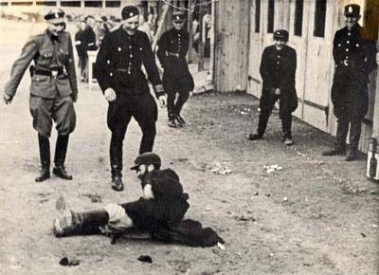

Slide 6
More Anti-Semitism Under Hitler
I ask nothing of the Jews except that they should disappear.
While rebuilding his military, Hitler needed a strong work force who would work for little (or no) pay
Hitler turned to the Jews, forcing them to work in concentration camps under the guard of Nazi soldiers
As the country grew strong, Hitler started to realize he didn’t need the Jews anymore, and thus began to enforce his Final Solution – the extermination of the “Jewish Problem” in Europe by executing all Jews

Slide 7
Execution Camps
Instead of being shipped to work camps, Jews began being moved to execution camps, where they would work until they would be put into gas chambers and murdered
When these camps were eventually liberated by the Allies, the world was shocked at what had occurred

Slide 8
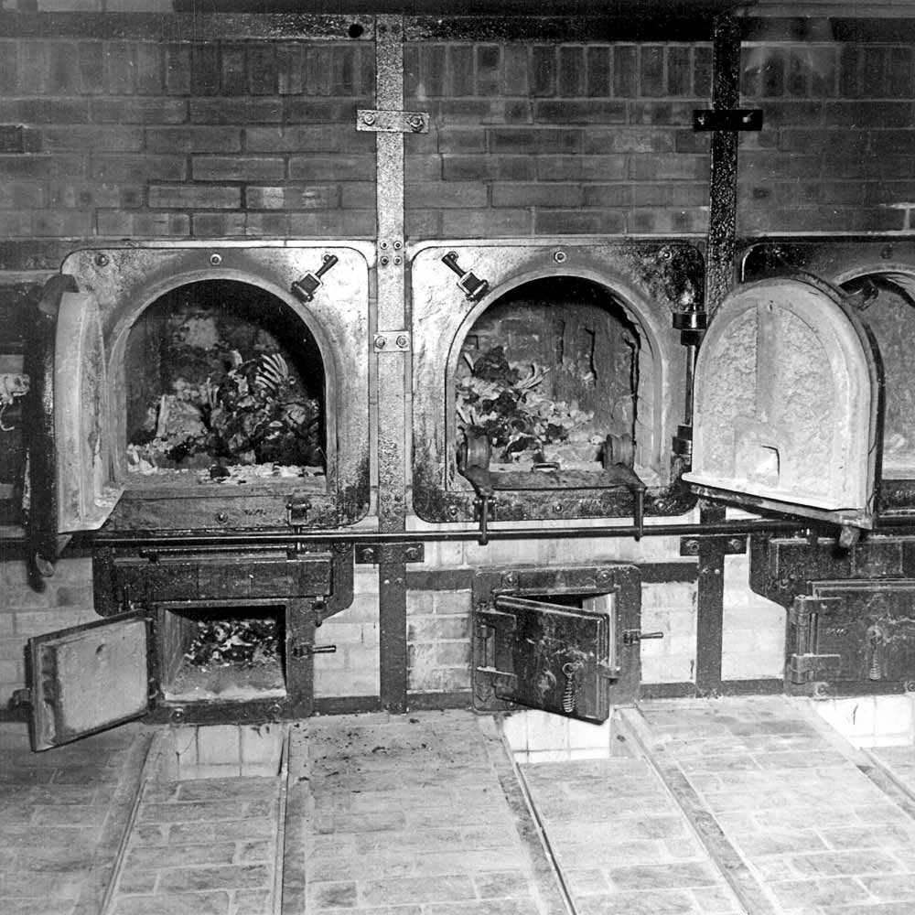
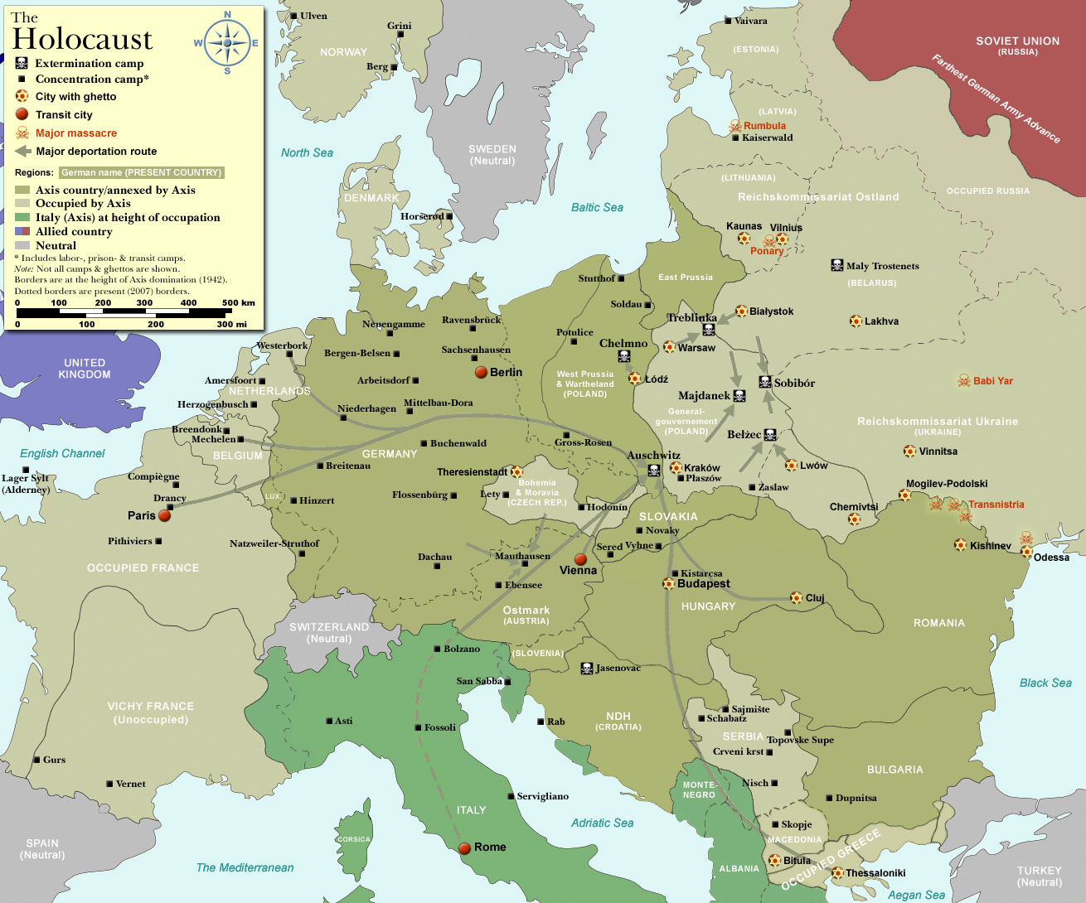
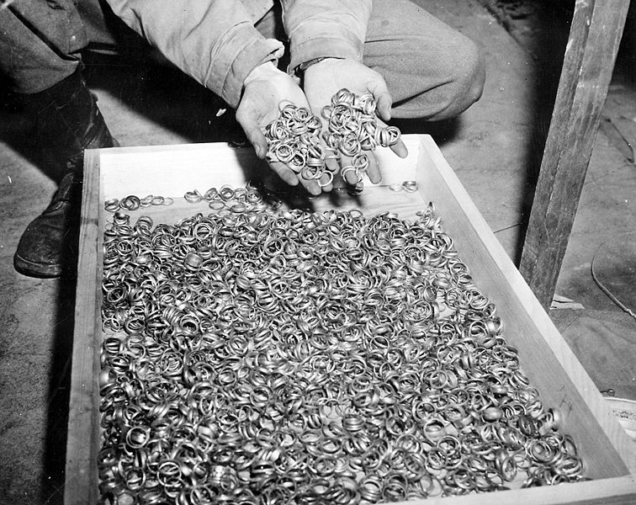
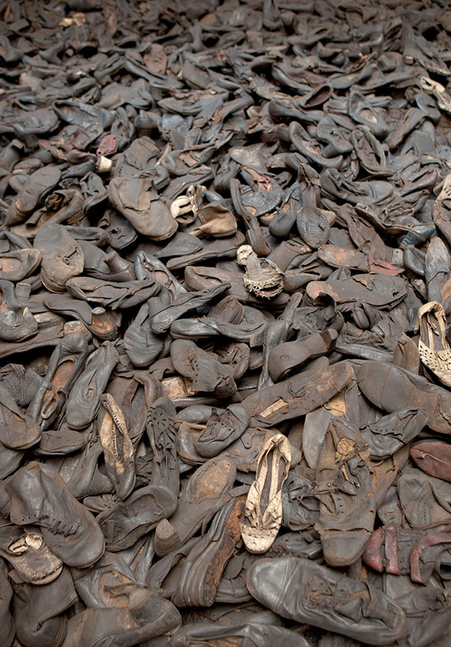
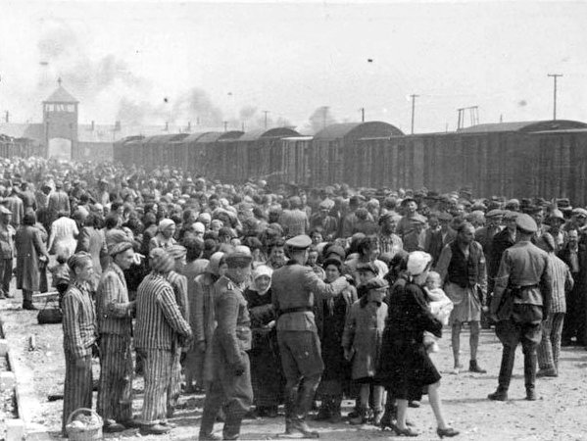
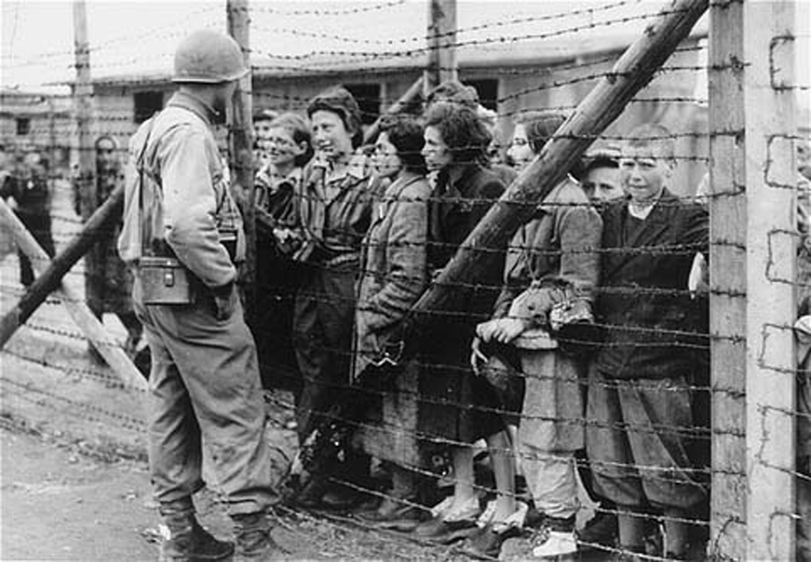
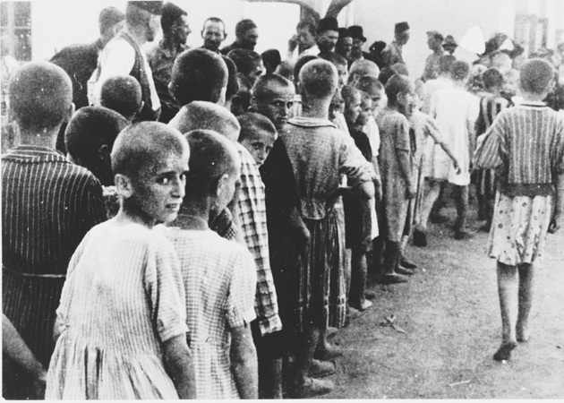
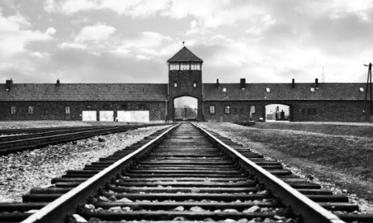
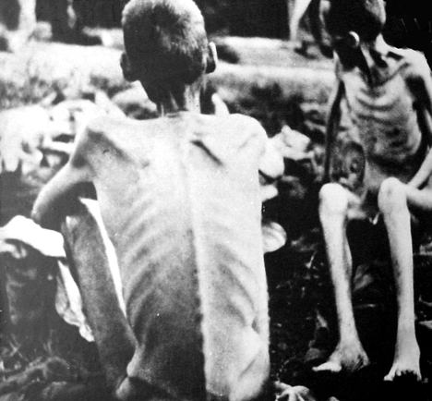
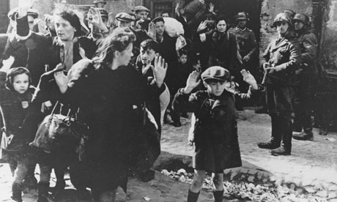

Slide 9
Nuremberg Trials
After WWII, 22 Nazi leaders were brought to trial in front of a War Crimes Tribunal in Nuremberg, Germany for “crimes against humanity.”
12 of the leaders were sentenced to death (later more Nazis would be tried for their roles as well).
These trials showed made public the atrocities of the holocaust and showed that individuals were responsible for their actions even if they were given orders by superior officers.

