Slide 1
The Cold War 1945-1989
WHII #42

Slide 2
The Cold War
A period of great tension and conflict after WWII between the United States and the Soviet Union
After WWII, the U.S. and the Soviet Union are the two Super Powers of the world
Known as the Cold War because the U.S. and Soviet Union never engage in direct combat against one another, despite the fact that they are enemies
Instead, they will fight proxy wars against one another – war is initiated by one of the Powers but both Powers will not fight in it
Example – the Vietnam War

Slide 3
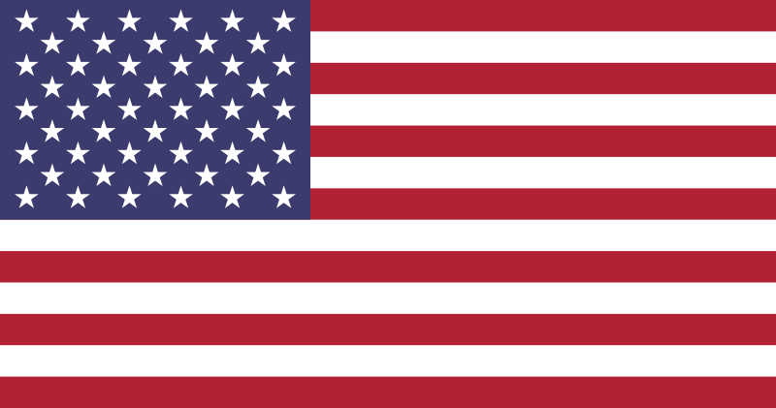
Ideologies
The U.S. and the Soviet Union represent vastly different fundamental values
United States Soviet Union
Democratic Government Totalitarian Government
Capitalist Economy Communist Economy
Contain Communism Spread Communism

Slide 4
Pre-Cold War
The Yalta Conference (Feb., 1945)
Meeting between the “Big Three” leaders of the Allied Powers – Churchill, FDR, and Stalin
Accomplished Three Important Decisions:
Europe will be split in half – Western half would be democratic and the Eastern half would be under the rule of the Soviet Union
Germany and Berlin will be split into 4 zones – Western half will be controlled by U.S., Britain, and France and known as West Germany (Federal Republic of Germany) and Eastern half will be controlled by the USSR and known as East Germany (German Democratic Republic)

Slide 5
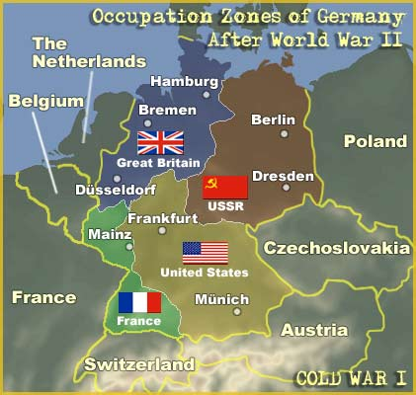
Germany After WWII

Slide 6
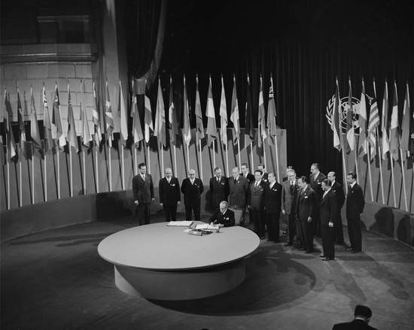
Pre-Cold War
3. Creation of the United Nations (UN)
Started by around 50 nations in order to keep peace in the world
Will be much more powerful than the former League of Nations because it will have soldiers to enforce its laws and rules
“The United Nations is designed to make possible lasting freedom and independence for all its members.” — Harry S. Truman

Slide 7
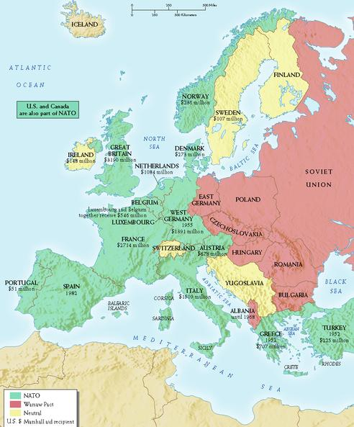
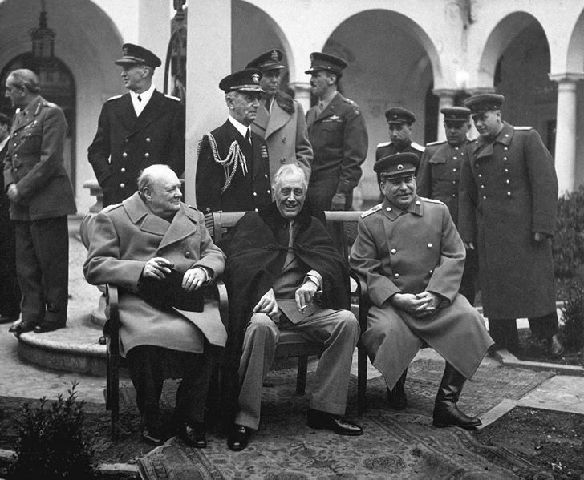

Slide 8
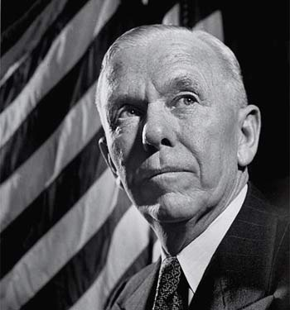
Rebuilding
After WWII, Europe is left in ruins
U.S. implements the Marshall Plan to rebuild Western Europe – named after U.S. Secretary of State, George C. Marshall
The Marshall Plan provides massive amounts of financial aid to rebuild European economies
In the Pacific, the U.S.
occupies Japan to oversee the
rebuilding of the country
Japan will eventually adopt a
democratic form of gov’t and
is one of our strongest allies

Slide 9
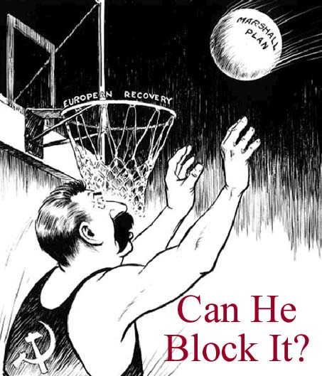
Many believed that Stalin would attempt to block the Marshall Plan so that the demolished countries would adopt Communism

Slide 10
The Iron Curtain
The division in Europe, both geographically and politically, becomes known as the Iron Curtain
The Iron Curtain refers to the separation of the Western democratic countries and the Soviet controlled/Communist countries
Churchill gives a speech condemning the Soviet Union and coins the term “Iron Curtain,” which worsens tensions between the USSR and the U.S.
Iron Curtain becomes the physical and symbolic boundary between the Democratic Western Europe and the Communist Eastern Europe
Eastern European countries that are “controlled” by the USSR become known as satellite states

Slide 11
