Slide 1
The Cold War 1945-1989 Part #2
WHII #43

Slide 2
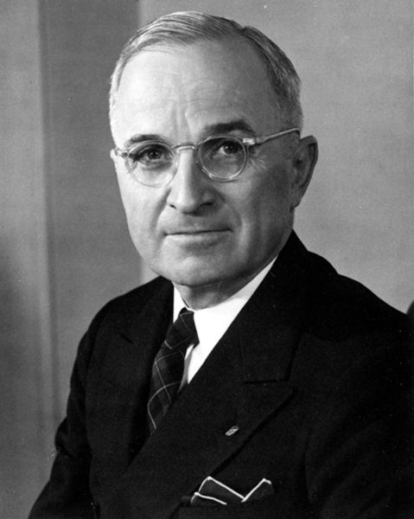
Truman Doctrine
Once it became clear that the U.S. was going to oppose the expansion of Communism, Truman signs the document that would come do symbolize U.S. foreign policy throughout the entire Cold War – The Truman Doctrine
The goal of the Truman Doctrine
is the policy of containment,
U.S. will try to contain the spread
of Communism
In addition, the U.S. will aid any
foreign gov’t that resists having
Communism in its country

Slide 3
Alliances
North Atlantic Treaty Organization (NATO)
Signed in 1949 to combat the spread of Soviet influence in Europe – stated that an attack against any one of its members was considered an attack against all
Original members were the U.S., Britain, France, Belgium, Canada, West Germany, Netherlands, Italy, Norway, and Denmark
The Warsaw Pact
Created in response to NATO and was a mutual defense treaty, just like NATO
Included the USSR, Poland, Czechoslovakia, East Germany, Bulgaria, Romania, and Hungary

Slide 4
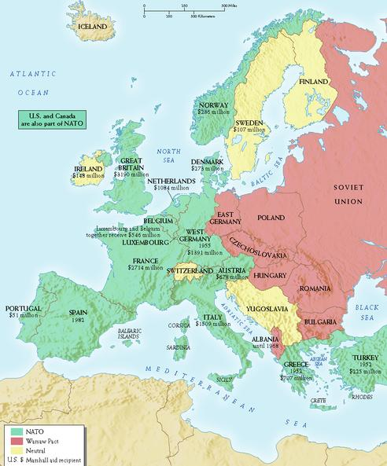
NATO countries are West of the Iron Curtain and are in Green
Warsaw Pact countries are East of the Iron Curtain and are in Red
Neutral countries are in Yellow
Yugoslovia, despite being Communist, is Neutral

Slide 5
Hydrogen Bomb
In 1950, Truman orders the construction of the world’s first Hydrogen Bomb, which proves to be 100 times more powerful than the atomic bomb

Slide 6
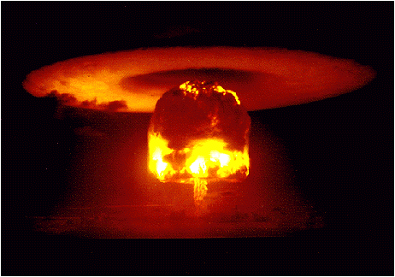
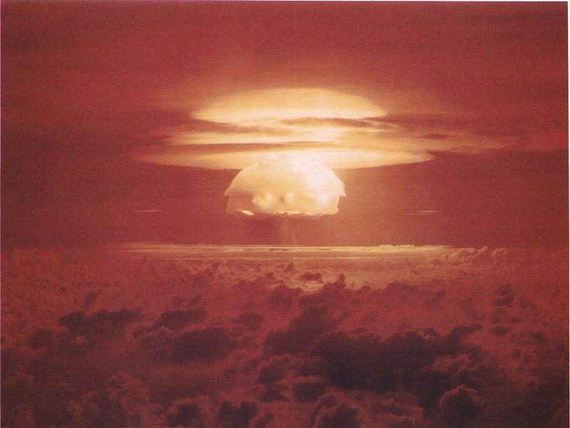
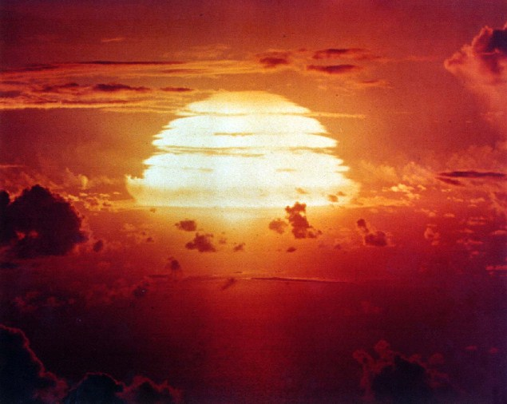
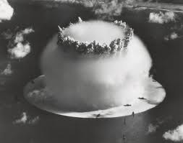
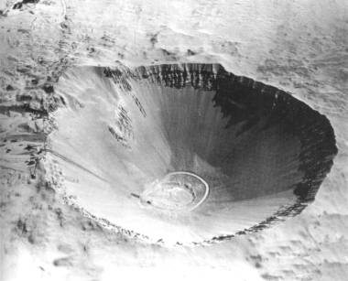
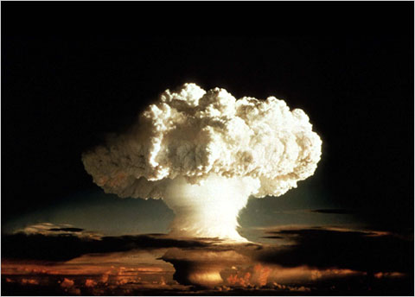
Hydrogen Bomb Explosions
Castle Bravo – the largest nuclear weapon to be tested in the United States

Slide 7
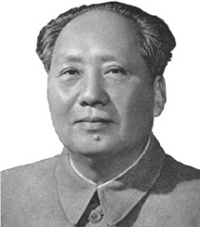
China
Shortly after WWII, a civil war in China resulted in the country breaking into two parts
Mao Zedong is the new dictator of Communist China and the newly formed People’s Republic of China (PRC)
Chiang Kai-shek is the leader of nationalist China, which becomes Taiwan
Despite both being Communist,
tensions rise between China and
the USSR over territory and
influence and they will not be
allies during the Cold War

Slide 8
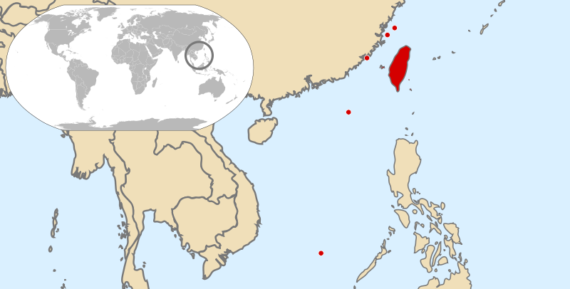
China Taiwan

Slide 9
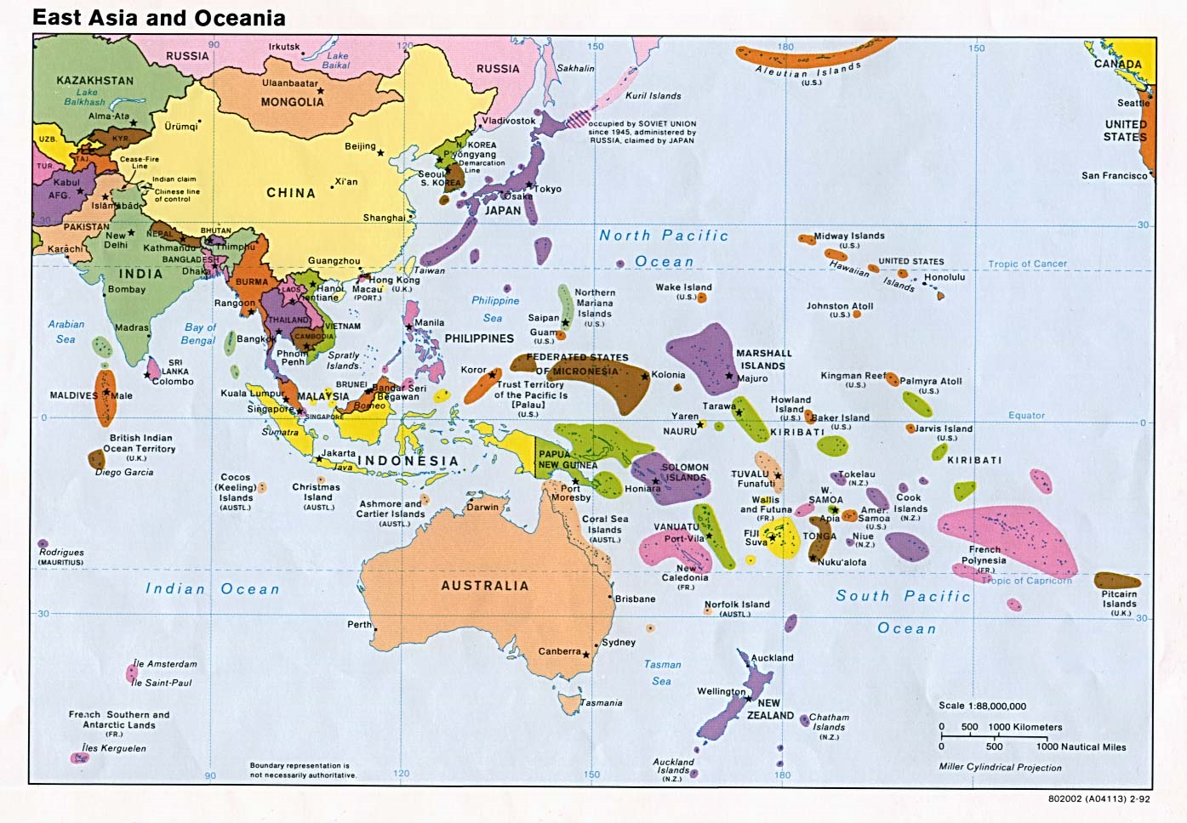

Slide 10
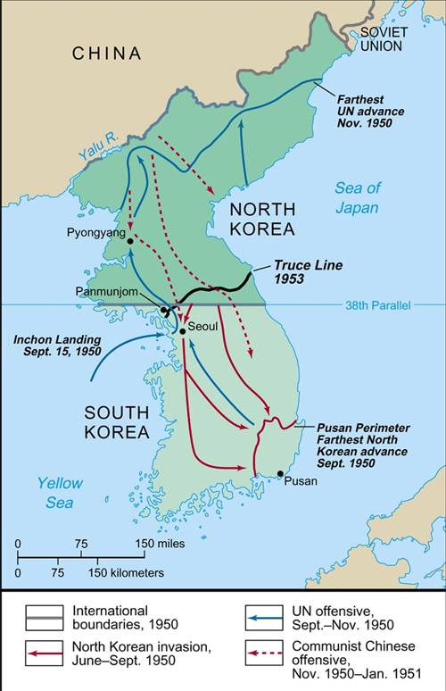
Korean War (1950-1953)
By September 1950, N. Korean forces had nearly overrun all of South Korea.
The U.S., led by Douglas MacArthur, lands in South Korea at Inchon, south of the 38th Parallel and quickly turns the tide of the war.
It’s not long after U.S. intervention
that China comes to the aid of North
Korea in October and pushes U.S.
forces back
A stalemate occurs for the next two
years until an armistice (cease-fire) is
agreed upon in 1953
N. Korea remains Communist
In this case, containment succeeded

Slide 11
Korean War

Slide 12
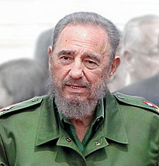
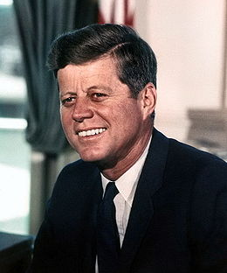
Cuban Missile Crisis
Cuba became Communist in the late 1950s when a man named Fidel Castro led a revolution to overthrow the government
Does not take long before the USSR takes interest
President John F. Kennedy places an embargo on Cuba in 1962 – no trade and no travel, attempts to overthrow Castro in the Bay of Pigs
invasion, which massively fails
The biggest concern that the U.S.
has is that the USSR will try and
place nuclear missiles in Cuba,
which is only 90 miles south of
Florida

Slide 13
Cuba

Slide 14
Cuban Missile Crisis
In 1962, a U2 spy plane discovers evidence of Soviet nuclear missiles in Cuba – Kennedy orders the Soviets to remove them
Kennedy orders a naval blockade of Cuba, allowing for no ships to come in or out
Soviet ships approach Cuba but are met by U.S. ships blocking the harbors
Tensions are mounting and the world is on the brink of nuclear war – Kennedy calls up the army reserves to prepare for a possible war
After several days, the Soviet Union leader Nikita Khrushchev removes the missiles and leaves Cuba
This was the closest the world has ever been to a nuclear war

Slide 15
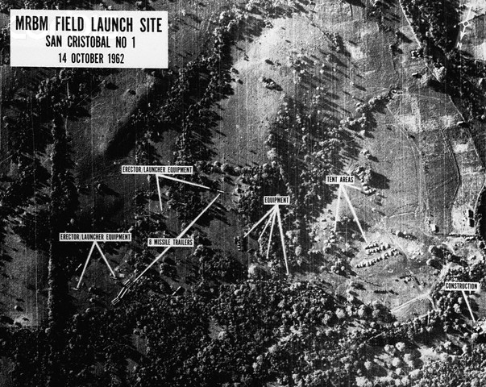
Missile Sites

