Slide 1
Miscellaneous Information
WHII #46

Slide 2
20th Century Genocide
Genocide – The systematic and purposeful destruction of a racial, political, or cultural group
Examples of genocide:
1915-1918 Armenians slaughtered by the Ottomans
Around 2 million Christian Armenians killed
1930s – Stalin kills peasants and military officials
Stalin’s collective farms result in the death of 8 million Ukraine citizens from starvation
Millions of other peasants and military officials are murdered or sent to the gulags
1975-1979 – Pol Pot in Cambodia
Over 2 million Cambodians are killed under the Communist regime known as the Khmer Rouge
Pol Pot murdered anyone deemed as a threat

Slide 3
Armenian Genocide

Slide 4
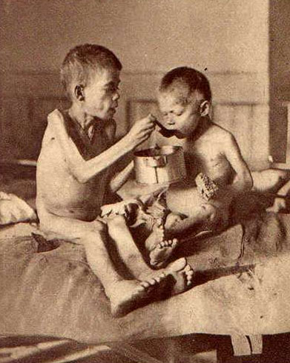
Soviet Union Genocide

Slide 5
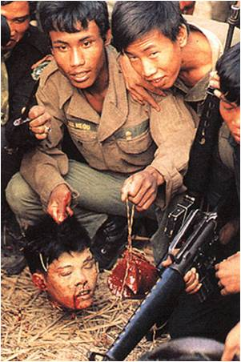
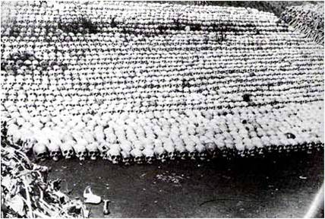
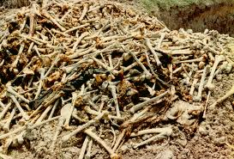
Cambodia Genocide

Slide 6
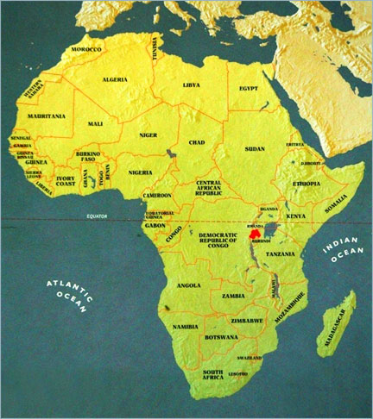
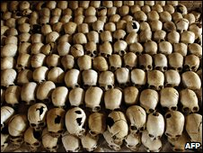
Rwandan Genocide
The small African country of Rwanda was established by the Belgians during colonization
Two different groups of people occupy the country – the Hutu and Tutsi
The Hutus are the majority ethnic group and murdered about 1 million Tutsis during a span of 100 days in the summer of 1994

Slide 7
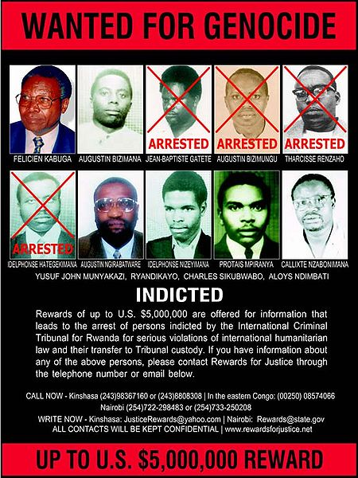
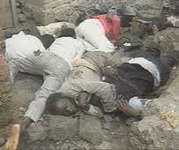
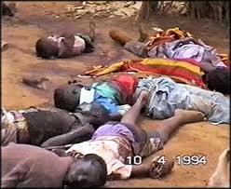
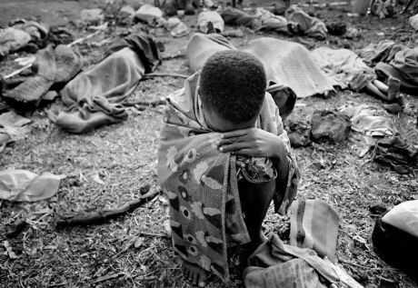
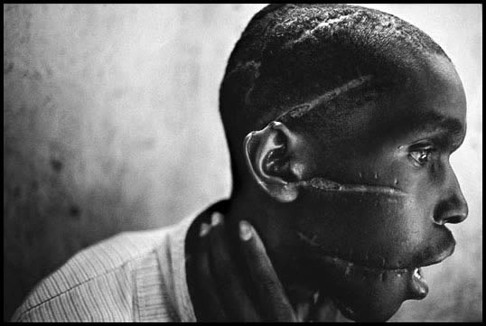
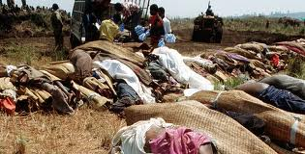

Slide 8
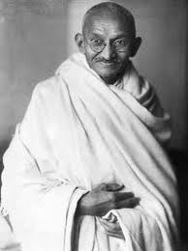
Independence in India
After years of British rule, India began a strong campaign of independence in the early 20th century
Mohandas Gandhi and the Indian National Congress put pressure on Britain through civil disobedience and passive resistance (nonviolent protest)
In 1947, Britain finally relinquished
its hold on India, leading to the
newly formed Republic of India
The Partition of India in 1947 broke
the country apart between Hindus
and Muslims and formed Pakistan

Slide 9
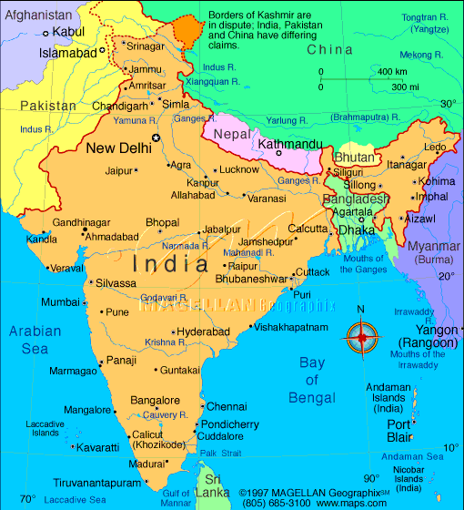
Partition of India
India 1946
Pakistan and East Pakistan (now Bangladesh) were formed out of the partition

Slide 10
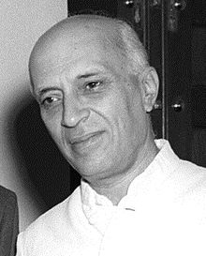
Independence in India
Jawaharlal Nehru became the first Prime Minister of India in 1947
He was a strong supporter of Western-style industrialization
In 1950 he sought to prohibit
the caste system from
continuing in India
Though religious differences
caused problems, India slowly
developed into the largest
democratic nation in the world

Slide 11
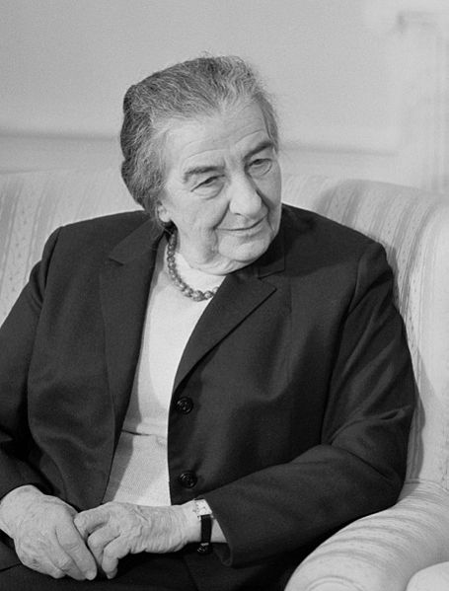
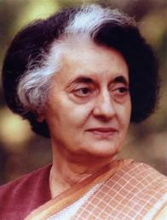
The Cold War in the Middle East and Asia
Indira Gandhi became the first and only female prime minister of India in 1966
She established a good relationship with the USSR and developed India’s nuclear program – She was assassinated in 1984 due to religious conflicts
Golda Meir became the first
female prime minister of Israel
in 1969
She led Israel to victory in the
Yom Kippur War and sought
support from the U.S

Slide 12
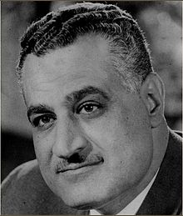
The Cold War in the Middle East and Asia
Gamal Abdul Nasser became President of Egypt 1956 and established a close relationship with the USSR
He immediately nationalized the Suez Canal, granted total control of it to Egypt
He also built the Aswan High Dam, which allowed Egypt to control flooding,
irrigation, and generate
hydro-electricity in the Nile River
Valley

Slide 13
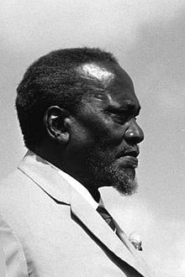
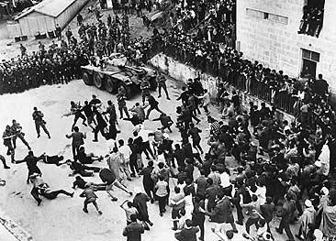
African Independence Movements
After WWII – peaceful transition of West African independence
1962 – Algeria wins independence from France after several years of war
1963 – Under the leadership of Jomo Kenyatta, Kenya wins its independence from Britain

Slide 14
Algeria
West Africa
Kenya
South Africa

Slide 15
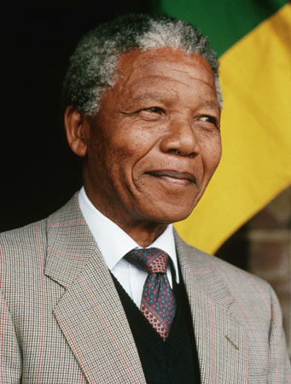
Apartheid in South Africa
Apartheid – meaning “apartness” or “separateness,” this was the policy of forced segregation in South Africa from 1950-1994
The white minority (known as Afrikaners) greatly limited the political power and freedom of the native black Africans
After serving 27 years in prison,
Nelson Mandela was released in
1990 and worked to end apartheid
He was voted the first black
president of South Africa in 1994

Slide 16
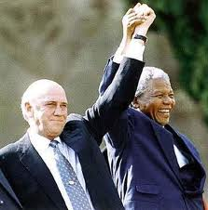
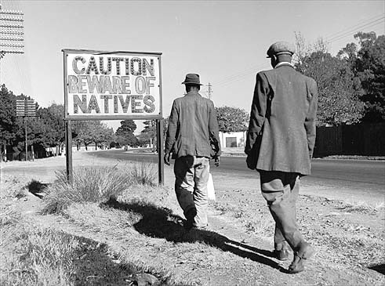
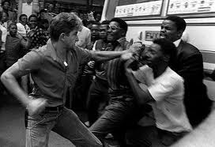

Slide 17
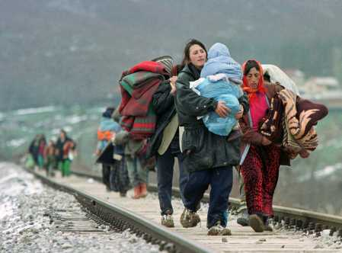
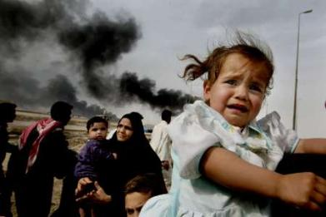
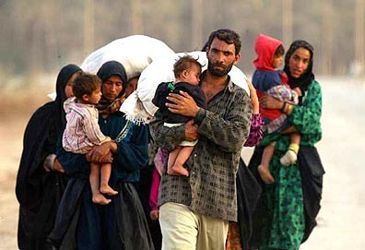
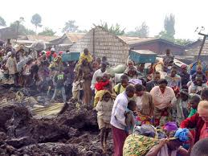
Worldwide Tension Issues
Refugees – people forced to leave their homeland due to ethnic or religious persecution
Due to many worldwide issues during the 1990s, around 40 million people became refugees
Most of the refugees attempt to flee to safer areas such as the United States or Europe
Guest Worker programs in
Europe allow refugees to
temporarily live and work
within European nations
Tensions often arise when
the refugees expect to stay
and the natives expect them to leave

Slide 18
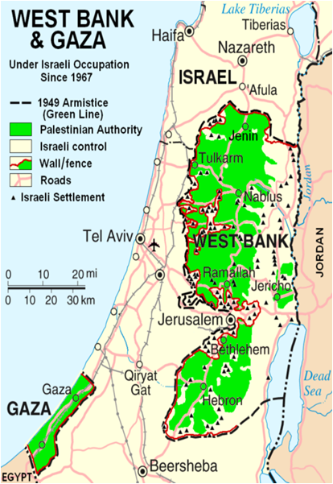
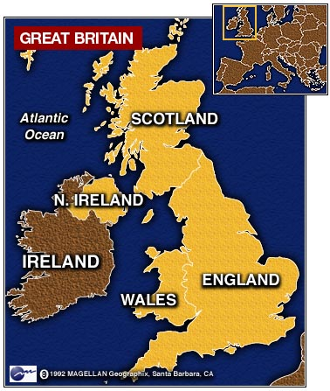
World Tension Issues
Arab-Israel Conflict – continual
battle between Jews and Muslims
in the region called Palestine
Conflict has been going on since
the founding of Israel in 1948
Northern Ireland – battle over religion between Protestants in Northern Ireland and the Catholics in the Republic of Ireland, also fought against Britain over independence

Slide 19
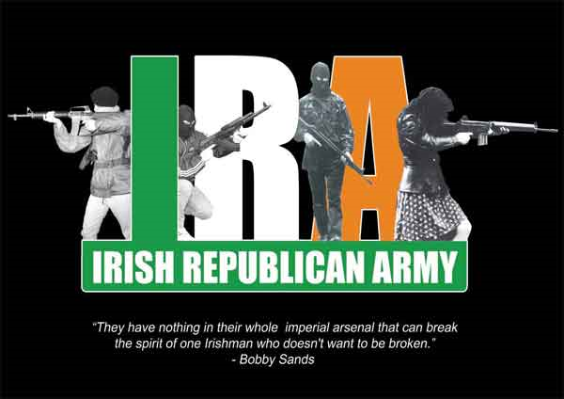
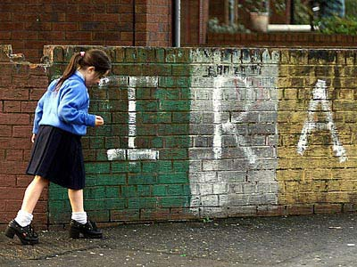
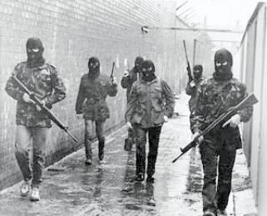
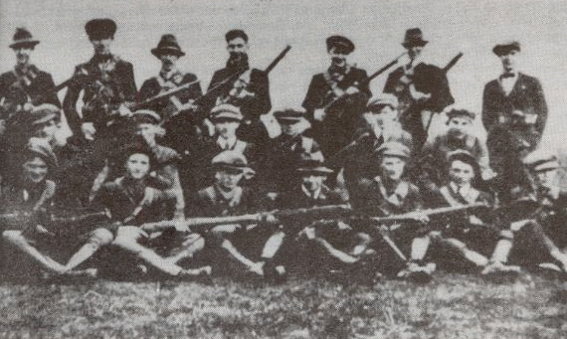
Irish Republican Army

Slide 20
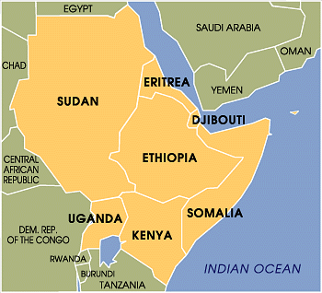
World Tension Issues
Horn of Africa – differences
between religion and ethnicity,
in addition to poverty, has caused
much tension between these
countries – Somalia, Sudan, Ethiopia, Uganda, Kenya, Djibouti, and Eritrea
South Asia – extreme religious and
territorial disputes between India
and Pakistan are among the worst
in the world today

Slide 21
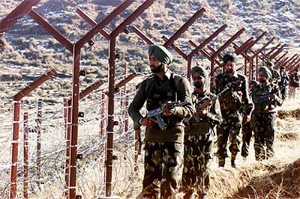
Indian/Pakistani Border

Slide 22
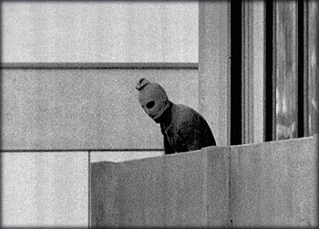
Munich Olympics
During the 1972 summer Olympics in Munich, West Germany, the Islamic terrorist group known as Black September kidnapped and murdered 11 athletes and coaches from the Israeli Olympic team
This event was one of the worst terrorist acts in modern history

