Slide 1
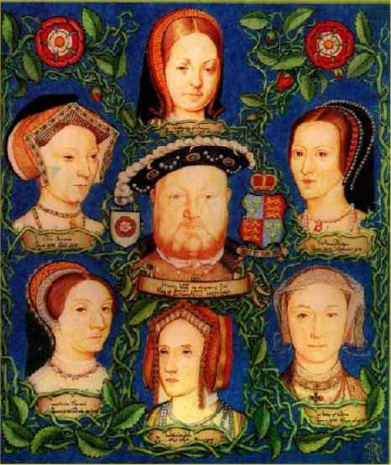
Henry VIII and The English Reformation

Slide 2
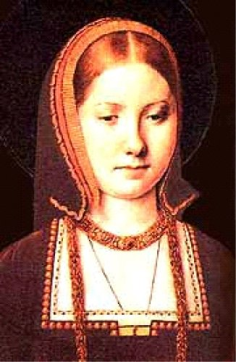
English Reformation
The ______________________________________ ________________________
Henry was given the title “___________________” by the Pope because of a pamphlet that he wrote against Martin Luther and his teachings
He ______________________________________ _______________ after 17 years because she had produced him _________________, however…
______________________________________________________________________________________________________________________
(annul ~ to cancel a marriage, or make void).

Slide 3
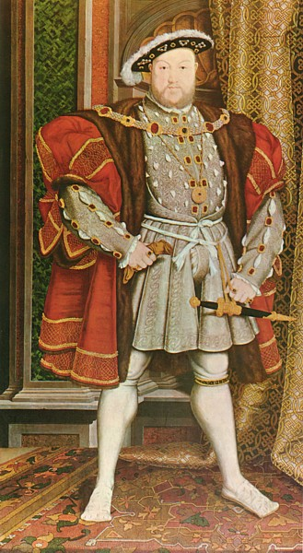
Henry VIII
Called for a _____________________________________ and created his own, the _____________________. He banned the Catholic Church in England.
________________made him “the only supreme head on Earth of the Church of England.”
Many __________________ ________________________ and refused to acknowledge the Act _______________________ _________(including Sir Thomas More, his old teacher and advisor).

Slide 4
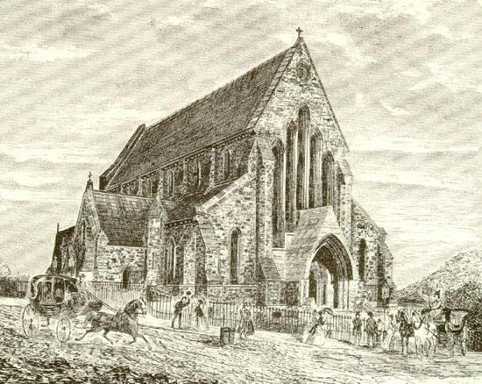
Anglican Church (aka – Church of England)
________________________________________
Very similar to Catholic Church in ____________, _______________, and other religious duties
___________________________________of the Roman Catholic Church in England and
_______________________________________________________________________________________________________.

Slide 5
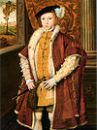
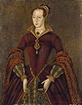
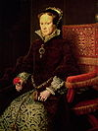
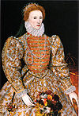
Henry and his kids… (Tudor Dynasty)
Henry dies and his only son…
Edward VI (P) takes the crown (age 10) for 5 years. Before he dies he names…
Lady Jane Grey his heir, but few consider her a true monarch (9 days).
(Bloody) Mary (C) gains power and support and takes the crown from Jane (executed age 16).
After Mary I rules for 5 years and dies…
Elizabeth I (P) becomes Queen of England and rules for 45 years (The Virgin Queen).

Slide 6
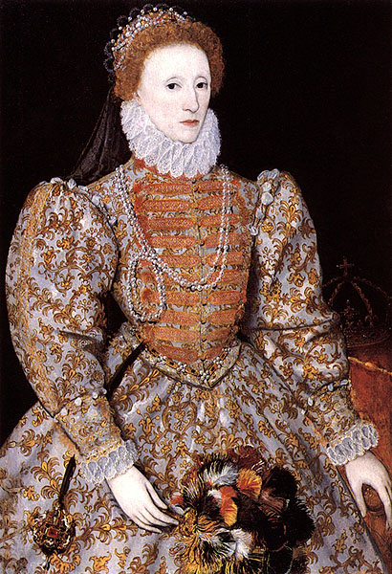
“The Good Queen”
___________________(ruled for 45 years).
Elizabeth had grown up watching her nation go ___ ____________________________________;
she compromised between the two…
The _____________________quietly made England Protestant while keeping some Catholic rituals and structure intact.
This ______________________ made her a beloved ruler. She truly _____________________ __________that her father created.

Slide 7
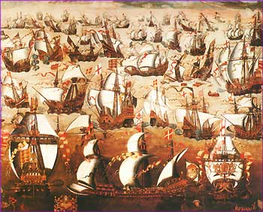
Elizabeth I
In _______, England’s rival nation of Spain (strictly Catholic) carried out an aggressive naval attack.
The huge _________________(130 ships; 20,000 men; tons of artillery) _____________________ _______________________________
This victory opened the world to England and the _____________________
It is still considered one of the _________________ __________________… and Elizabeth is credited
with the victory.

