Slide 1
Henry VIII and The English Reformation

Slide 2
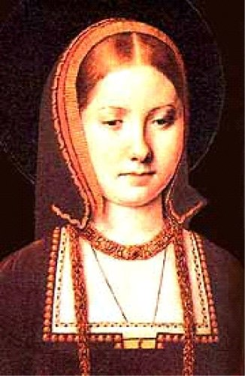
English Reformation
The English king, Henry VIII was a devout Catholic.
Henry was given the title “Defender of the Faith” by the Pope because of a pamphlet that he wrote against Martin Luther and his teachings
He wanted a divorce from his wife Catherine of Aragon after 17 years because she had produced him no male heir, however…
Catholic law does not allow divorce and
the Pope would not grant Henry an
annulment.
(annul ~ to cancel a marriage, or make void).

Slide 3
Henry VIII
Called for a break from the Roman Catholic Church and created his own, the Church of England. He banned the Catholic Church in England.
Act of Supremacy made him “the only supreme head on Earth of the Church of England.”
Many Catholics in England remained loyal to their faith and refused to acknowledge the Act Henry had many of them executed (including Sir Thomas More, his old teacher and advisor).

Slide 4
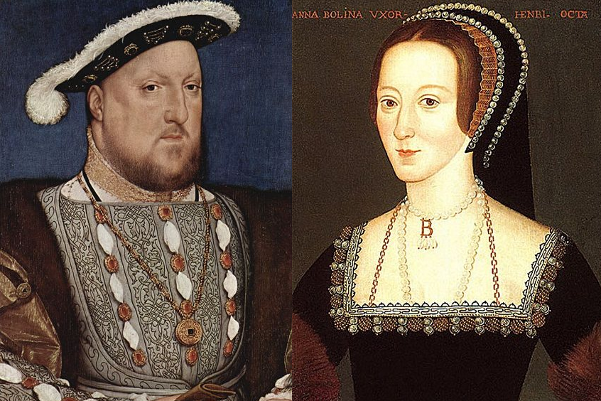
Henry VIII & Anne Boleyn

Slide 5
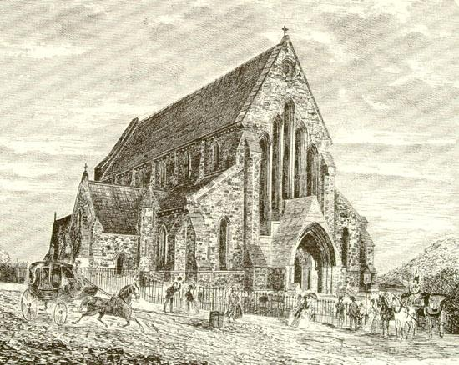
Anglican Church (aka – Church of England)
Anglican Church started by Henry VIII
Very similar to Catholic Church in ceremonies, rituals, and other religious duties
Appropriated (seized) lands & wealth of the Roman Catholic Church in England and
gave it to the wealthy in England to secure support of the new church.

Slide 6
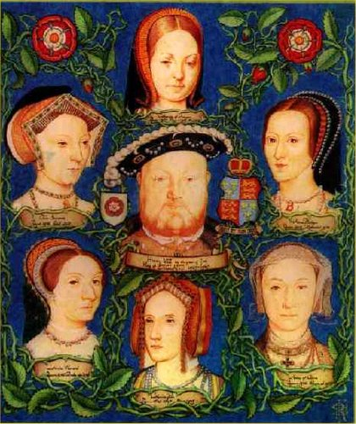
Wives & Children of Henry VIII
Henry
VIII
Catherine
of Aragon
Divorced
Mary I
Anne
Boleyn
Beheaded
Elizabeth
I
Jane
Seymore
Died in
Childbirth
Edward
VI
Anne of
Cleves
Divorced
None
Catherine
Howard
Beheaded
None
Catherine
Parr
Outlived
Henry
None

Slide 7
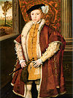
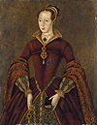
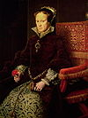
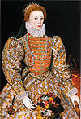
Henry and his kids… (Tudor Dynasty)
Henry dies and his only son…
Edward VI (P) takes the crown (age 10) for 5 years. Before he dies he names…
Lady Jane Grey his heir, but few consider her a true monarch (9 days).
(Bloody) Mary (C) gains power and support and takes the crown from Jane (executed age 16).
After Mary I rules for 5 years and dies…
Elizabeth I (P) becomes Queen of England and rules for 45 years (The Virgin Queen).

Slide 8
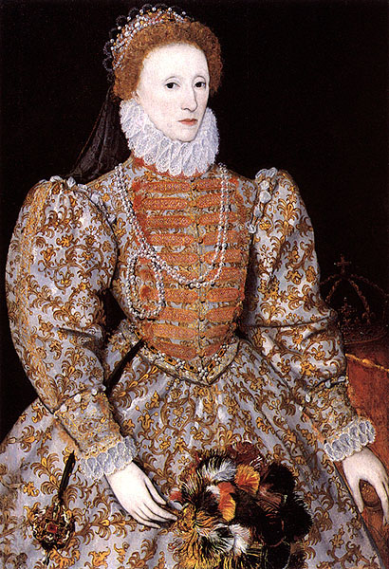
“The Good Queen”
Queen Elizabeth I (ruled for 45 years).
Elizabeth had grown up watching her nation go back and forth from Protestant & Catholic;
she compromised between the two…
The Elizabethan Settlement quietly made England Protestant while keeping some Catholic rituals and structure intact.
This tolerance for dissenters made her a beloved ruler. She truly developed the Anglican Church that her father created.

Slide 9
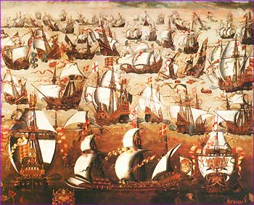
Elizabeth I
In 1588, England’s rival nation of Spain (strictly Catholic) carried out an aggressive naval attack.
The huge Spanish Armada (130 ships; 20,000 men; tons of artillery) was defeated by Elizabeth’s smaller, faster navy.
This victory opened the world to England and the growth of its empire.
It is still considered one of the greatest British battles in history… and Elizabeth is credited
with the victory.

