Slide 1
English Reformation DQ
#1. Which English king broke from the Catholic church and established the Church of England?
#2. In 1588, what fleet of ships sailed to England in an attempt to overthrow the English queen?
#3. What is the official name of the Church of England?
#4. What English queen, known as the Virgin Queen, is one of the greatest monarchs in English history?
#5. While similar to the Catholic Church, the Church of England allowed what new law?
Bonus Q ~ How many children did Henry VIII have?

Slide 2
The Spread of the ____________
WHII #5

Slide 3
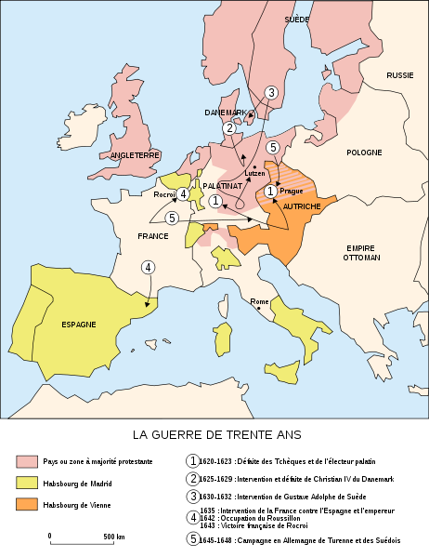
Reformation in _____________
Home of M. Luther; Princes of Germany _________________ __________________.
The _______________ (powerful family) remained ___________ _________________.
Conflicts between Protestants and Catholics resulted in the __________________.

Slide 4
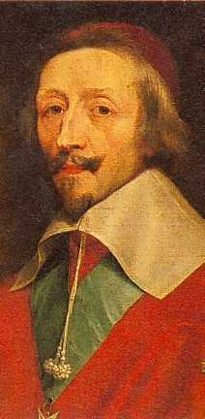
Reformation in ____________
Protestants in France were called ______________________.
King Henry IV attempted to quiet conflict in France between Catholics and Huguenots.
Issued “________________” 1598 – the law ______________________ ____________________________ _____________ (Huguenots).
___________________________made the 30 Years’ War about politics not religion.

Slide 5
____________________________
___________________ doctrine, end corruption, win back favor of citizenry, and combat popularity of Protestantism with their own Catholic __________ _________________.
_____________________________ ~ (1545) Pope called for a council to look into allegations made by Protestants.
______________________________________.
______________________________________.
______________________________________.

Slide 6
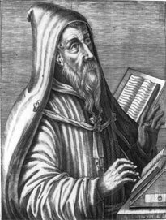
Counter Reformation
Key Catholic Changes:
(different than Protestant beliefs)
The _______, not the individual, __________________________.
Church traditions had authority over the lives of Christians and was now ______________________.
3. ____________________________________ __________________a life of good works was required as well.

Slide 7
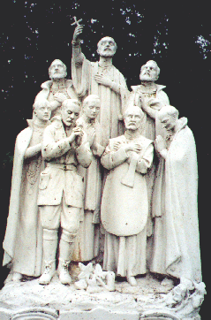
_________________
_________ ~ (aka - the Society of Jesus) pledged ______________________ in Rome.
A group of __________________ - duty was to _____________________________________ ____________________________________.
Heavily influenced the cultures of the Latin America (Central and South America).
Still in existence today.

Slide 8
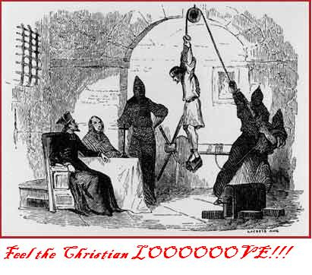
The Inquisition
Committee of 6 cardinals were charged by the Pope to _____________________________________.
(heresy – _______________________; a heretic)
Inquisition empowered by the Pope to __________ _________; aka – witch hunts.
____________________ to accomplish their mission.

