Slide 1
The Spread of the Reformation

Slide 2
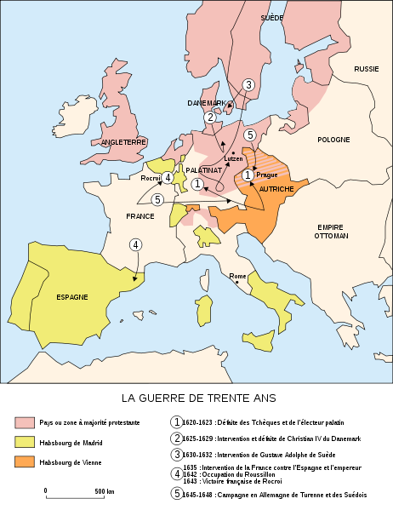
Reformation in Germany
Home of M. Luther; Princes of Germany broke from the Catholic Church.
The Hapsburgs (powerful family) remained loyal to the Pope.
Conflicts between Protestants and Catholics resulted in the Thirty Years’ War.

Slide 3
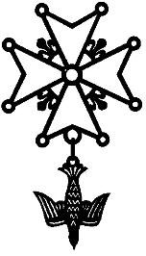
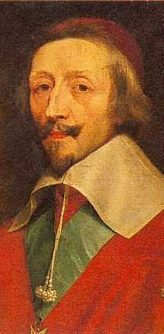
Reformation in France
Protestants in France were called Huguenots.
King Henry IV attempted to quiet conflict in France between Catholics and Huguenots.
Issued “Edict of Nantes” 1598 – the law granted freedom of religion and rights to French Protestants (Huguenots).
Cardinal Richelieu made the 30 Years’ War about politics not religion.

Slide 4
Catholic [Counter] Reformation
Church attempts to reform doctrine, end corruption, win back favor of citizenry, and combat popularity of Protestantism with their own Catholic Counter Reformation.
Council of Trent ~ (1545) Pope called for a council to look into allegations made by Protestants.
Reaffirmed traditional Catholic Views.
Put penalties on corrupt clergy.
Set up schools to better educate clergy.

Slide 5
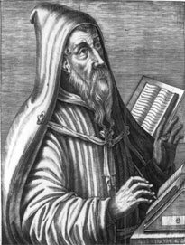
Counter Reformation
Key Catholic Changes:
(different than Protestant beliefs)
The Church, not the individual, interpreted the bible.
Church traditions had authority over the lives of Christians and was now equal to the Bible’s.
3. Faith alone was not enough to gain salvation a life of good works was required as well.

Slide 6
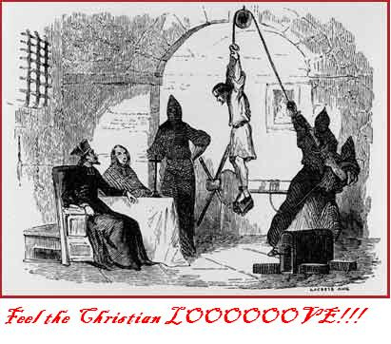
The Inquisition
Committee of 6 cardinals were charged by the Pope to weed out all forms of heresy.
(heresy – different ideas or beliefs; a heretic)
Inquisition empowered the Pope to prosecute all heretics; essentially these were witch hunts against Protestants
Used torture and death to accomplish their mission.

Slide 7
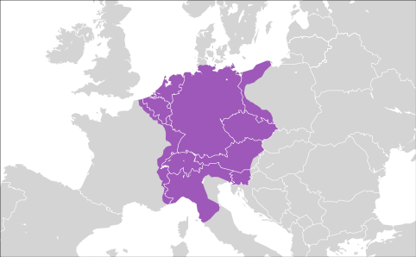
Holy Roman Empire
The Holy Roman Empire was a collection of kingdoms within one big empire and proclaimed itself as the successor to the Western Roman Empire
It was centered around the Kingdom of Germany
While ruled by an emperor, the HRE was a Catholic empire and thus saw the
Pope as its true leader
The empire was ruled
by the Hapsburg family

Slide 8
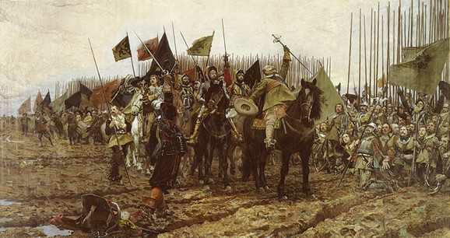
Thirty Years’ War (1618-1648)
Fought over religion, this war involved most of the countries of Europe
It was originally fought as a war between Protestants and Catholics in the Holy Roman Empire
The Peace of Westphalia ended the war, stating that countries could
determine their own faith
The Holy Roman Empire
was greatly weakened

