Slide 1
Age of Discovery
WHII #6

Slide 2
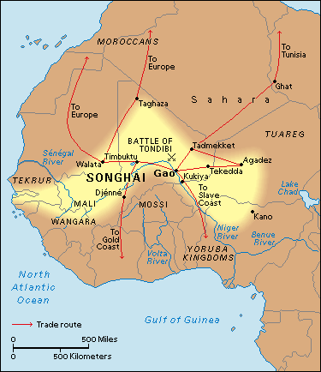
Traditional Trade by 1500A.D.
Previous to the Age of Exploration and Discovery several __________________________________ ________________________________________.
_________ extended from ____________________ _____________________(connects with Europe).
Other notable trade routes:
←_________________ routes across North Africa (from the Songhai Empire), maritime routes through the _________ _____, European connections along the _____________.

Slide 3
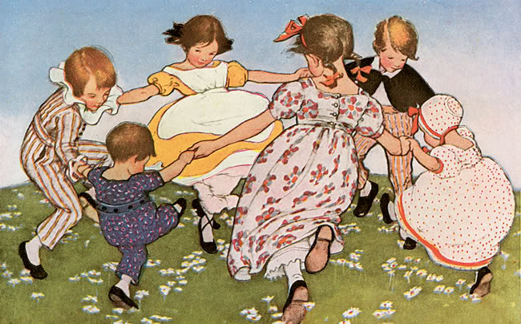
Why did Europe explore?
#1 ~ _____________________;
Europe’s numbers were recovering in the aftermath of the Black Plague.
(60% or 50 million dead).
More people means more ________________ _______________
#2 ~ _____________________ (individualism, creativity, capitalism).
#3 ~ To ____________________(Catholicism).

Slide 4
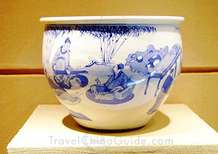
Why explore cont.
#4 ~ ______________________ as an overland trade route; forced to find a water route.
Portugal and Spain began ___________________ ______________ instead of overland routes.
#5 ~ _______________________________________.
The west (Europe) wanted more and more of the goods and spices from the east:
From _____ (Silk Road) ~ __________________________, etc.
From __________________________~ ____________________________.
Also a ___________________of ideas ~ medicine, astronomy, mathematics, etc.

Slide 5
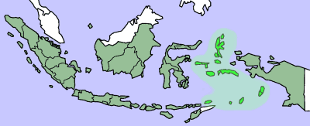
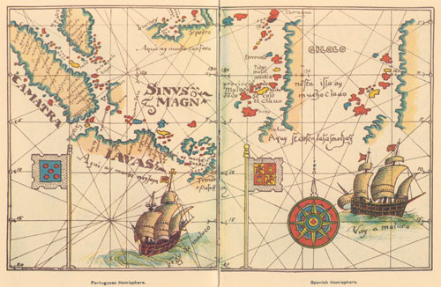
________________today (above) are part of Indonesia.
Big ___________________ due to the natural production of sage, cinnamon, mace, nutmeg, cloves, etc.
Asia provided Europe with many other spices as well: _________________, turmeric, ginger, curry, etc.
Spain and Portuguese claims and maps.

Slide 6
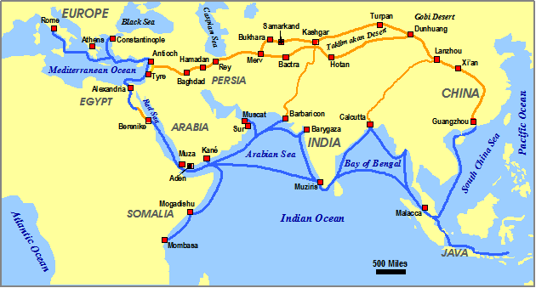
#6 ~ ____________________________ and foreign powers. _____________________controlled the routes and ports.

Slide 7
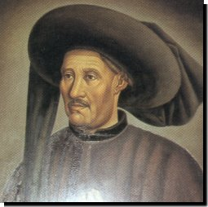
Portugal
______________________ and most aggressive exploring country.
________________________~
Not a sailor, but ____________________
________________________________to redesign ships, prepare maps, and train captains and crews to explore the west coast of Africa and beyond.
_______________________________ for long voyages.
Hoped to expand Christianity and find African Gold. Discovered islands and ports down Africa’s western coast (aka – “_____________”).

Slide 8
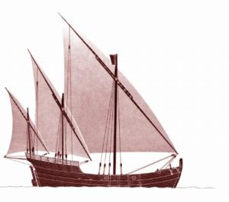
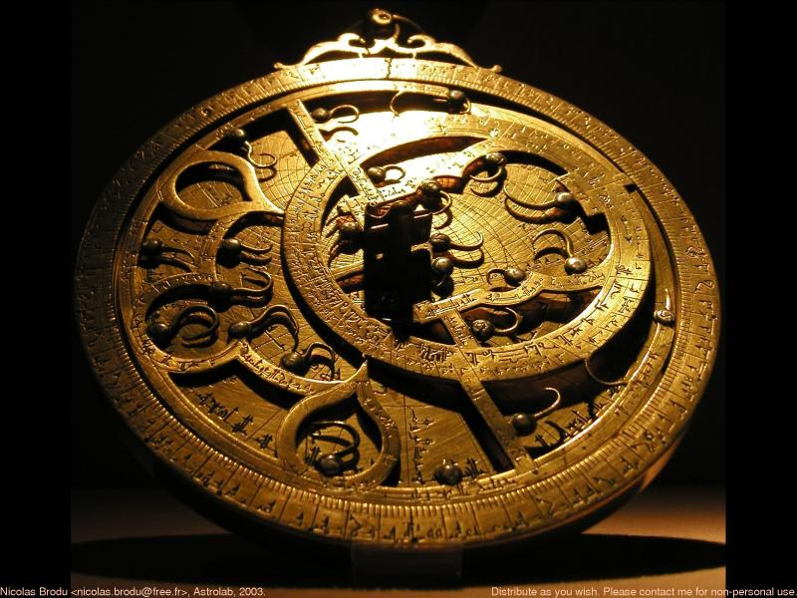
New Navigational Technologies~
__________ – new ship incorporating various sail and mast designs. Easier to sail into or across the wind.
__________ – measures latitude while at sea.
Magnetic ___________

Slide 9
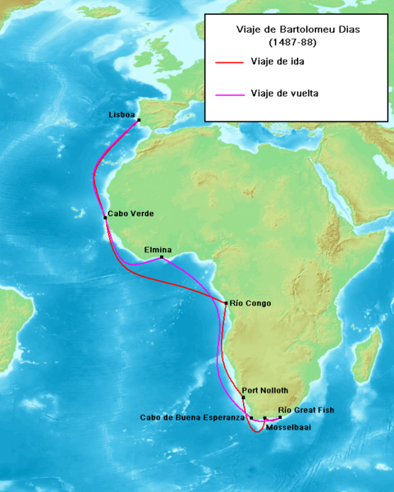
Portugal goes East
___________________
Sailed beyond the “Gold Coast” and rounded the southern tip of Africa.
It became known as the _______________ ______b/c of the good fortunes the Portuguese thought it would bring.

Slide 10
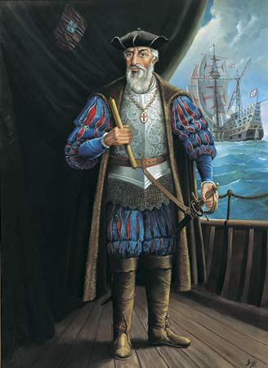
Portugal goes East
___________________
Led four ships around the Cape of Good Hope and on to _______where he reached a port called _______.
Da Gama and Portugal established a permanent trading posts in India and created a vast trading empire in the Indian Ocean _________________ ________________

