Slide 1
Age of Discovery
WHII #6

Slide 2
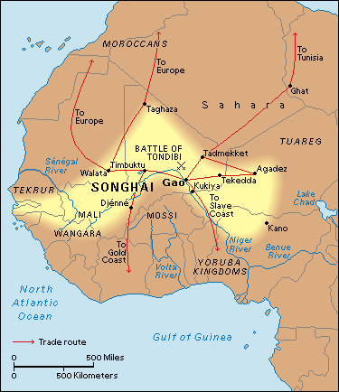
Traditional Trade by 1500A.D.
Previous to the Age of Exploration and Discovery several trade routes existed that provided Europe with goods from Asia and Africa.
Silk Road extended from China to the edge of the Mediterranean Sea (connects with Europe).
Other notable trade routes:
←Trans-Saharan routes across North Africa (from the Songhai Empire), maritime routes through the Indian Ocean, European connections along the Black Sea.

Slide 3
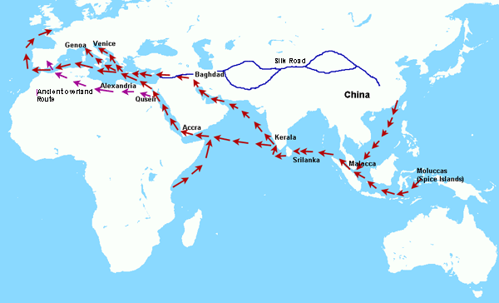
From the Spice Islands to Europe

Slide 4
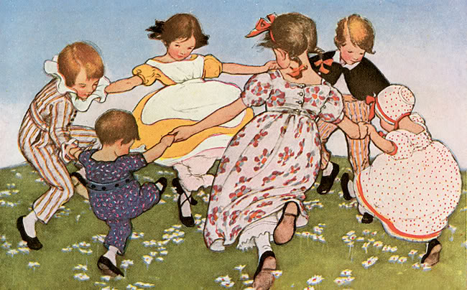
Why did Europe explore?
#1 ~ Population increase;
Europe’s numbers were recovering in the aftermath of the Black Plague.
(60% or 50 million dead).
More people means more demand for food and supplies.
#2 ~ Renaissance thinking (individualism, creativity, capitalism).
#3 ~ To spread Christianity (Catholicism).

Slide 5
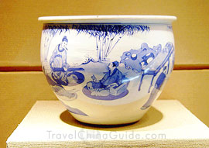
Why explore cont.
#4 ~ Loss of Constantinople as an overland trade route; forced to find a water route.
Portugal and Spain began looking for water access to Asia instead of overland routes.
#5 ~ Continued desire for gold, goods, and spices.
The west (Europe) wanted more and more of the goods and spices from the east:
From China (Silk Road) ~ paper, compass, silk, porcelain, etc.
From India and the Middle East ~ textiles and a numeral system.
Also a scientific transfer of ideas ~ medicine, astronomy, mathematics, etc.

Slide 6
Questions:
Give two reasons why Europeans suddenly began a mass exploration of the world
Why did Europeans want to discover new trade routes?

Slide 7
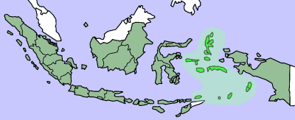
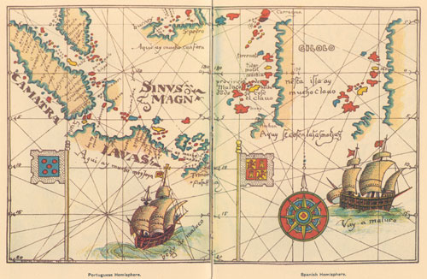
Spice Islands today (above) are part of Indonesia.
Big trade target location due to the natural production of sage, cinnamon, mace, nutmeg, cloves, etc.
Asia provided Europe with many other spices as well: black pepper, salt, turmeric, ginger, curry, etc.
Spain and Portuguese claims and maps.

Slide 8
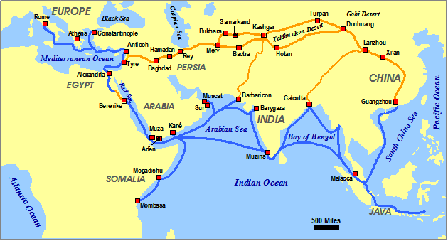
#6 ~ Competition between European and foreign powers. Muslims and Italians controlled the routes and ports.

Slide 9
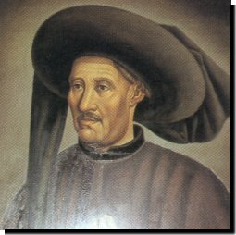
Portugal
Portugal was the first and most aggressive exploring country.
Prince Henry the Navigator ~
Not a sailor, but gathered many scientists, cartographers, and other experts to redesign ships, prepare maps, and train captains and crews to explore the west coast of Africa and beyond.
Developed schools to train explorers for long voyages.

Slide 10
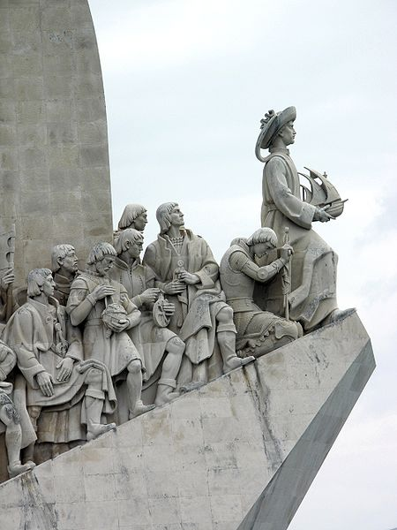
Prince Henry the Navigator

Slide 11
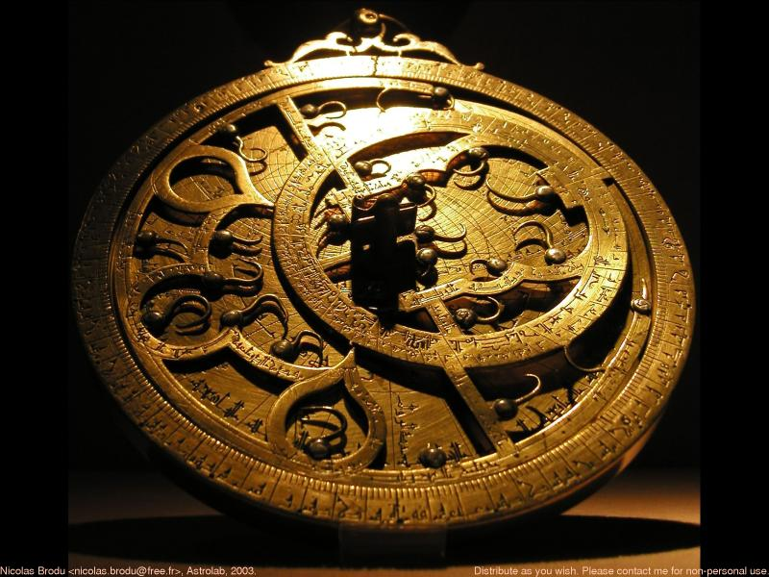
New Navigational Technologies~
Caravel – new ship incorporating various sail and mast designs. Easier to sail into or across the wind.
Astrolabe – measures latitude while at sea.
Magnetic Compass

Slide 12
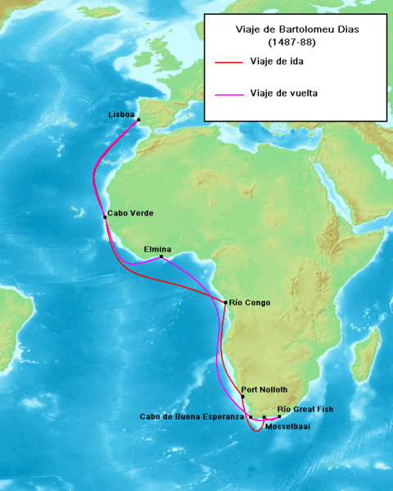
Portugal goes East
Bartholomew Dias
Sailed beyond the “Gold Coast” and rounded the southern tip of Africa.
It became known as the Cape of Good Hope b/c of the good fortunes the Portuguese thought it would bring.

Slide 13
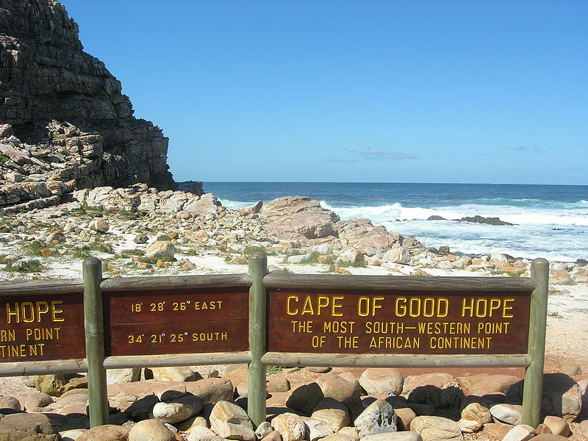
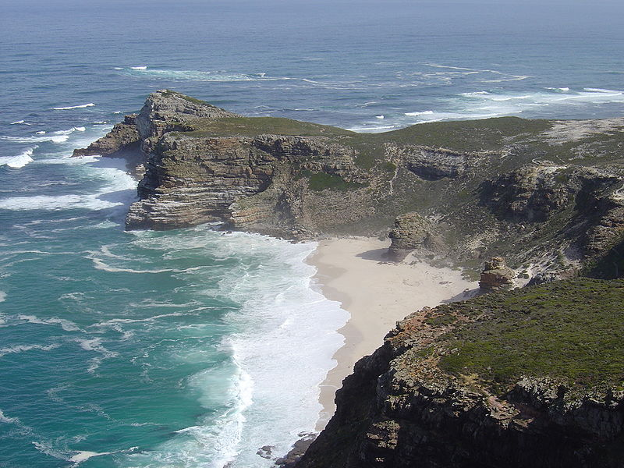
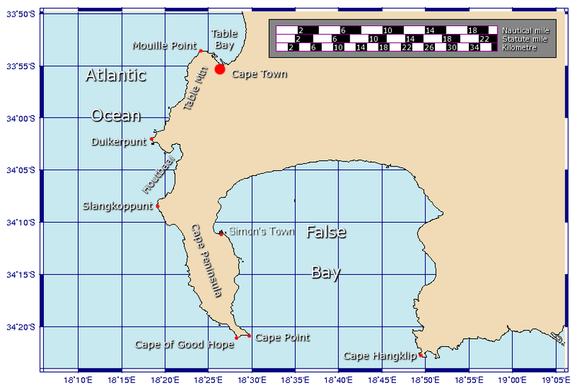
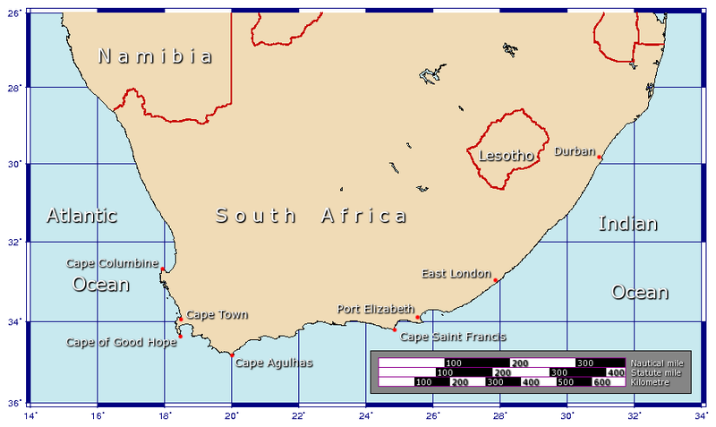
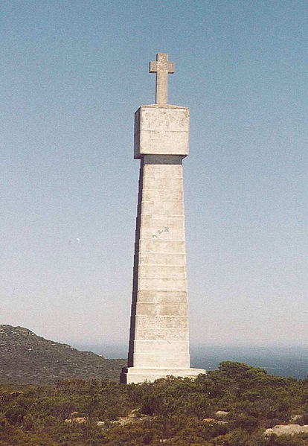
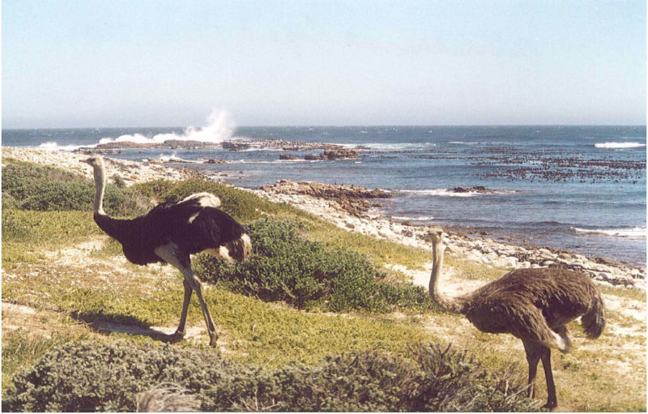
Cape of Good Hope

Slide 14
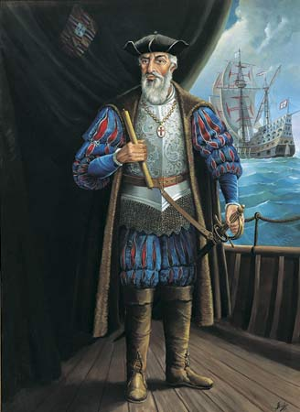
Portugal goes East
Vasco da Gama-
Led four ships around the Cape of Good Hope and on to India where he reached a port called Calicut.
Da Gama and Portugal established a permanent trading posts in India and created a vast trading empire in the Indian Ocean with the Mughal Empire in India.

Slide 15
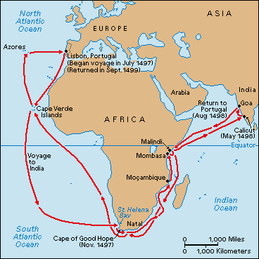
Da Gama’s route:

Slide 16
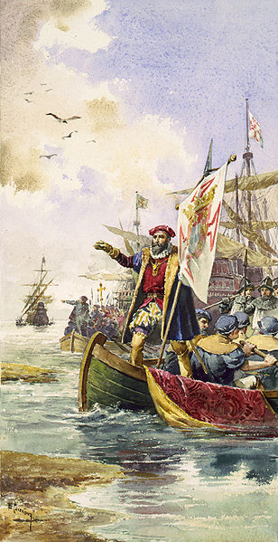
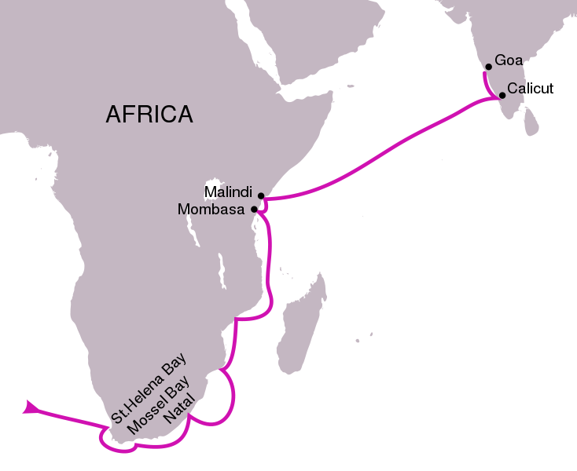
Da Gama lands in Calicut, India

Slide 17
Questions:
Why was Henry the Navigator important?
Vasco da Gama wasn’t the first to arrive in India, but why was he important?

