Slide 1
Age of Discovery #2
WHII #7

Slide 2
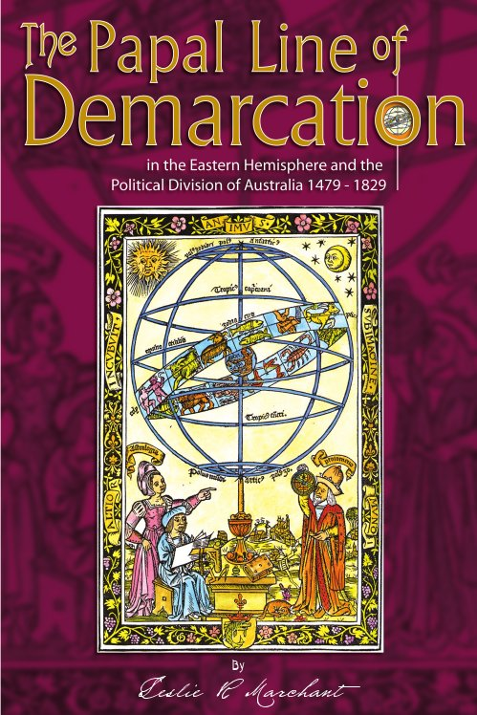
Who gets what?
________________were competing for control of the new lands.
____________________~
Pope Alexander VI set the a line of demarcation splitting the non- European lands into 2 zones.
_________________________.
_________________________.

Slide 3
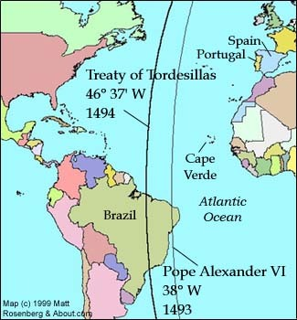
Treaty of Tordesillas
1494 – _______________
___________________
Spain and Portugal agree to move the Line of Demarcation ________ from its original spot.
1500 - Explorer Pedro Cabral landed in ______ and claimed it for ________________.

Slide 4
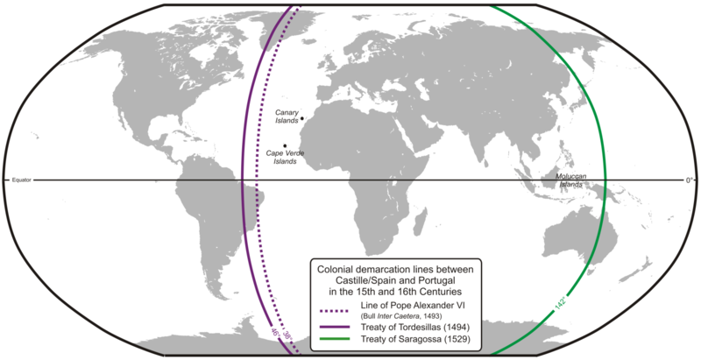
Line of Demarcation & Treaty of Tordesillas

Slide 5
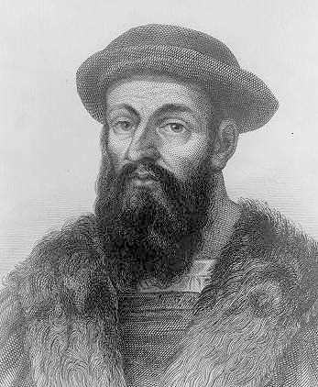
Ferdinand Magellan
___________________but sailed for Spain
_______________________trying to reach the East Indies via a western route.
Went through an area now known as the
____________________________________________
_____________________________(which he named, means ‘peaceful’), __________________________ ___________). He put down more than one mutiny.
_______________________________________________________________ to Seville, Spain.
Magellan died in the Philippines in a local conflict.
First explorer to ___________________the world.

Slide 6
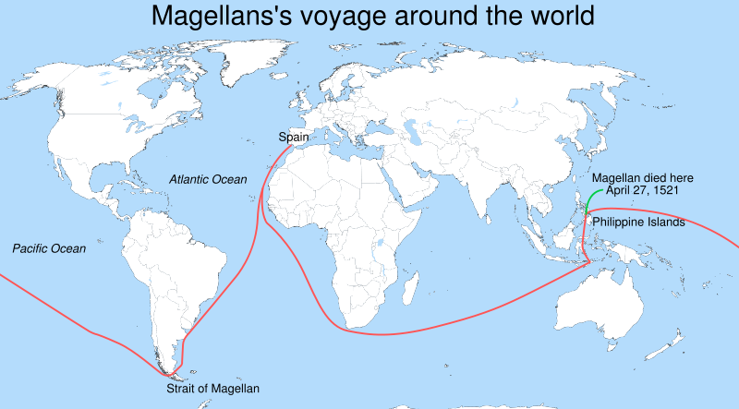
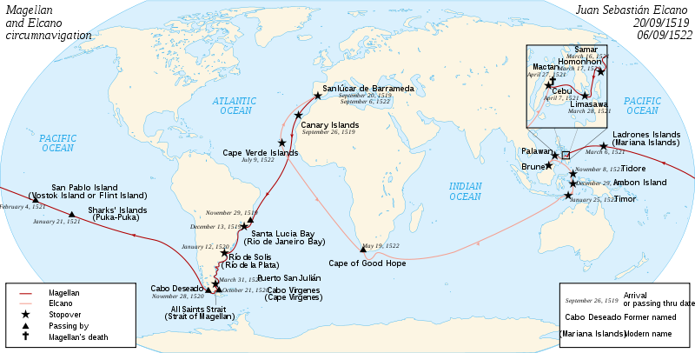

Slide 7
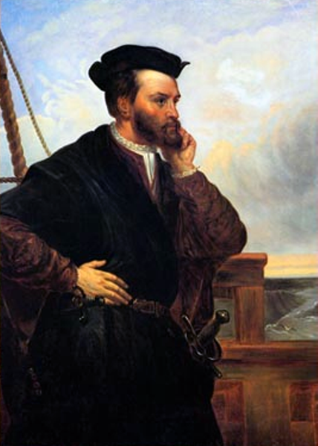
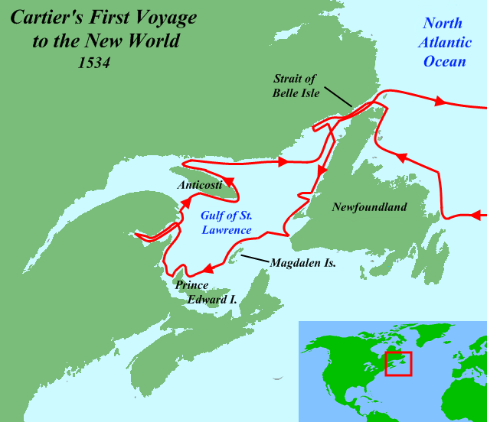
Jacques Cartier
________________________first explored and mapped the area around St. Lawrence River and claimed the lands he found for ____________.
He had discovered _________ and named it for
the native word “kanata” meaning ‘village’
(he thought it meant ‘new lands’).
His discovery _______________
_____________for further and
European expansion.

Slide 8
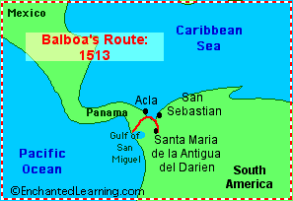
Other Notable Explorers
________________(Italian) – sailor wrote about the “new world.”
His name was used for the Americas.
John _________________ – fishing waters off of Newfoundland.
Henry ________________– explored the
Hudson River around modern day New York.
Vasco _________________–
first to view the Pacific by crossing overland in Panama.

Slide 9
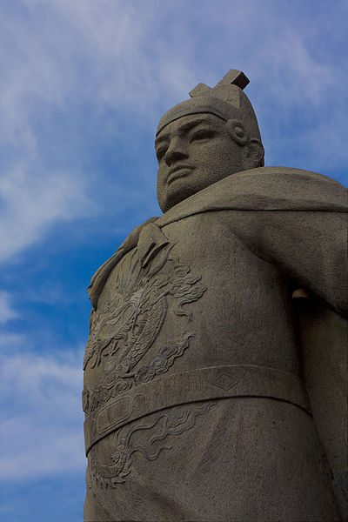
A Brief Background
_______________(1371-1433) was a _______ ______________and fleet admiral
He commanded voyages throughout South Asia, _____________________________
Due to China’s continued trade with the Islamic world, Zheng He was actually ______________
Unlike the European explorers, his
__________________________, not
gold or religion

Slide 10
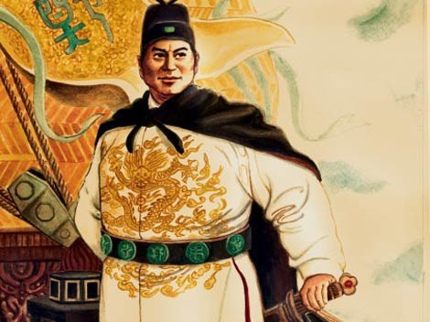
The Voyages
In the early 1400s, China wanted to control trade in __________________________
Zheng He commanded a fleet of around ________ ________________________________
He traveled all over the Indian Ocean, _________ ___________________________
Despite the fact that he had a huge navy, he attempted to use __________________________
Most countries were so intimidated
by his navy that they immediately
agreed to trade

Slide 11
The Impact
Zheng He _____________________________, including African animals, and greatly _____________________________________
China’s military was also strengthened to ensure ________________________________
As a result, China became the _______________________ and in the Indian Ocean

