Slide 1
Daily Quiz
#1 ~ What city was lost as an overland trade route when it was taken by Muslims?
#2 ~ Who started schools to train sailors for long voyages?
#3 ~ Da Gama was the first man to sail to Asia from Europe, specifically to what country?
#4 ~ B. Dias sailed to the southern tip of Africa. What is that location called today?
#5 ~ Name two of the three Portuguese ‘inventions.’
Bonus Q ~ List two specific items Europeans wanted from the East other than land and gold.

Slide 2
Age of Discovery #2

Slide 4
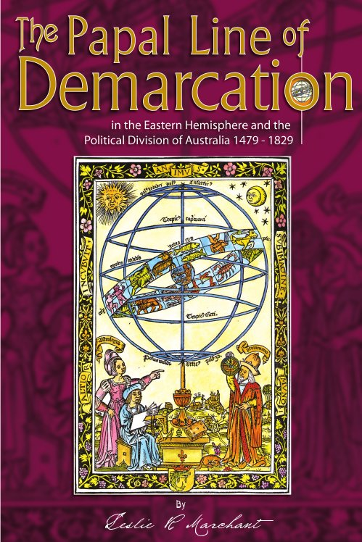
Who gets what?
Portugal & Spain were competing for control of the new lands.
Line of Demarcation ~
Pope Alexander VI set the a line of demarcation splitting the non- European lands into 2 zones.
West of the line was Spain’s territory.
East of the line was Portugal’s territory.

Slide 5
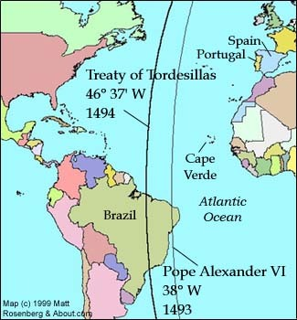
Treaty of Tordesillas
1494 – Treaty of Tordesillas
Spain and Portugal agree to move the Line of Demarcation westward from it original spot.
1500 - Explorer Pedro Cabral landed in Brazil and claimed it for Portugal.

Slide 6
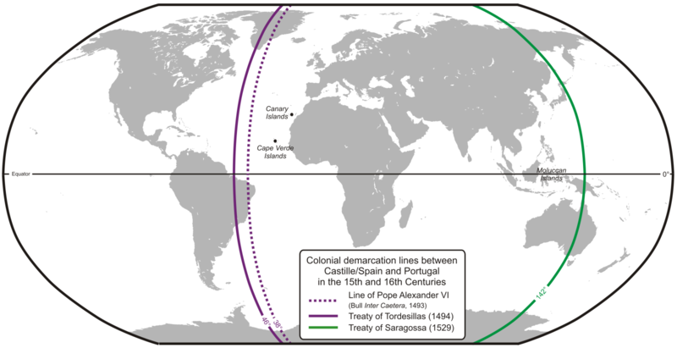
Line of Demarcation & Treaty of Tordesillas

Slide 7
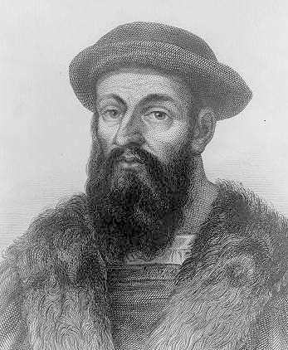
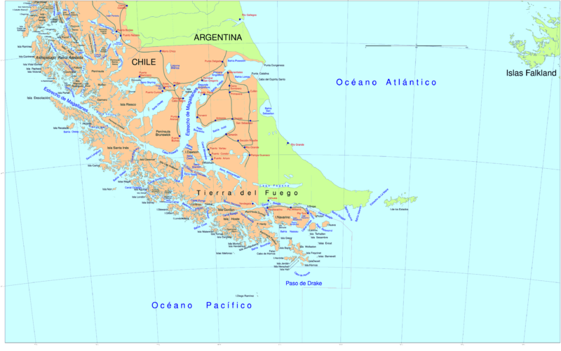
Ferdinand Magellan
Portuguese explorer but sailed for Spain
Left Spain with five ships trying to reach the East Indies via a western route.
Went through an area now known as the Strait of Magellan (southern tip of South
America).
Four month trip across the Pacific (which he named, means ‘peaceful’), eventually reaches Asia (East Indies). He put down more than one mutiny.
3 years after embarking… 1 ship and 18 sailors make it back to Seville, Spain.
Magellan died in the Philippines in a local conflict.
First explorer to circumnavigate the world.

Slide 8
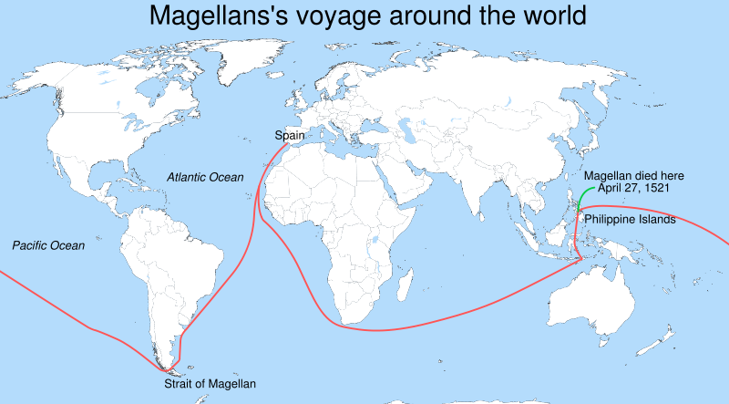
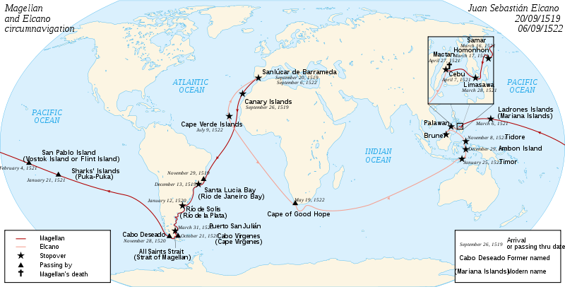

Slide 9
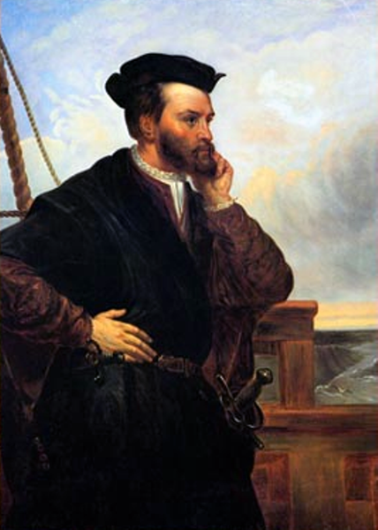
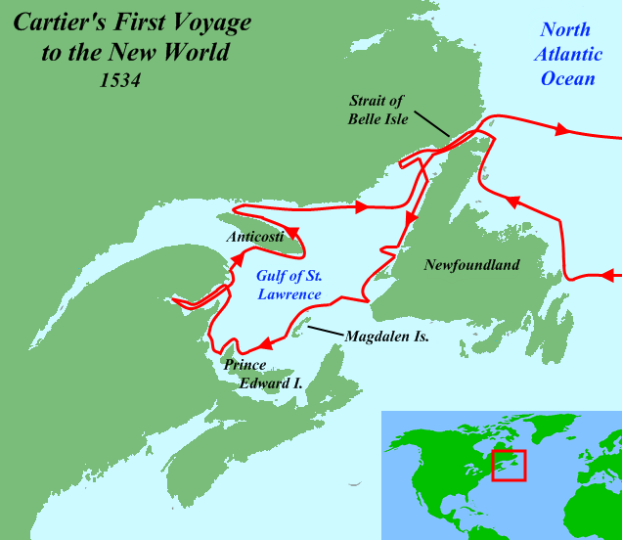
Jacques Cartier
French explorer Cartier who first explored and mapped the area around St. Lawrence River and claimed the lands he found for France.
He had discovered Canada and named it for the native word “kanata” meaning ‘village’ (he thought it meant ‘new lands’).
His discovery opened up North America for further and European expansion.

Slide 10
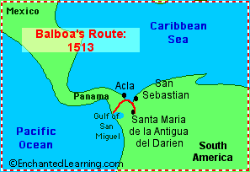
Other Notable Explorers
Amerigo Vespucci (Italian) – sailor wrote about the “new world.”
His name was used for the Americas.
John Cabot (England) – fishing waters off of Newfoundland.
Henry Hudson (Dutch) – explored the
Hudson River around modern day New York.
Vasco Balboa (Spain) –
first to view the Pacific by crossing overland in Panama.

Slide 11
Zheng He
The Most Famous Explorer Who You’ve Never Heard Of

Slide 12
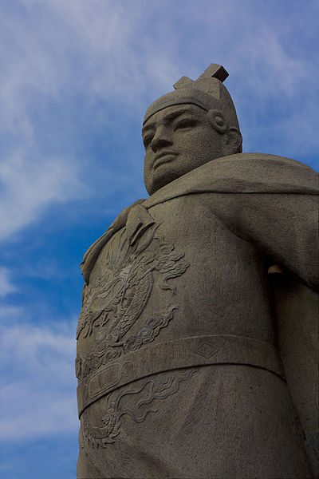
A Brief Background
Zheng He (1371-1433) was a Chinese explorer and fleet admiral
He commanded voyages throughout South Asia, Africa, and the Middle East
Due to China’s continued trade with the Islamic world, Zheng He was actually born a Muslim
Unlike the European explorers, his
voyages were about discovery, not
gold or religion

Slide 13
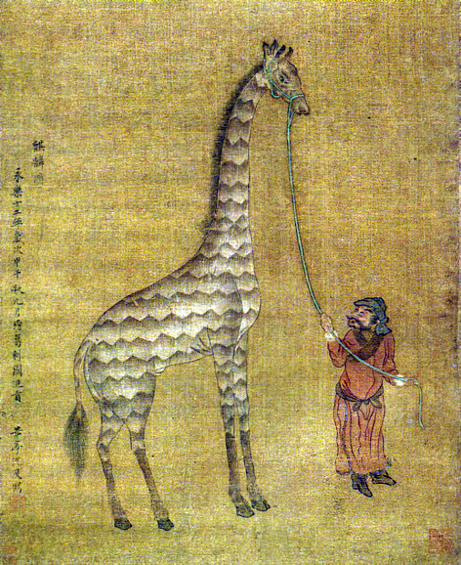
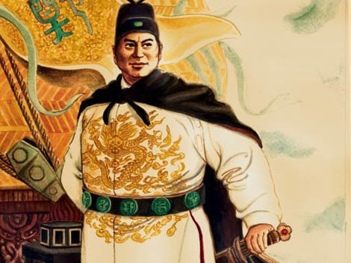
The Voyages
In the early 1400s, China wanted to control trade in the Indian Ocean
Zheng He commanded a fleet of around 300 ships and 28,000 men
He traveled all over the Indian Ocean, forcing many empires to trade with him
Despite the fact that he had a huge navy, he attempted to use diplomacy to achieve his goals
Most countries were so intimidated
by his navy that they immediately
agreed to trade

Slide 14
Zheng He’s Destinations

Slide 15
The Impact
Zheng He brought back many treasures, including African animals, and greatly expanded China’s trading empire
China’s military was also strengthened to ensure control of the trade routes
As a result, China became the dominant empire in Asia and in the Indian Ocean

Slide 16
Zheng’s Ships

