Slide 1
Conquest in the Americas
WHII #9

Slide 2
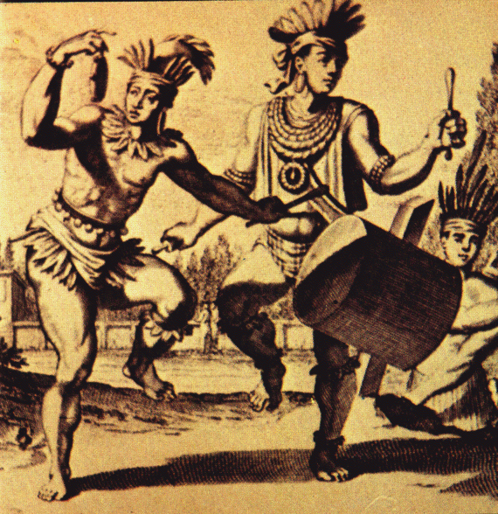
First Contact
1492 Columbus lands in the _____________; aka – Caribbean.
He made first contact with the ___________people:
____________, yams, and cotton in their villages. Europeans initially had good relations with the Taino Indians until…

Slide 3
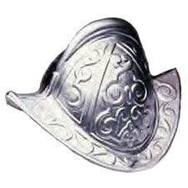
Conquistadors
______________– Spanish conqueror.
First set up shop in _________________________ ___________(modern day Haiti and the Dominican Republic).
Forced the Tainos to convert to ______________.
Confiscated their ______; made them pan for more.
___________________ of being the first people to conquer the new world and strengthen their empire.

Slide 4
Conquistador motto ~
_____________________
___________________________
______________________
_________________________

Slide 5
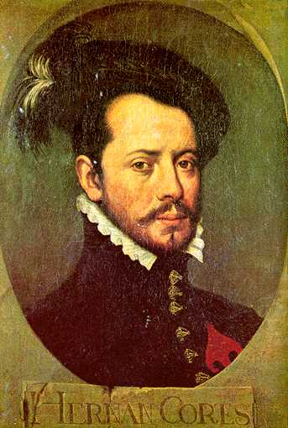
Conquistadors in Mexico
1519 ____________ sailed to ________with 600 men, 16 horses, and cannons.
His goal was to conquer the __________capital city – ________________
(teh noech tee tlahn).
Guided by __________, an Indian woman who spoke Mayan, Aztec, & Spanish.

Slide 6
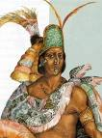
Fight for Tenochtitlan
________________________________.
He heard the Spanish were coming and feared Cortes was a god-king who had returned to destroy the Aztecs.
He sent gold and silver hoping the gifts would satisfy them, but ______________________________________ __________________.
(Jumping ahead) Cortes’ men fought their way to the capital, but were forcibly driven out by Aztec warriors;
Moctezuma was killed in the struggle.
1521 __________________________________________ (those who hated being controlled by the Aztecs).
Cortes got their help because of _______________.
In a very bloody assault the Spanish captured and destroyed the Aztec capital city of Tenochtitlan.

Slide 7
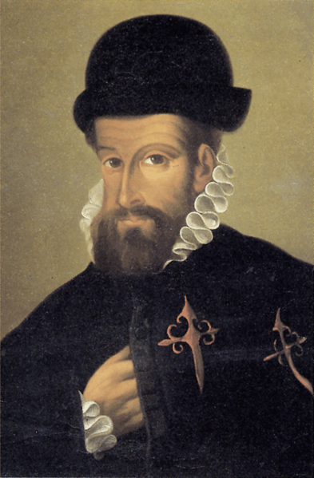
Spanish in Peru
__________________________
landed in ______________in 1532.
Lusting for the silver of the Andes mines and helped by Indian allies the
Spanish slaughtered thousands of ______and captured Incan ruler _________________(at tah wahl pah).
Pizarro demanded a huge ransom for the ruler and got it, but killed Atahualpa anyway.
Despite continued attempts by the natives to drive out the conquistadors, the __________________________________ _________________________________________________ _______________

Slide 8
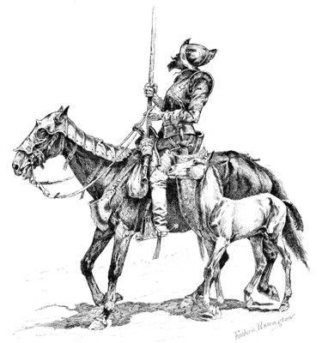
Why were the Spanish so successful?
___________________________
Spanish ___________frightened the natives.
_____________and cannons.
____________and helmets.
___________________
Discontent tribes hated being under the power of the Aztec and Incan empire; due to slavery and human sacrifices.
_____________________________________________ _________________

Slide 9
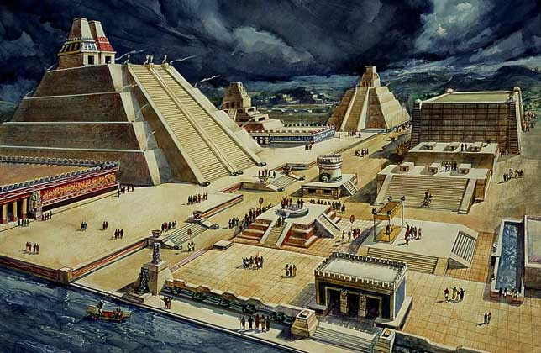
How they did it cont…
__________________
Europeans brought ____________ _____________________________________________ for: measles, ____________, and influenza.
______________________ and weakened survivors.
90% population drop on Caribbean islands.
___________________________
Indians believed the Spanish gods were more powerful than their own. They had the weapons, diseases, etc.
The _________________________________________ ____________for many natives.

Slide 10
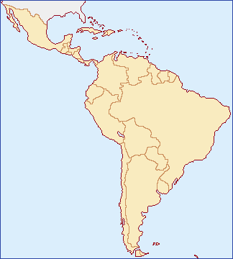
Latin America
Empire locations:
_______________~
_______________
_______________~
______________
______________
_______________~
________________
____________

