Slide 1
Adam Smith and Market Economies
Economics and Personal Finance

Slide 2
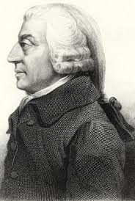
Adam Smith
Known as the father of modern economics
Some of his economic theories and beliefs:
Smith believed that people, acting in their own self interest, would work hard and produce what consumers wanted
- What’s the rationale behind this?
Argued that competition among businesses would keep prices in check

Slide 3
Smith cont…
3. Government has a limited but important role – such as providing public works (like schools) and roads
4. Argues for the improvement of trade, saying that it opens up new markets where surplus goods can be sold and allowed for cheaper goods to be imported

Slide 4
Six Characteristics of a Market Economy
Private ownership of resources – provides incentives for the owners of resources to weigh the value of present uses against the value of conserving the resource for future use
Competition among businesses – which tends to lower prices and raise quality
Prices determined in the market place through the interaction of supply and demand
Consumer Sovereignty – the concept that “dollar votes” tell businesses what to produce

Slide 5
Six Characteristics of a Market Economy
5. Profit motive – an incentive for businesses to produce what consumers demand and to produce those goods and services efficiently, keeping costs down, in hopes of earning a greater profit
6. Limited government intervention – government serves as a referee to protect consumers, workers, the environment, and competition in the marketplace

