Slide 1
Sol Images and maps review

Slide 2
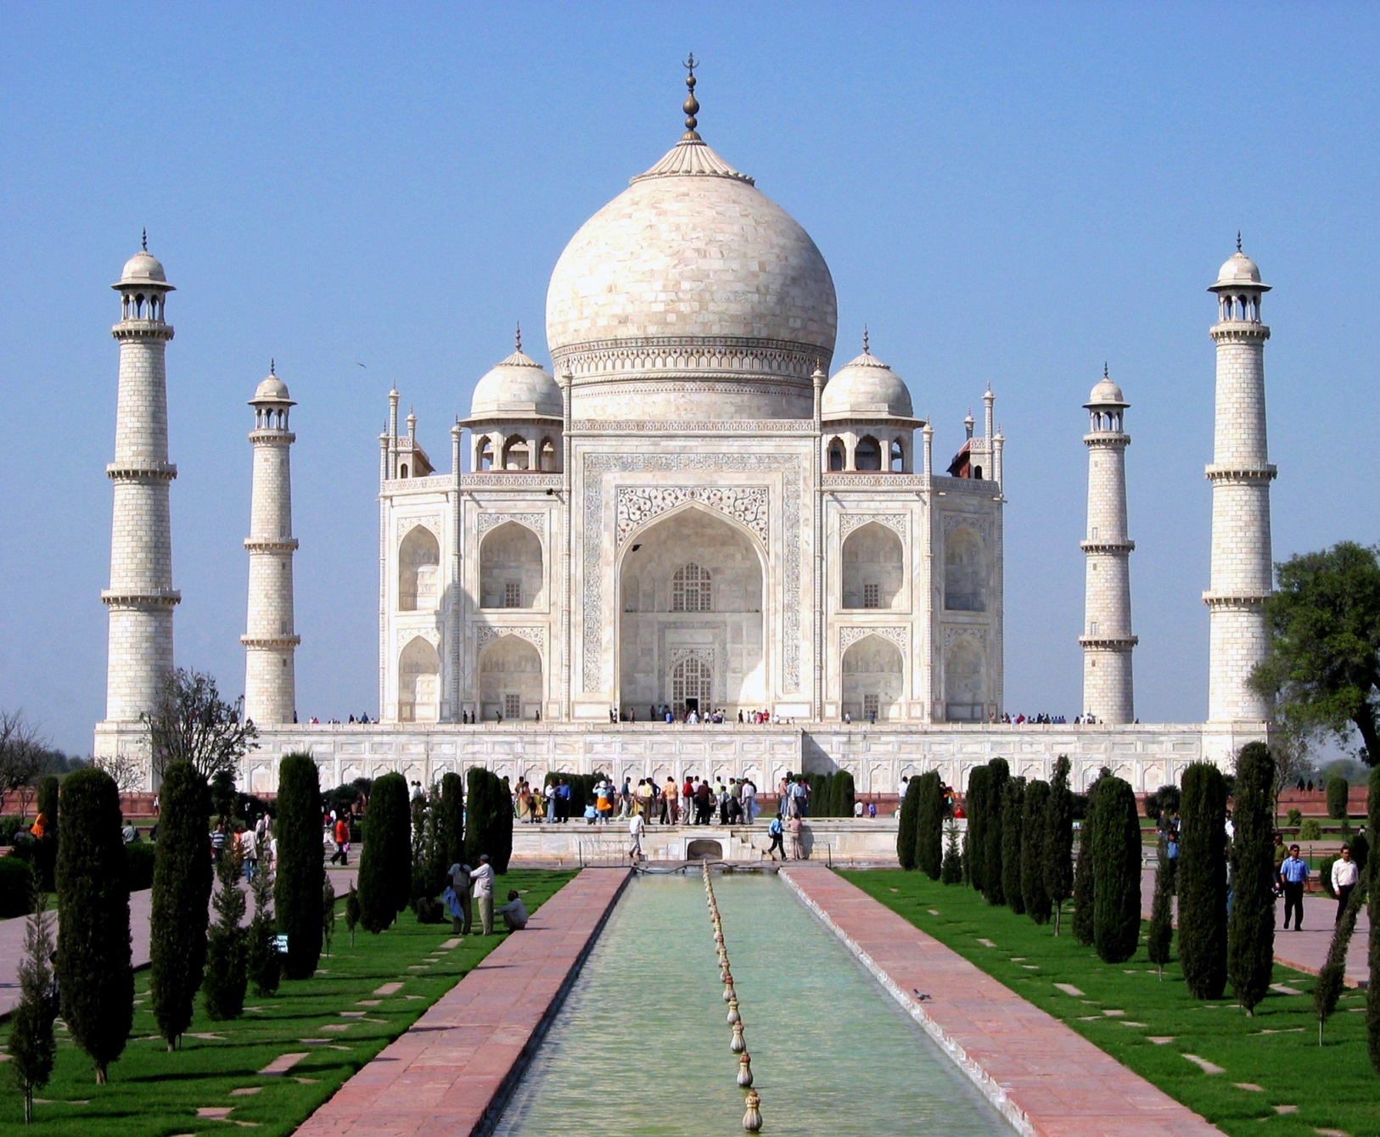
#1 What is this?
Where is this located?
2. What Muslim empire built this?

Slide 3
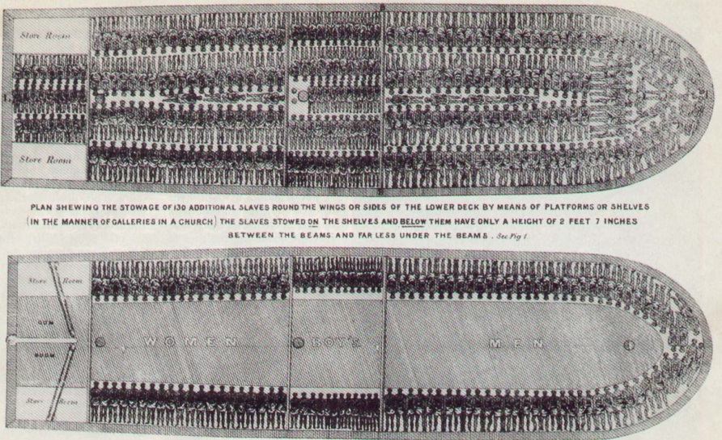
#2 What is this?

Slide 4

#3 What is this?
What country has this symbol on its flag? Why?

Slide 5
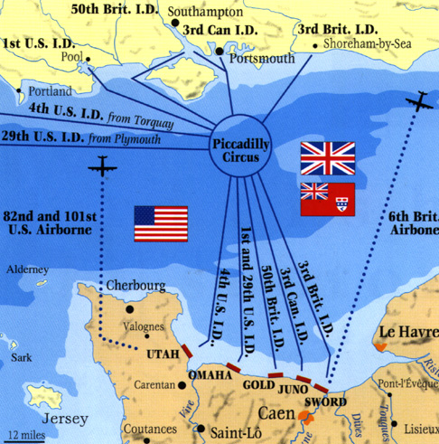
#4 What is this?
1. Where is this occurring?
2. Explain the importance.

Slide 6
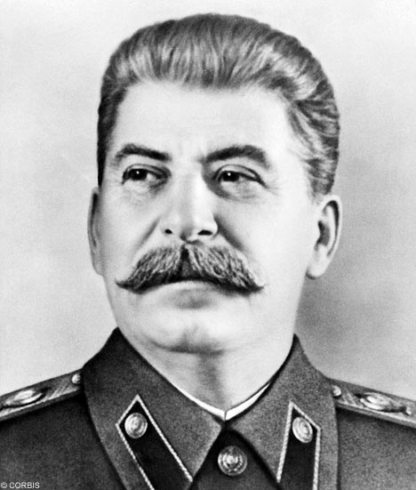
#5 Who is this?
1. Where did he rule and when?

Slide 7
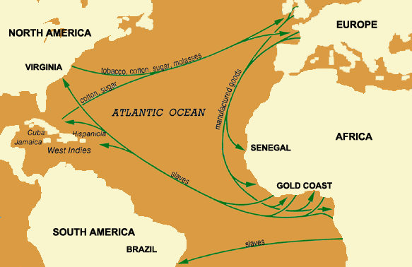
#6 What is this?

Slide 8
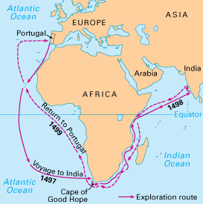
#7 What is this?
1. Who was the first explorer to make this journey?

Slide 9
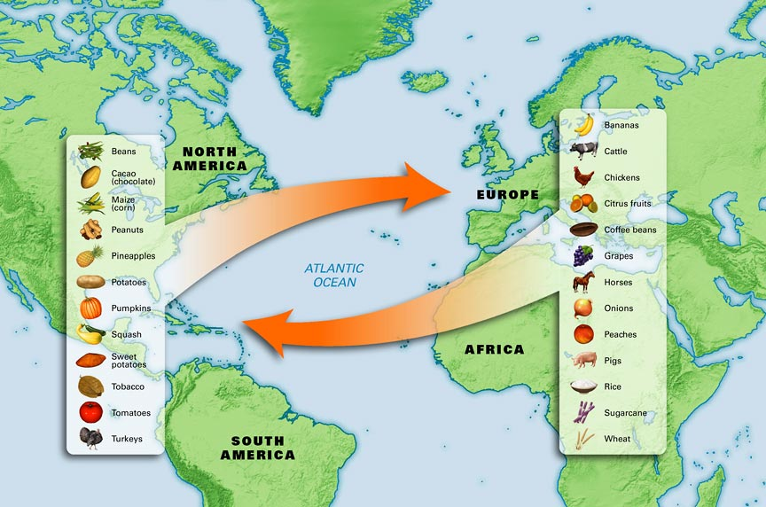
What is this?
Explain the significance

