Slide 1
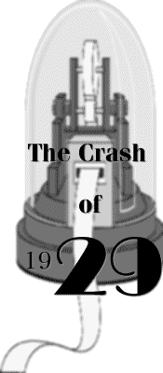
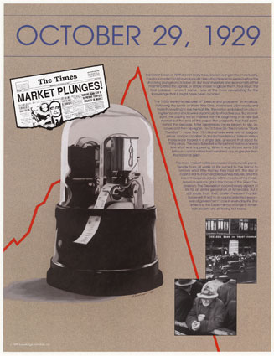
The stock Market Crash of 1929

Slide 2
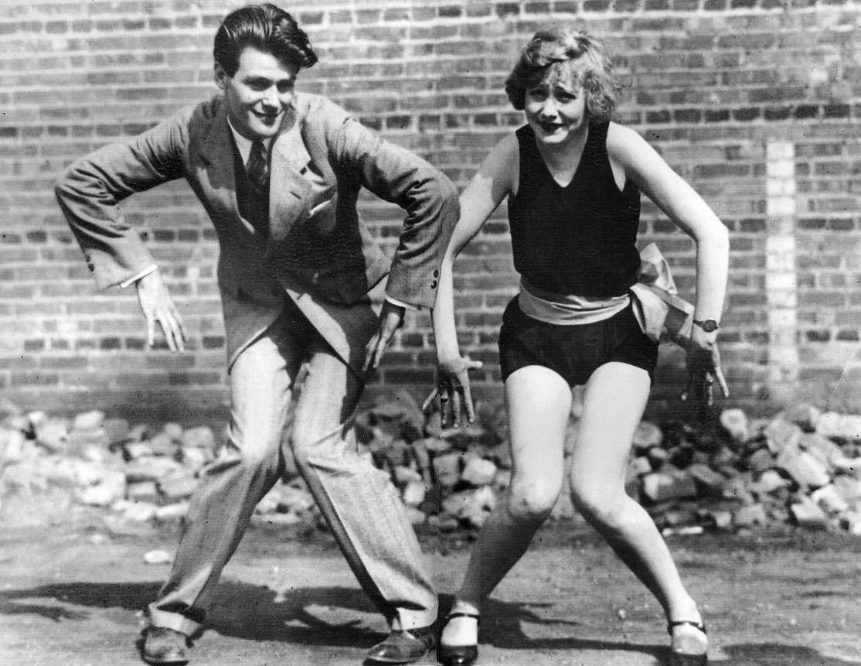
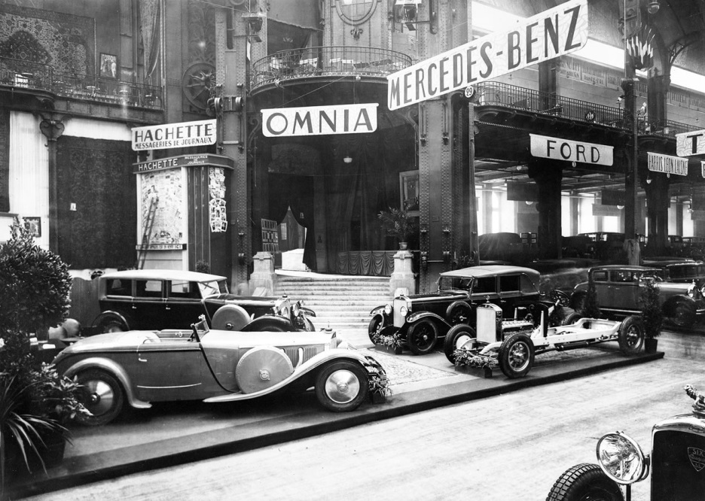
1920s Booming Economy
Wages up 40% after WWI
Stock Market was soaring
Many people investing – get rich quick schemes
1920s fad – get into the market

Slide 3
Economic Danger Signs
200 businesses control 50% of the economy?
Why is this dangerous?
Too much industry overproduction - surplus goods not being purchased
Too many products, not enough consumers buying
80% of population has no savings

Slide 4
More Economic Danger Signs
Banks are uninsured
No gov. agencies monitor banks or the Stock Market – Laissez Faire/Republican Presidents
Market value based on borrowed $ and over speculation instead of real value
Increase in personal debt – (Credit debt and installment plan debt)
Buying Stocks on Margin – borrowed money from Stock Broker to purchase Stocks

Slide 5
The Warning Sign
Farm prices drastically fall after WWI
Farmers paid by gov. to make food for allies, creates a huge surplus
Farmers unable to repay loans after gov. pulls WWI agricultural contracts
6,000 banks close out West
What are the consequences?
Pres. Hoover vetoes all bills to help farmers
Laissez-Faire

Slide 6
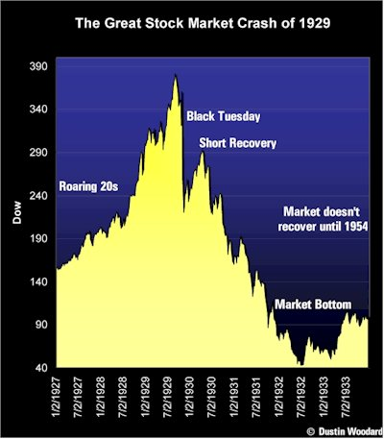
STOCK MARKET CRASH OF 1929

Slide 7
Black Thursday
Black Thursday
Oct. 24th, 1929
Stocks fall drastically
Brokers panic
GE falls from $400 a share to $283 a share
Brokers make margin calls – no one can pay
What’s a margin call?

Slide 8
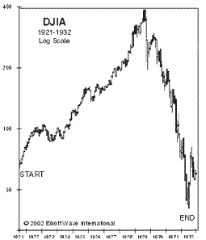
Black Tuesday
October 29th, 1929
Stocks plunge again
Value of market falls
People sell what’s left to get some $
By the end of Oct. – over $30 billion has been lost
Thousands lose everything

Slide 9
Immediate Effects of the Crash
Many lost life savings in the market crash
Banks and Brokers call in loans – American people have no $
Hundreds of banks close
No $ to pay back loans = empty savings accounts
Banks not prepared for people to withdrawal $ at the same time
No bank insurance
9 million savings accounts vanish

